Slide 1
Chapter 11 Object-Oriented Programming: Inheritance
C++ How to Program, 9/e

Slide 2
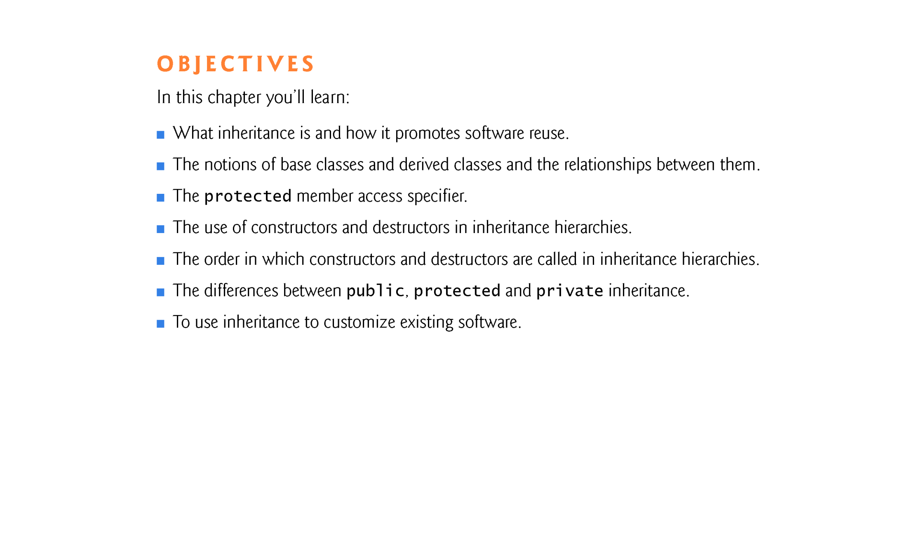

Slide 3
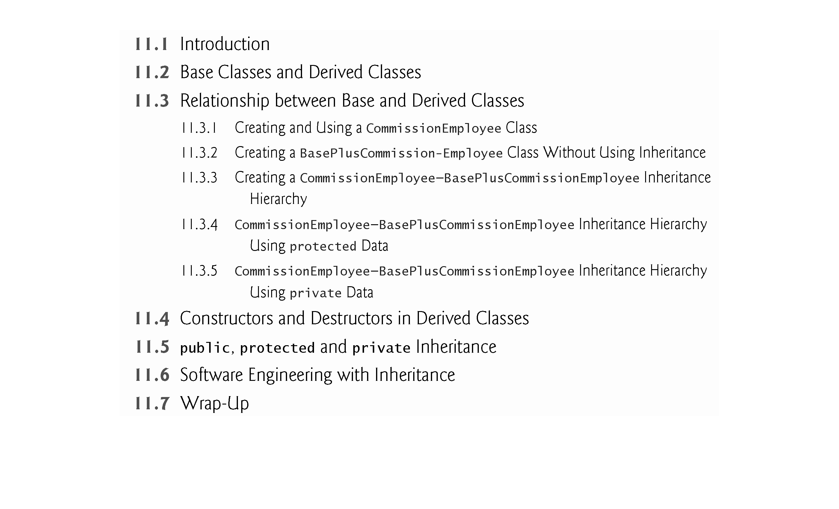

Slide 4
11.1 Introduction
Inheritance is a form of software reuse in which you create a class that absorbs an existing class’s data and behaviors and enhances them with new capabilities.
You can designate that the new class should inherit the members of an existing class.
This existing class is called the base class (aka super class), and the new class is referred to as the derived class (aka sub class).
A derived class represents a more specialized group of objects.
C++ offers public, protected and private inheritance.
With public inheritance, every object of a derived class is also an object of that derived class’s base class (“is-a” relationship).
However, base-class objects are not objects of their derived classes.

Slide 5
11.1 Introduction (cont.)
With object-oriented programming, you focus on the commonalities among objects in the system rather than on the special cases.
We distinguish between the is-a relationship and the has-a relationship.
The is-a relationship represents inheritance.
In an is-a relationship, an object of a derived class also can be treated as an object of its base class.
By contrast, the has-a relationship represents composition.

Slide 6
11.2 Base Classes and Derived Classes
Figure 11.1 lists several simple examples of base classes and derived classes.
Base classes tend to be more general and derived classes tend to be more specific.
Because every derived-class object is an object of its base class, and one base class can have many derived classes, the set of objects represented by a base class typically is larger than the set of objects represented by any of its derived classes.
Inheritance relationships form class hierarchies.

Slide 7
11.2 Base Classes and Derived Classes (cont.)
A base class exists in a hierarchical relationship with its derived classes.
Although classes can exist independently, once they’re employed in inheritance relationships, they become affiliated with other classes.
A class becomes either a base class - supplying members to other classes, a derived class - inheriting its members from other classes, or both.
For Java the terms super class and sub class are usually used.

Slide 8
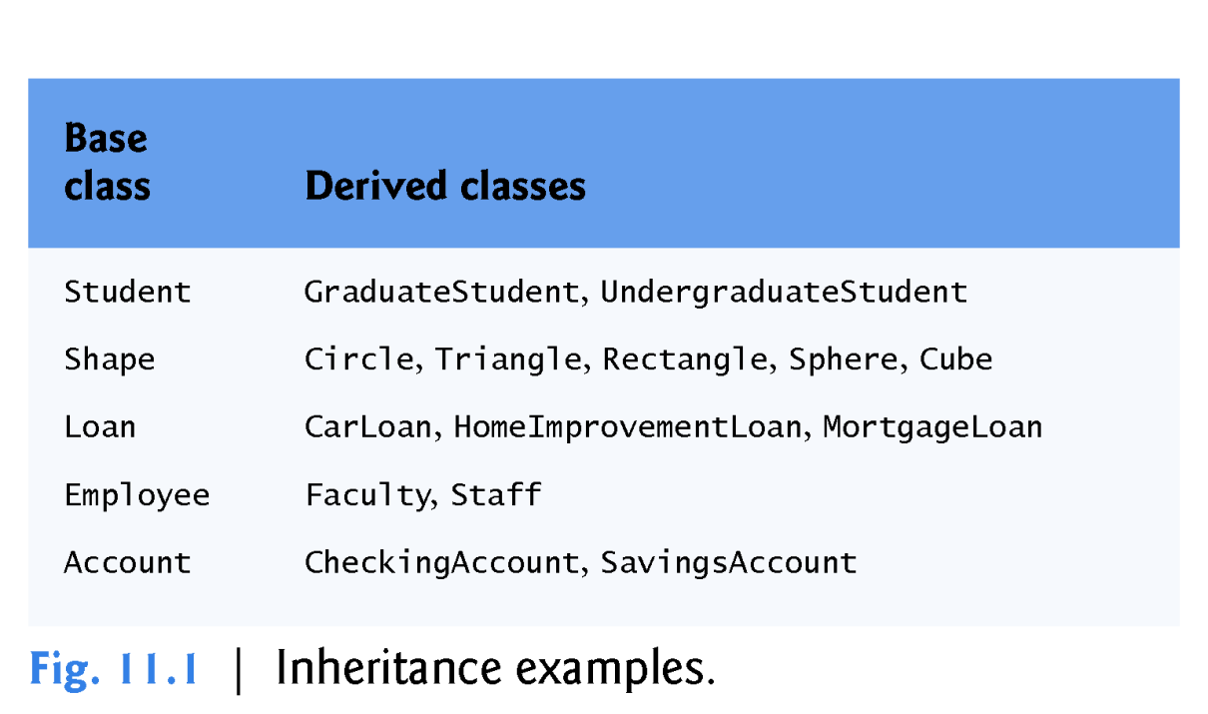

Slide 9
11.2 Base Classes and Derived Classes (cont.)
CommunityMember Class Hierarchy
Let’s develop a simple inheritance hierarchy with five levels (represented by the UML class diagram in Fig. 11.2).
A university community has thousands of CommunityMembers.
Employees are either Faculty or Staff.
Faculty are either Administrators or Teachers.
Some Administrators, however, are also Teachers.
We’ve used multiple inheritance to form class AdministratorTeacher.

Slide 10
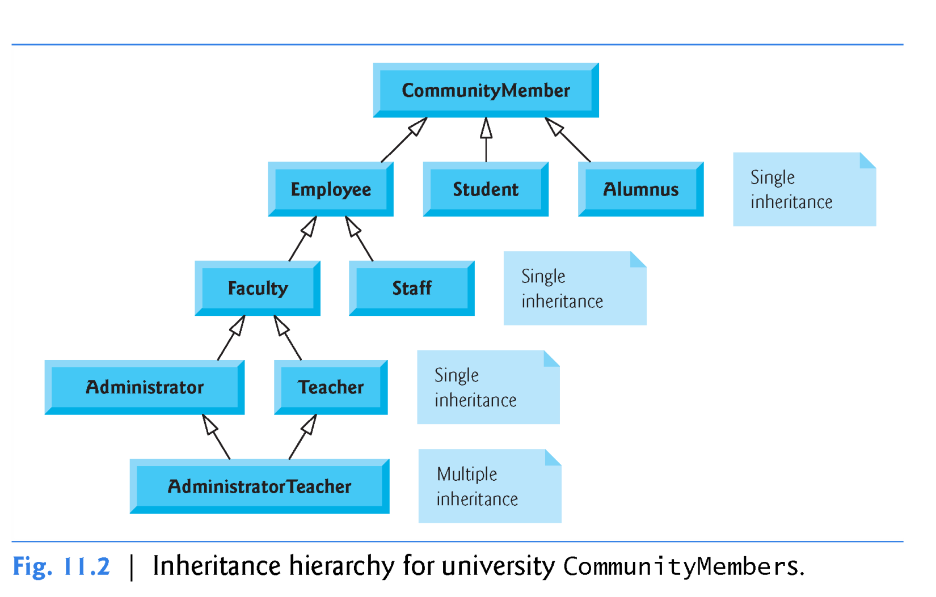

Slide 11
11.2 Base Classes and Derived Classes (cont.)
With single inheritance, a class is derived from one base class.
With multiple inheritance, a derived class inherits simultaneously from two or more (possibly unrelated) base classes.
We discuss multiple inheritance in Chapter 23, Other Topics.

Slide 12
11.2 Base Classes and Derived Classes (cont.)
Each arrow in the hierarchy (Fig. 11.2) represents an is-a relationship.
As we follow the arrows in this class hierarchy, we can state “an Employee is a CommunityMember” and “a Teacher is a Faculty member.”
CommunityMember is the direct base class of Employee, Student and Alumnus.
CommunityMember is an indirect base class of all the other classes in the diagram.
Starting from the bottom of the diagram, you can follow the arrows and apply the is-a relationship to the topmost base class.
An AdministratorTeacher is an Administrator, is a Faculty member, is an Employee and is a CommunityMember.

Slide 13
11.2 Base Classes and Derived Classes (cont.)
Shape Class Hierarchy
Consider the Shape inheritance hierarchy in Fig. 11.3.
Begins with base class Shape.
Classes TwoDimensionalShape and ThreeDimensionalShape derive from base class Shape—Shapes are either TwoDimensionalShapes or Three-DimensionalShapes.
The third level of this hierarchy contains some more specific types of TwoDimensionalShapes and ThreeDimensionalShapes.
As in Fig. 11.2, we can follow the arrows from the bottom of the diagram to the topmost base class in this class hierarchy to identify several is-a relationships.

Slide 14
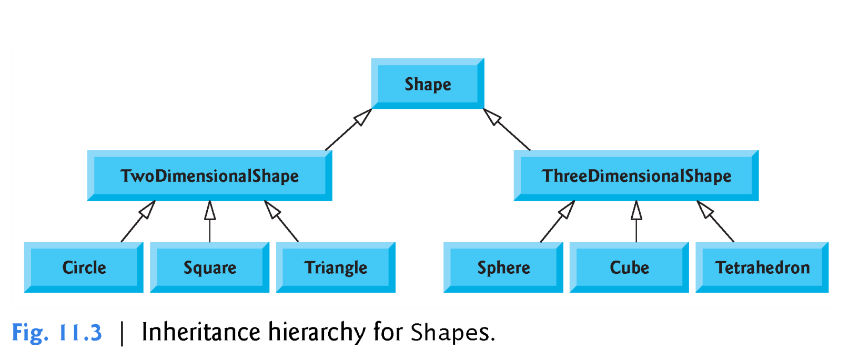

Slide 15
11.3 Relationship between Base and Derived Classes
In this section, we use an inheritance hierarchy containing types of employees in a company’s payroll application to discuss the relationship between a base class and a derived class.
Commission employees (who will be represented as objects of a base class) are paid a percentage of their sales, while base-salaried commission employees (who will be represented as objects of a derived class) receive a base salary plus a percentage of their sales.

Slide 16
11.3.1 Creating and Using a CommissionEmployee Class
CommissionEmployee’s class definition (Figs. 11.4–11.5).
CommissionEmployee’s public services include a constructor and member functions earnings and print.
Also includes public get and set functions that manipulate the class’s data members firstName, lastName, socialSecurityNumber, grossSales and commissionRate.
These data members are private, so objects of other classes cannot directly access this data.
Declaring data members as private and providing non-private get and set functions to manipulate and validate the data members helps enforce good software engineering.

Slide 17
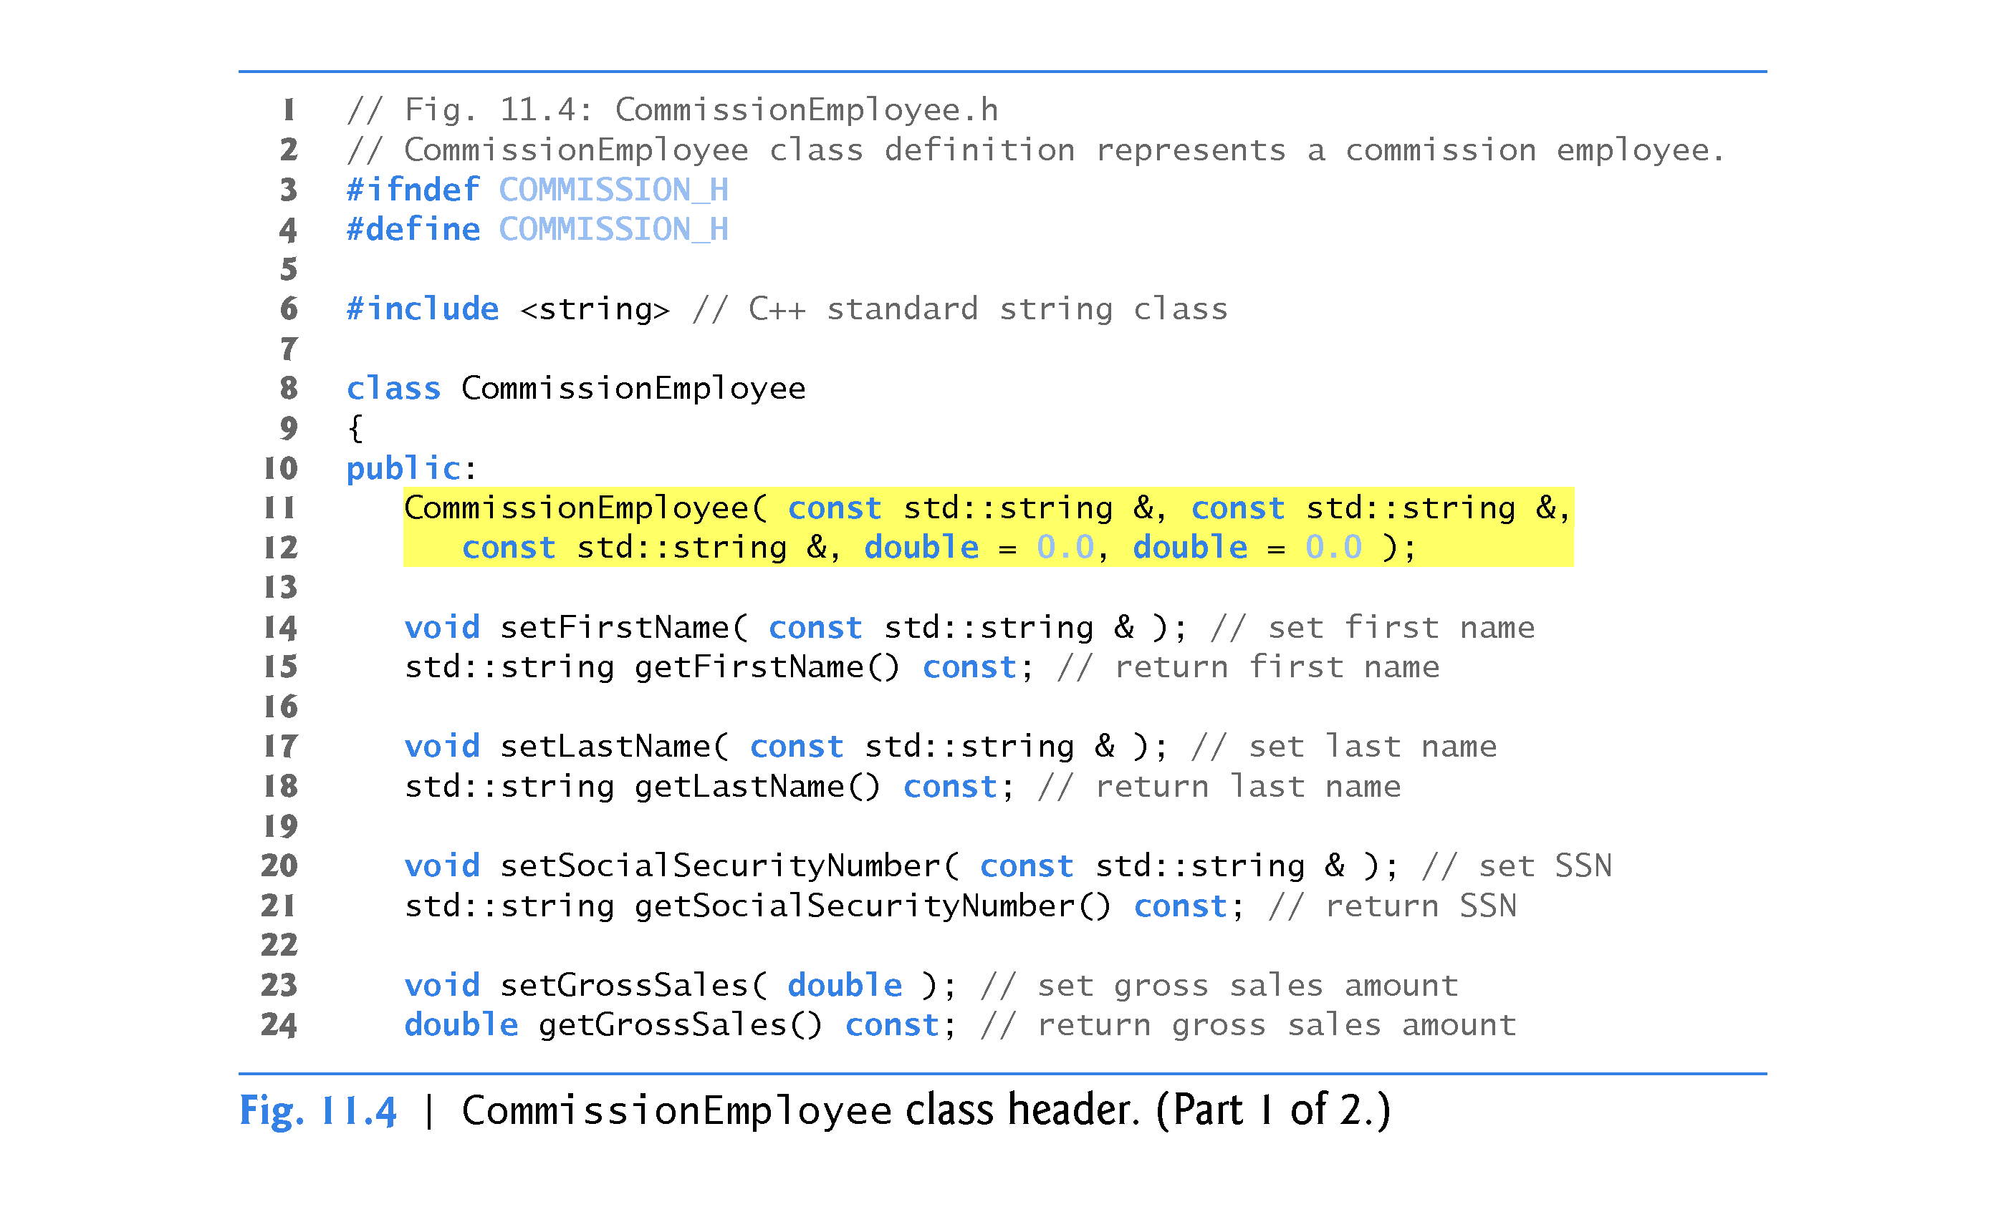

Slide 18
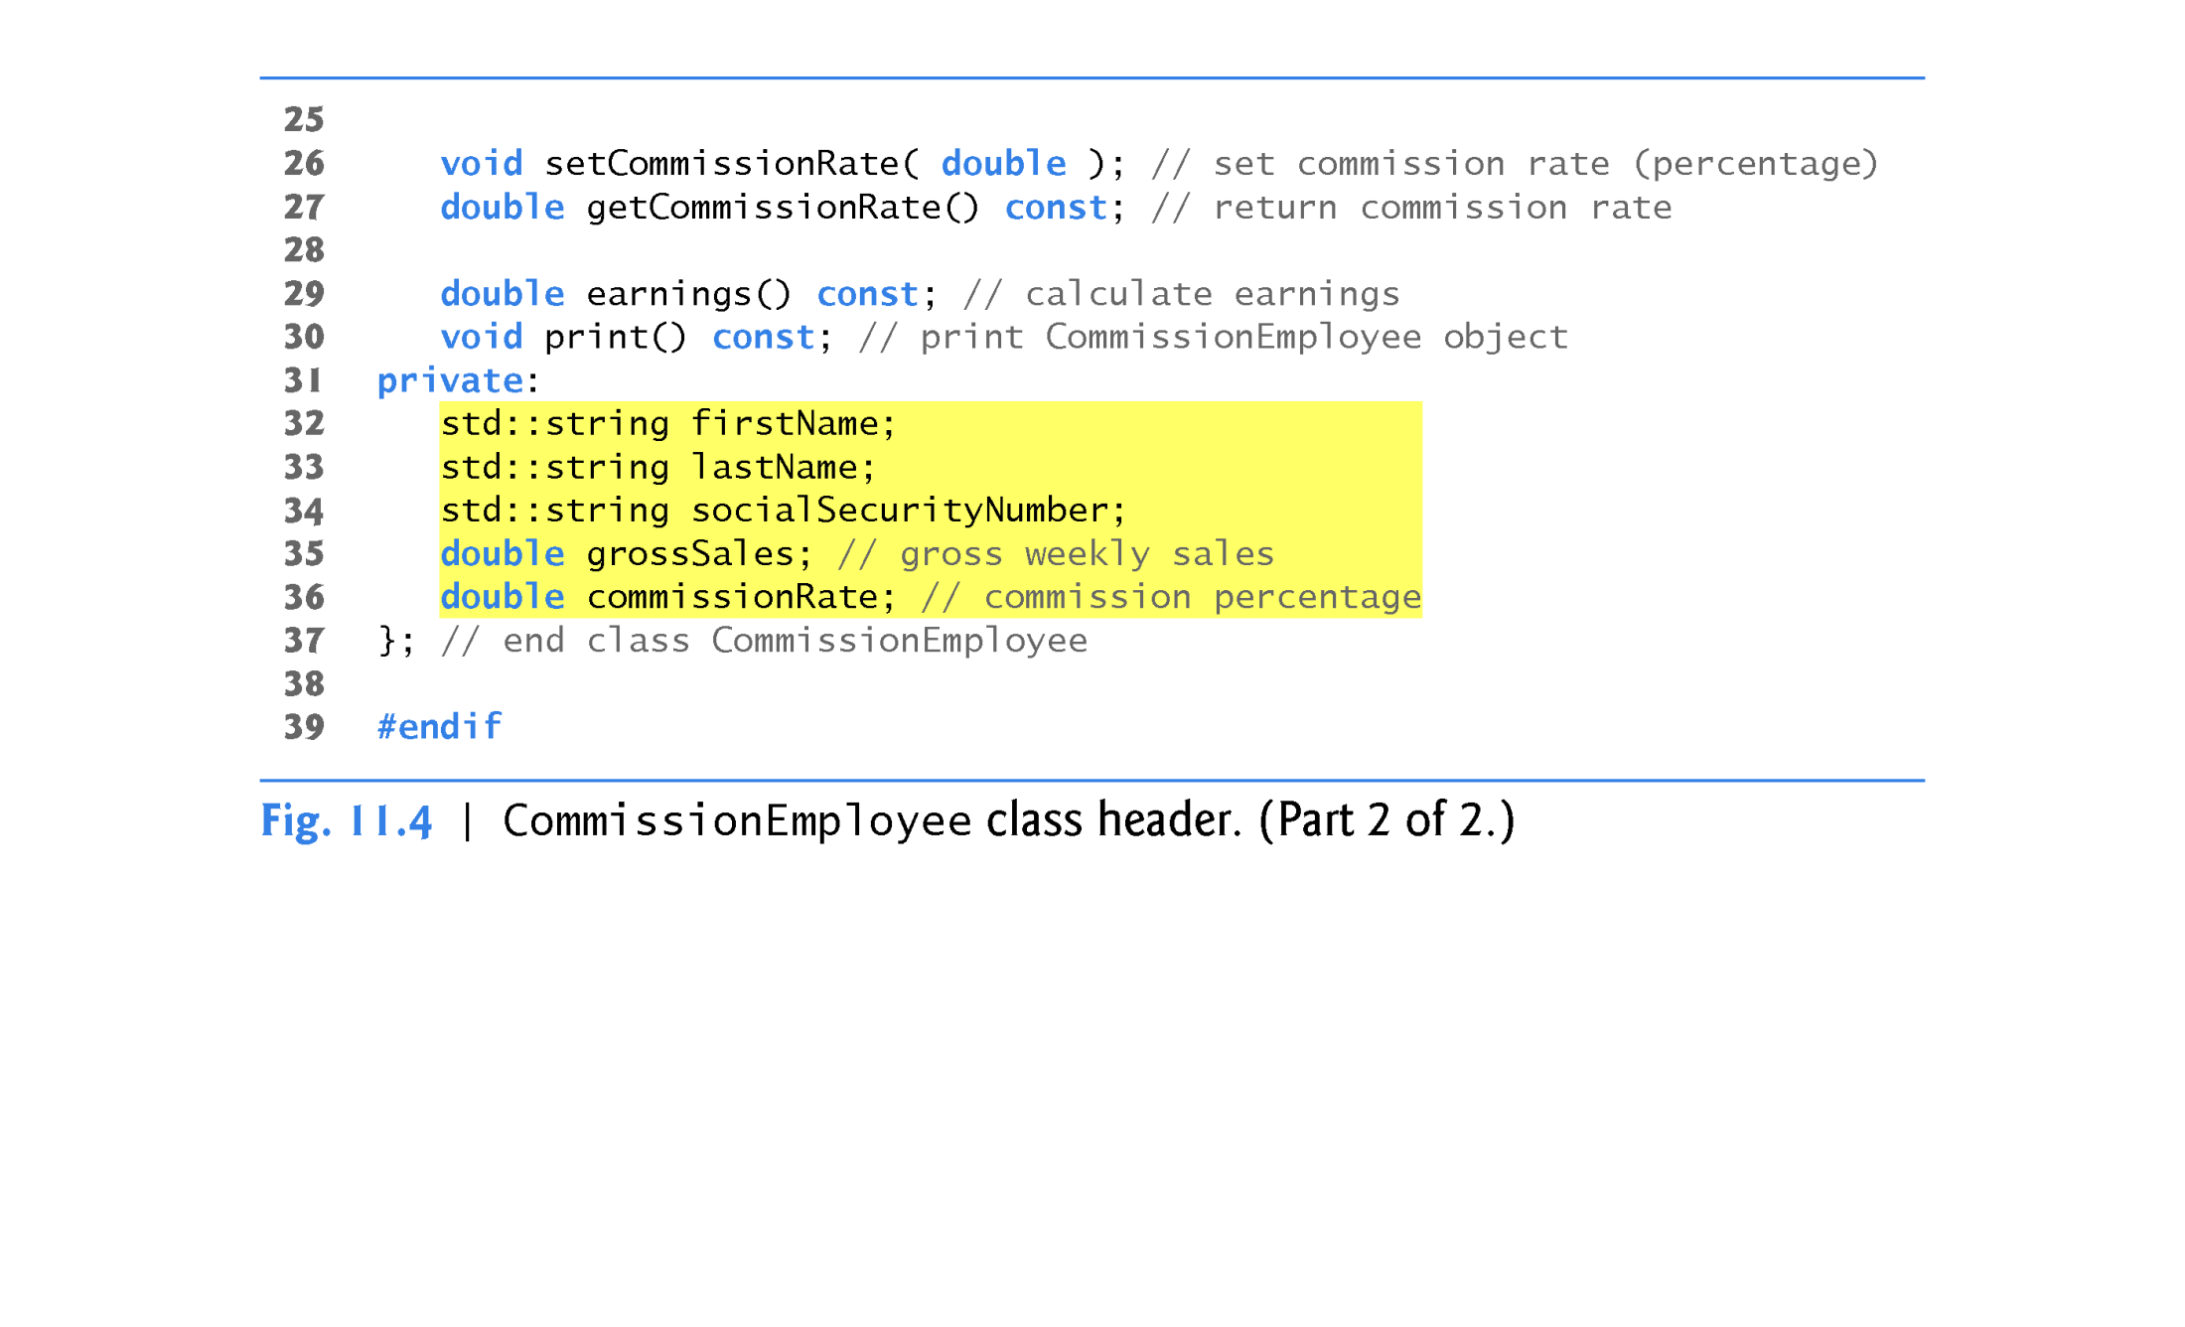

Slide 19
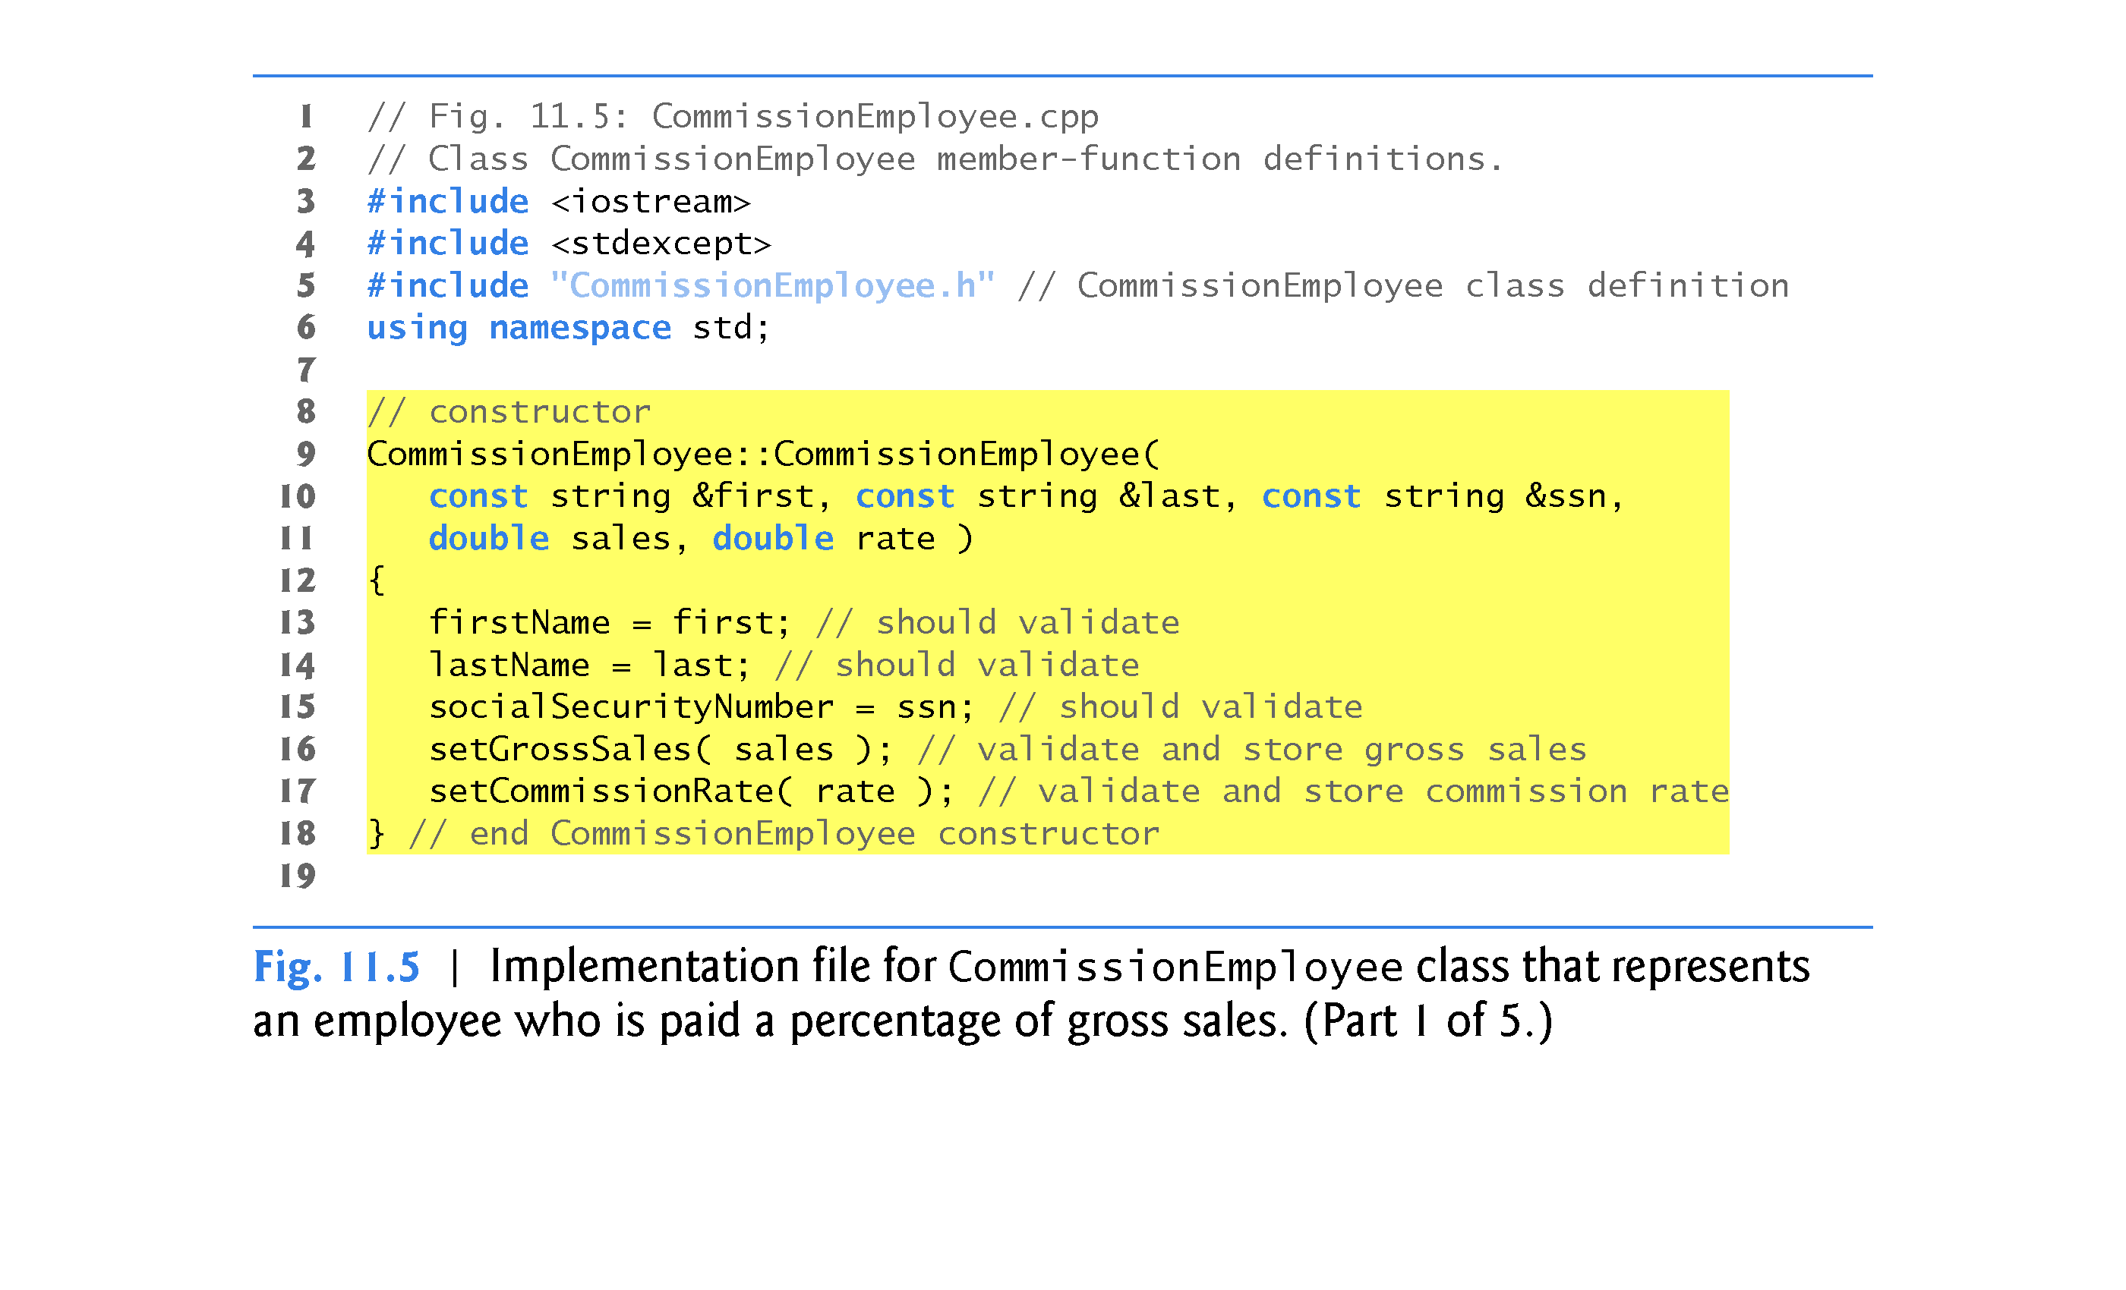

Slide 20
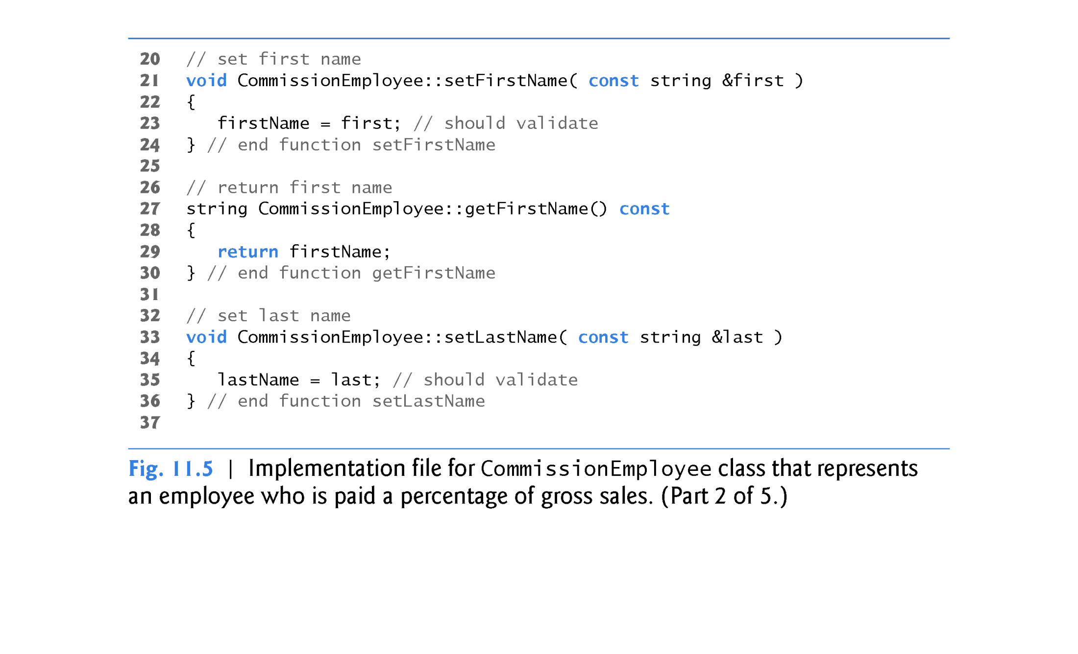

Slide 21
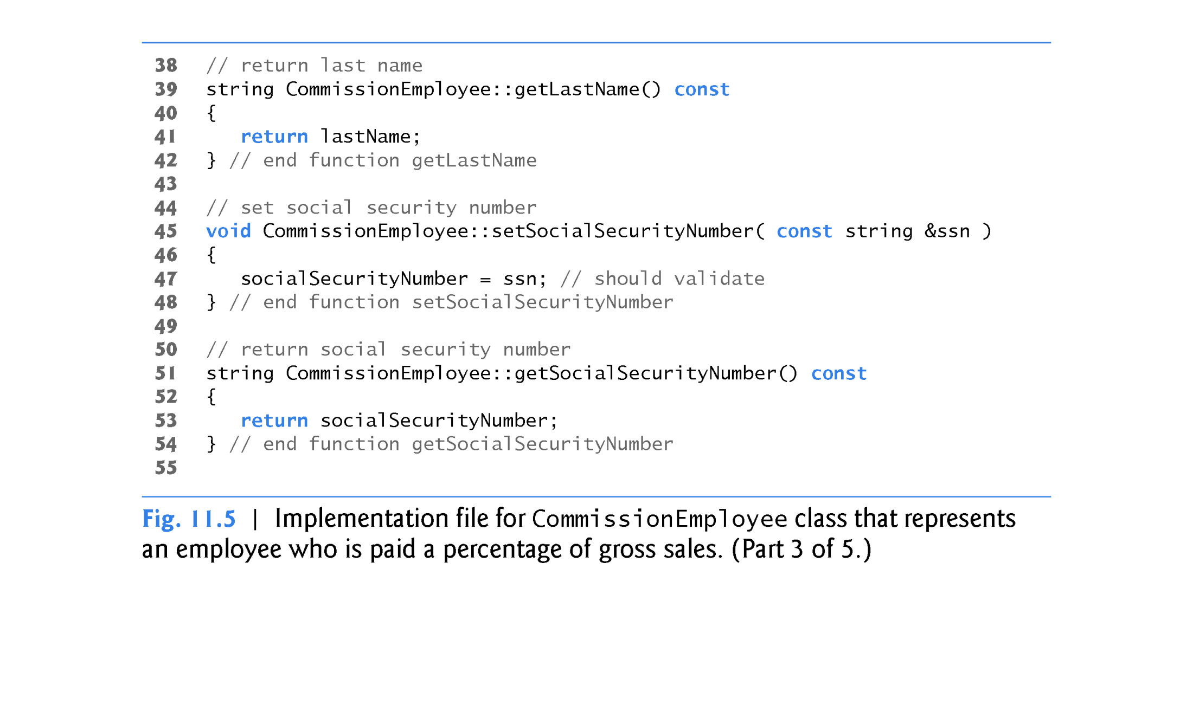

Slide 22
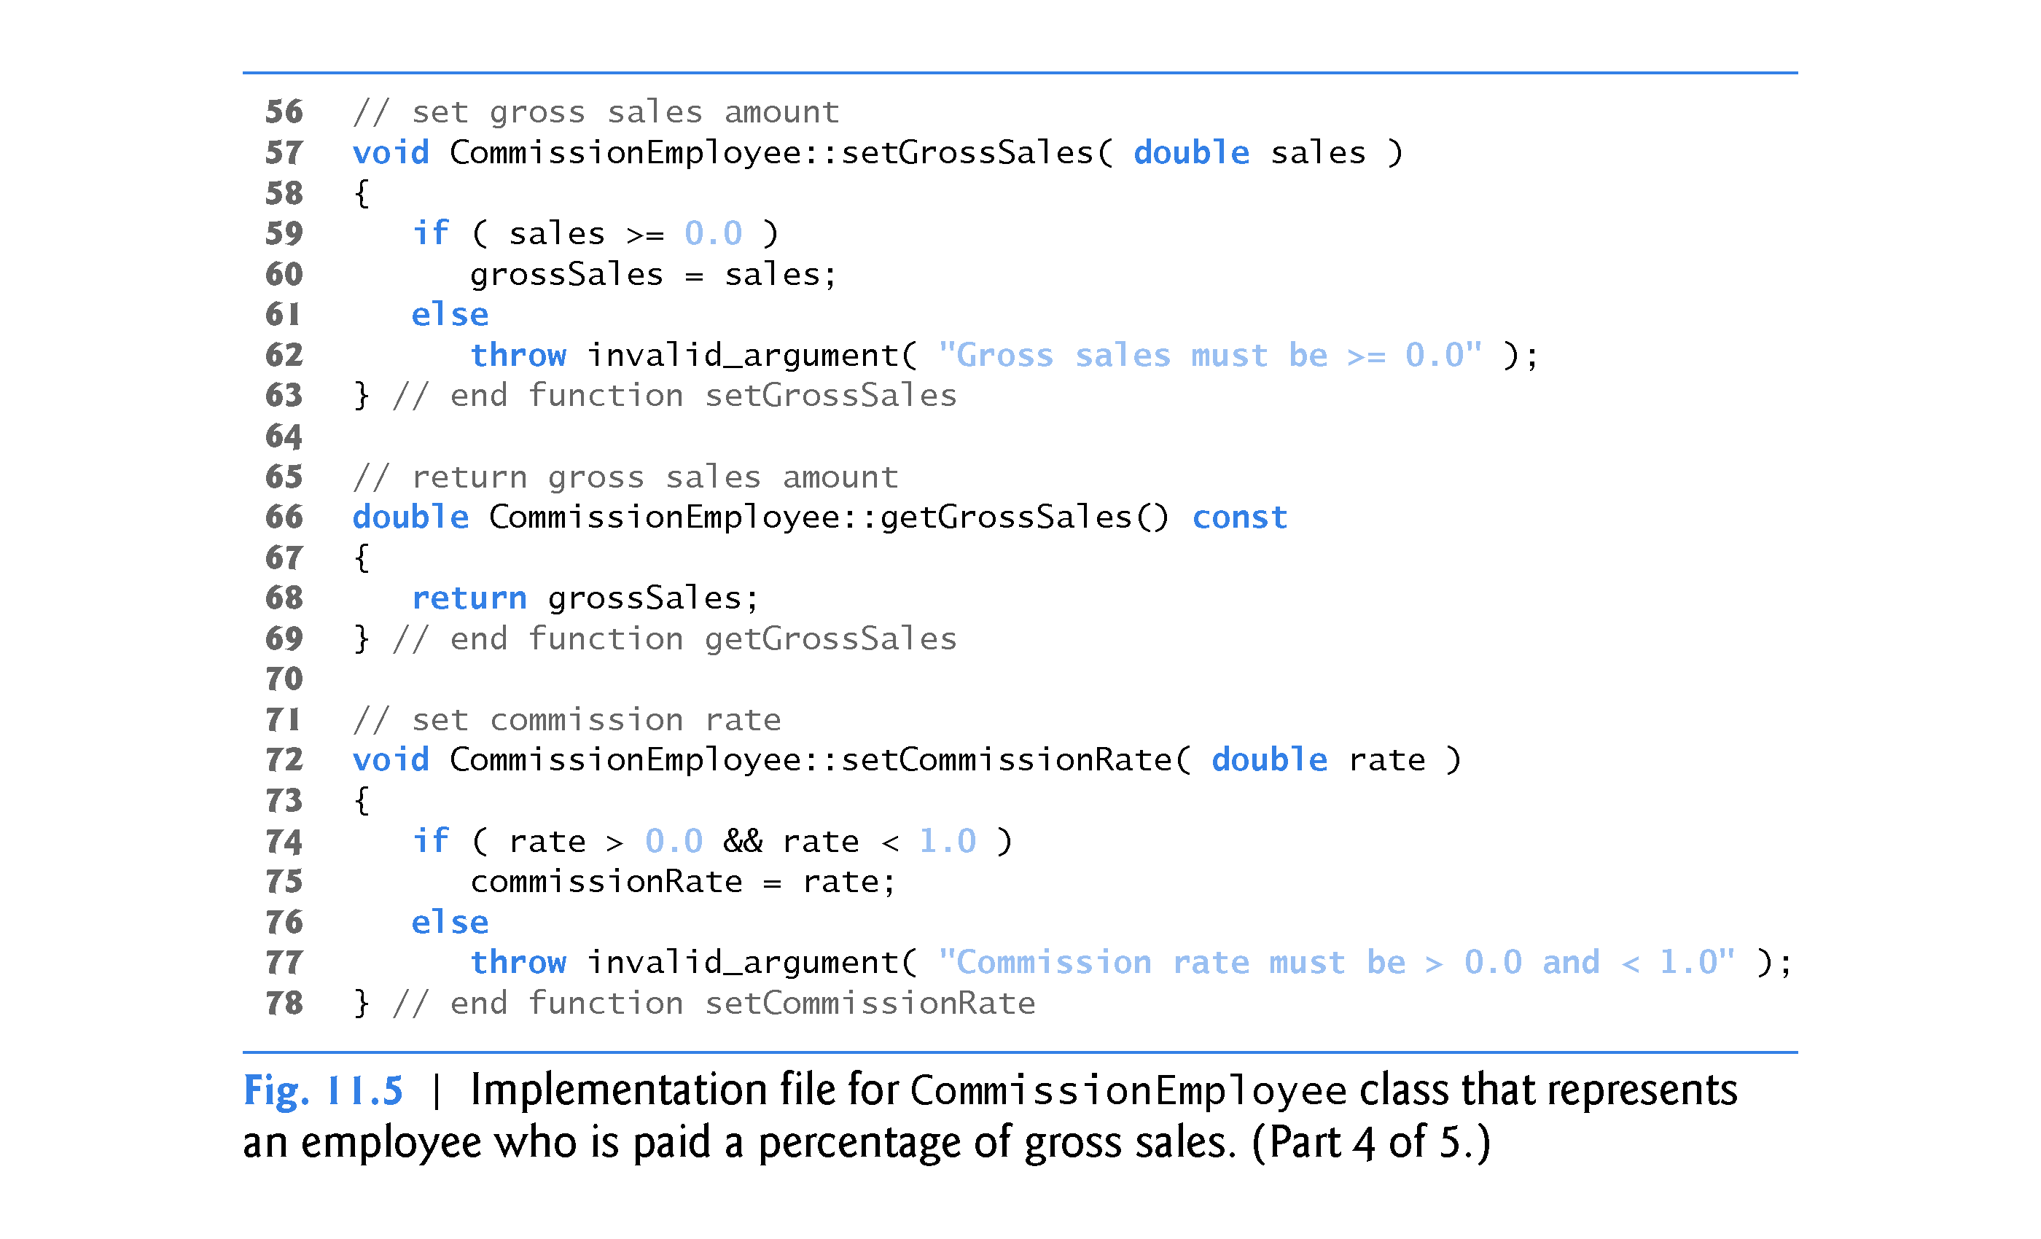

Slide 23
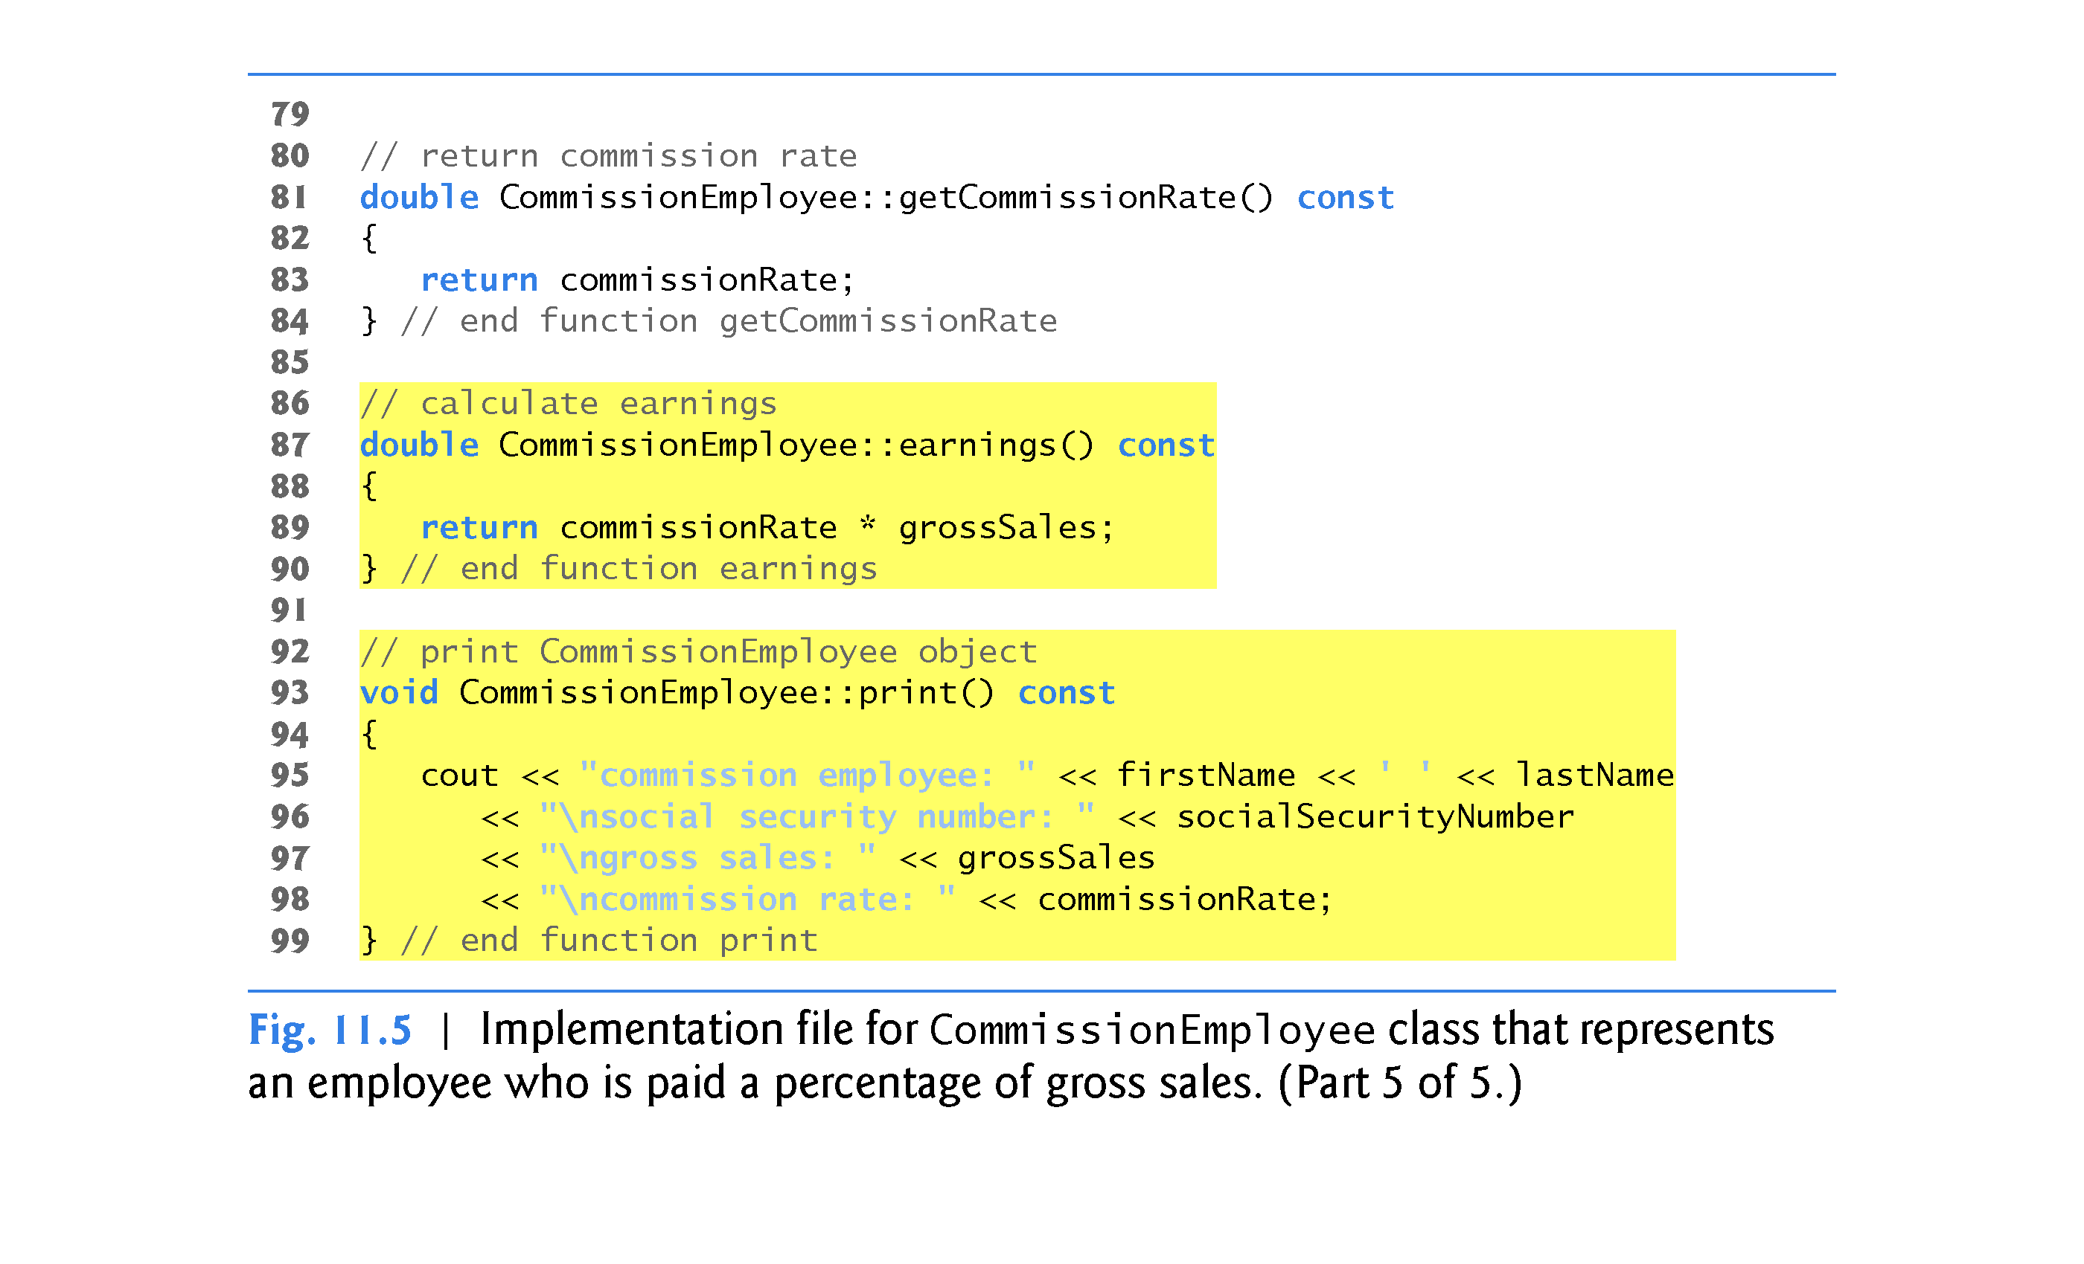

Slide 24
11.3.1 Creating and Using a CommissionEmployee Class
CommissionEmployee Constructor
The CommissionEmployee constructor definition purposely does not use member-initializer syntax in the first several examples of this section, so that we can demonstrate how private and protected specifiers affect member access in derived classes.
Later in this section, we’ll return to using member-initializer lists in the constructors.

Slide 25
11.3.1 Creating and Using a CommissionEmployee Class
CommissionEmployee Member Functions earnings and print
Member function earnings calculates a CommissionEmployee’s earnings.
Member function print displays the values of a CommissionEmployee object’s data members.
Testing Class CommissionEmployee
Figure 11.6 tests class CommissionEmployee.

Slide 26
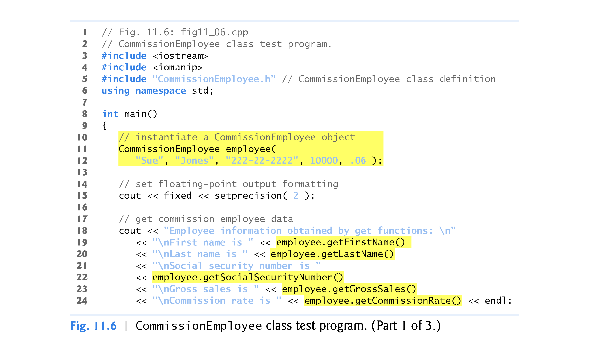

Slide 27
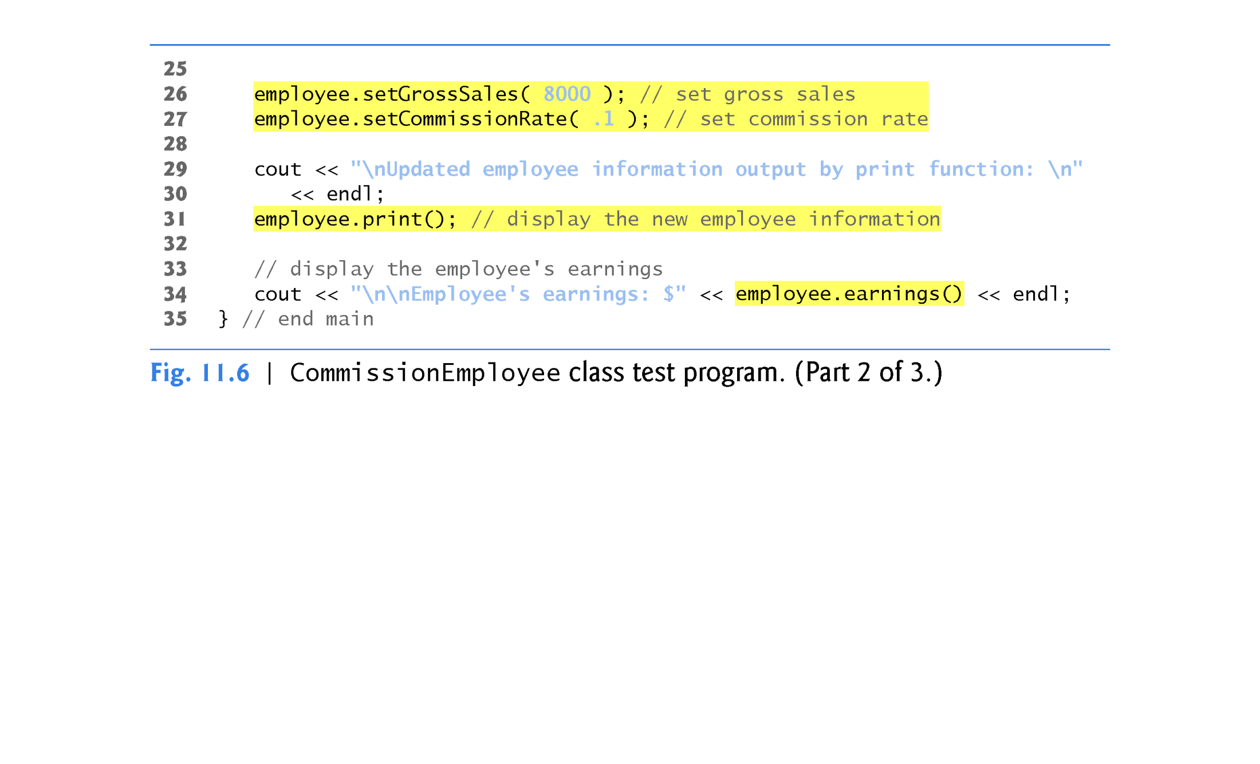

Slide 28
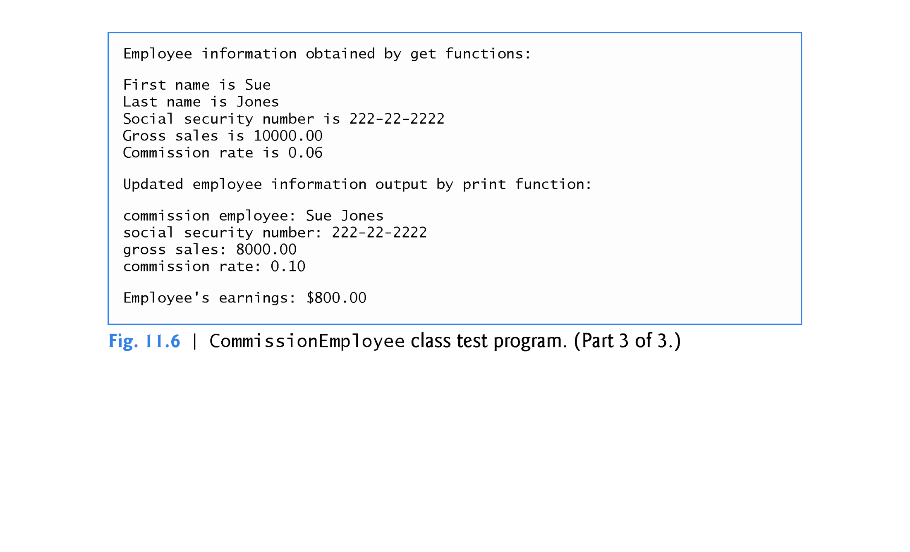

Slide 29
11.3.2 Creating a BasePlusCommissionEmployee Class Without Using Inheritance
We now discuss the second part of our introduction to inheritance.
We do this by creating and testing (a completely new and independent) class BasePlusCommissionEmployee (Figs. 11.7–11.8), which contains a first name, last name, social security number, gross sales amount, commission rate and base salary.

Slide 30
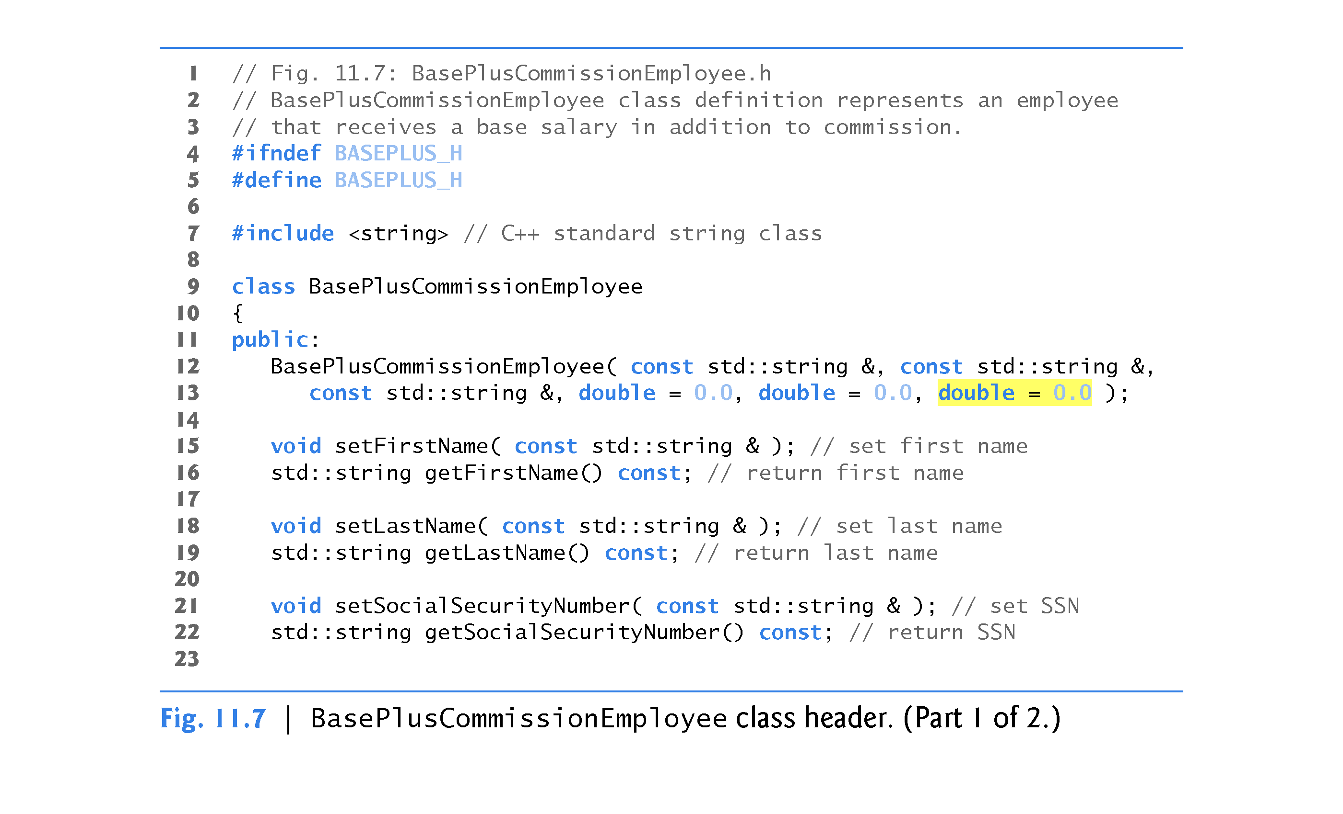

Slide 31
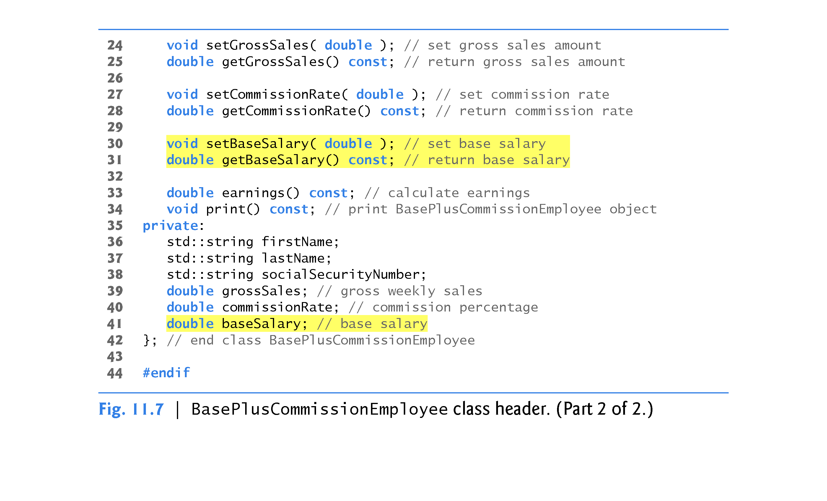

Slide 32
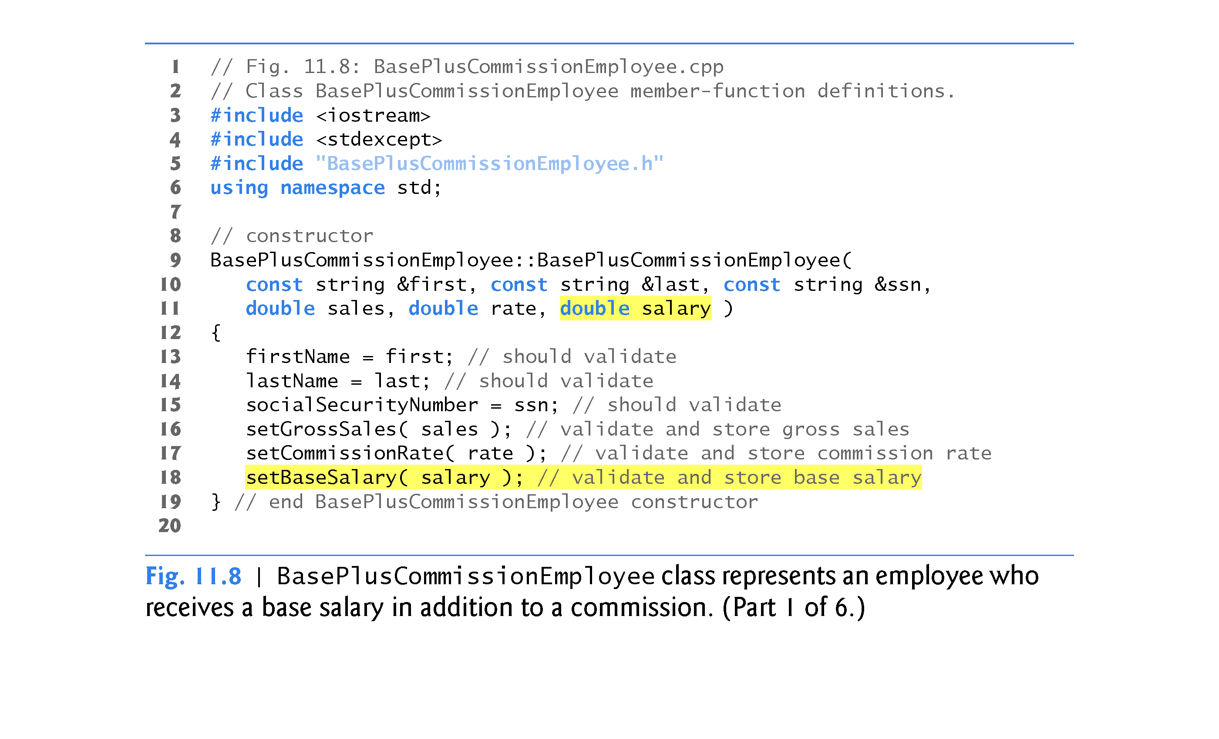

Slide 33
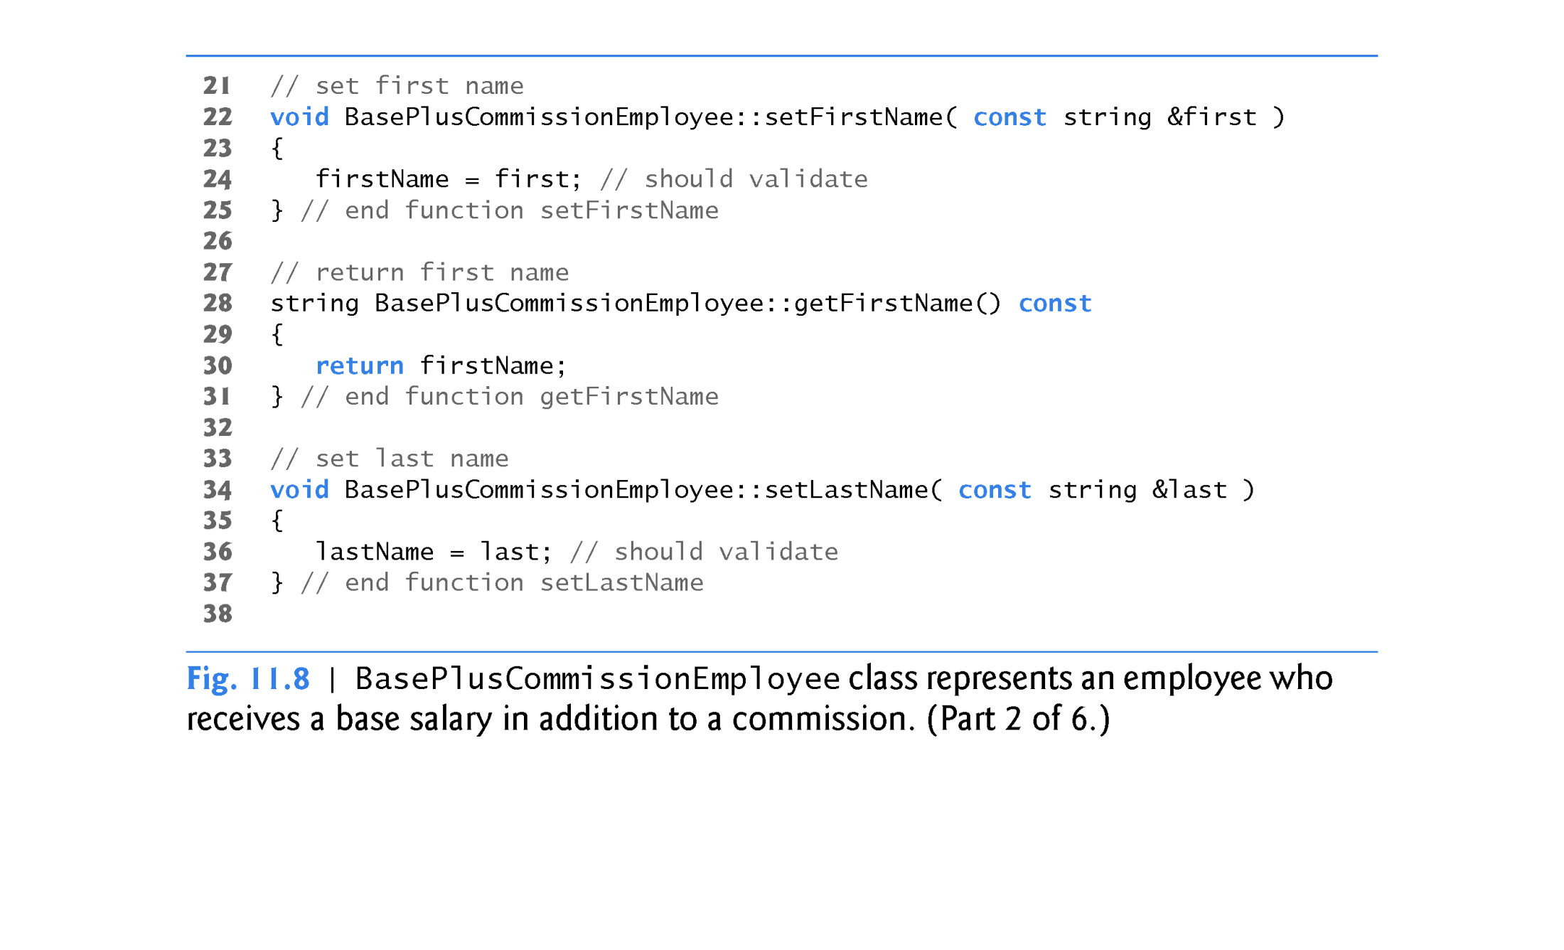

Slide 34
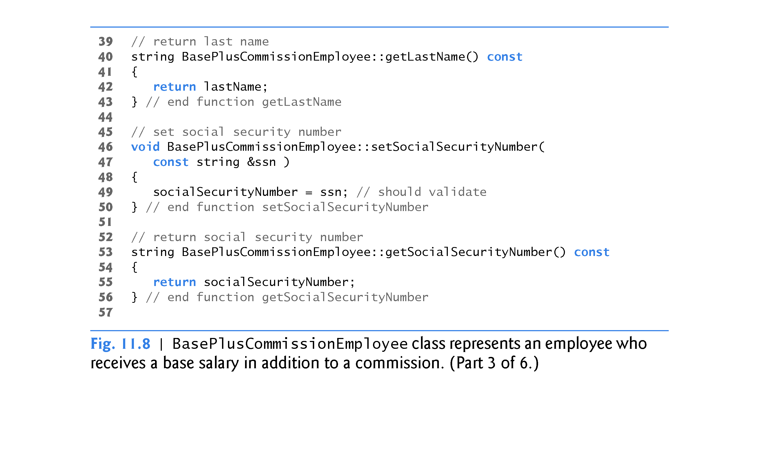

Slide 35
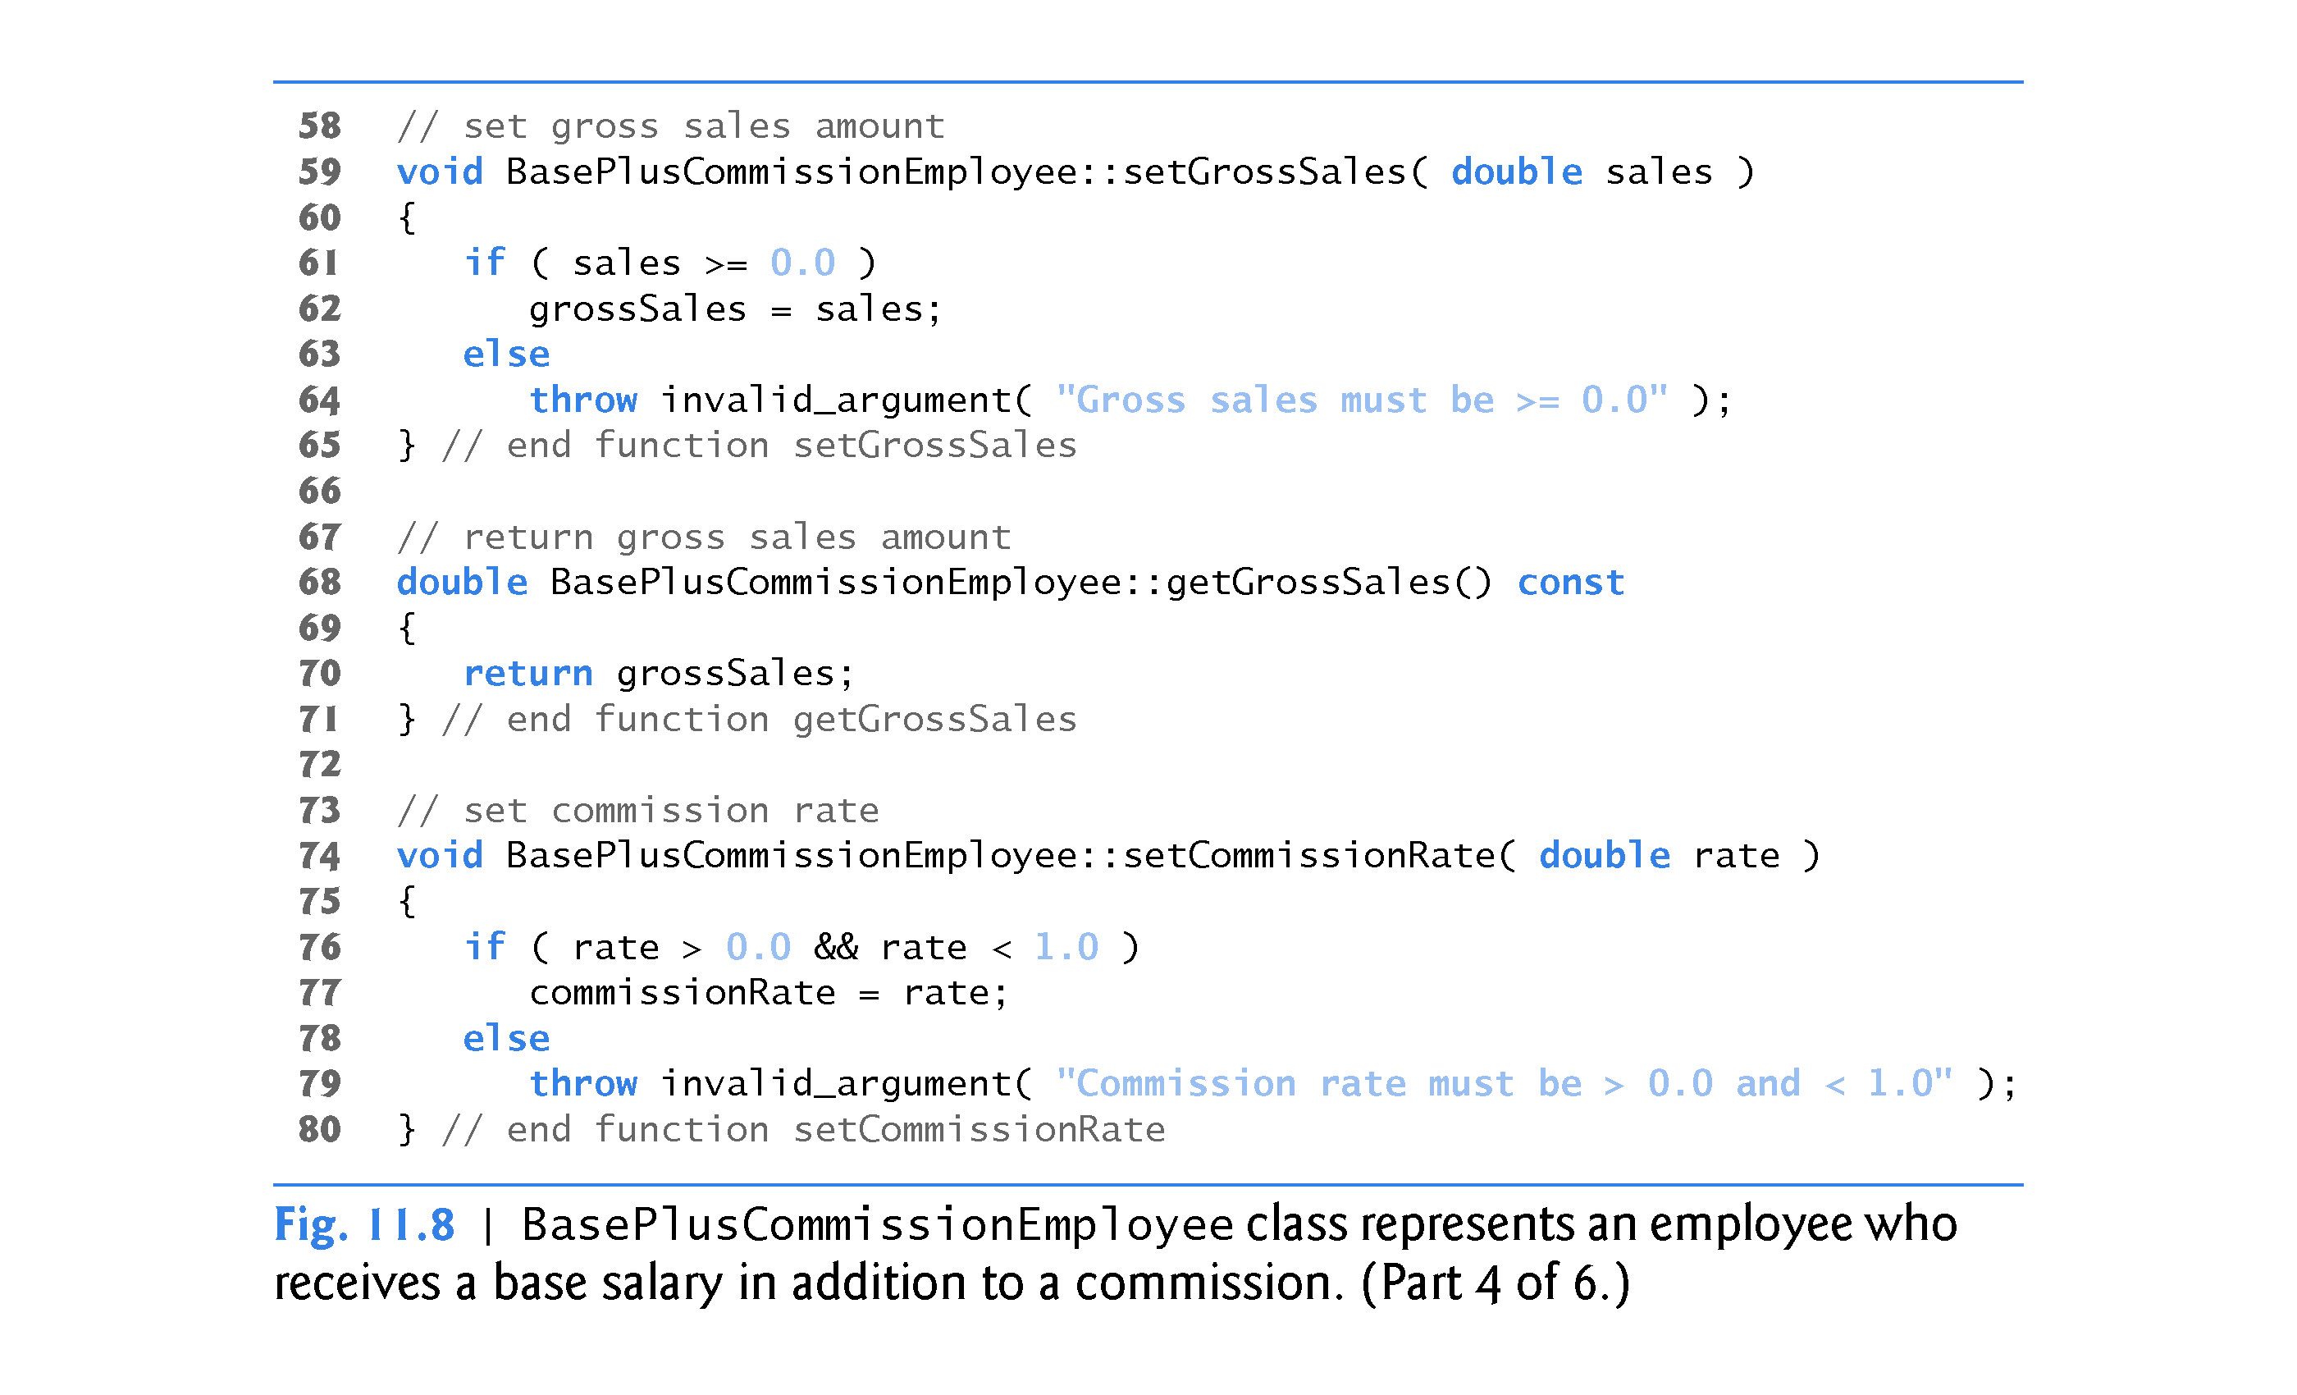

Slide 36
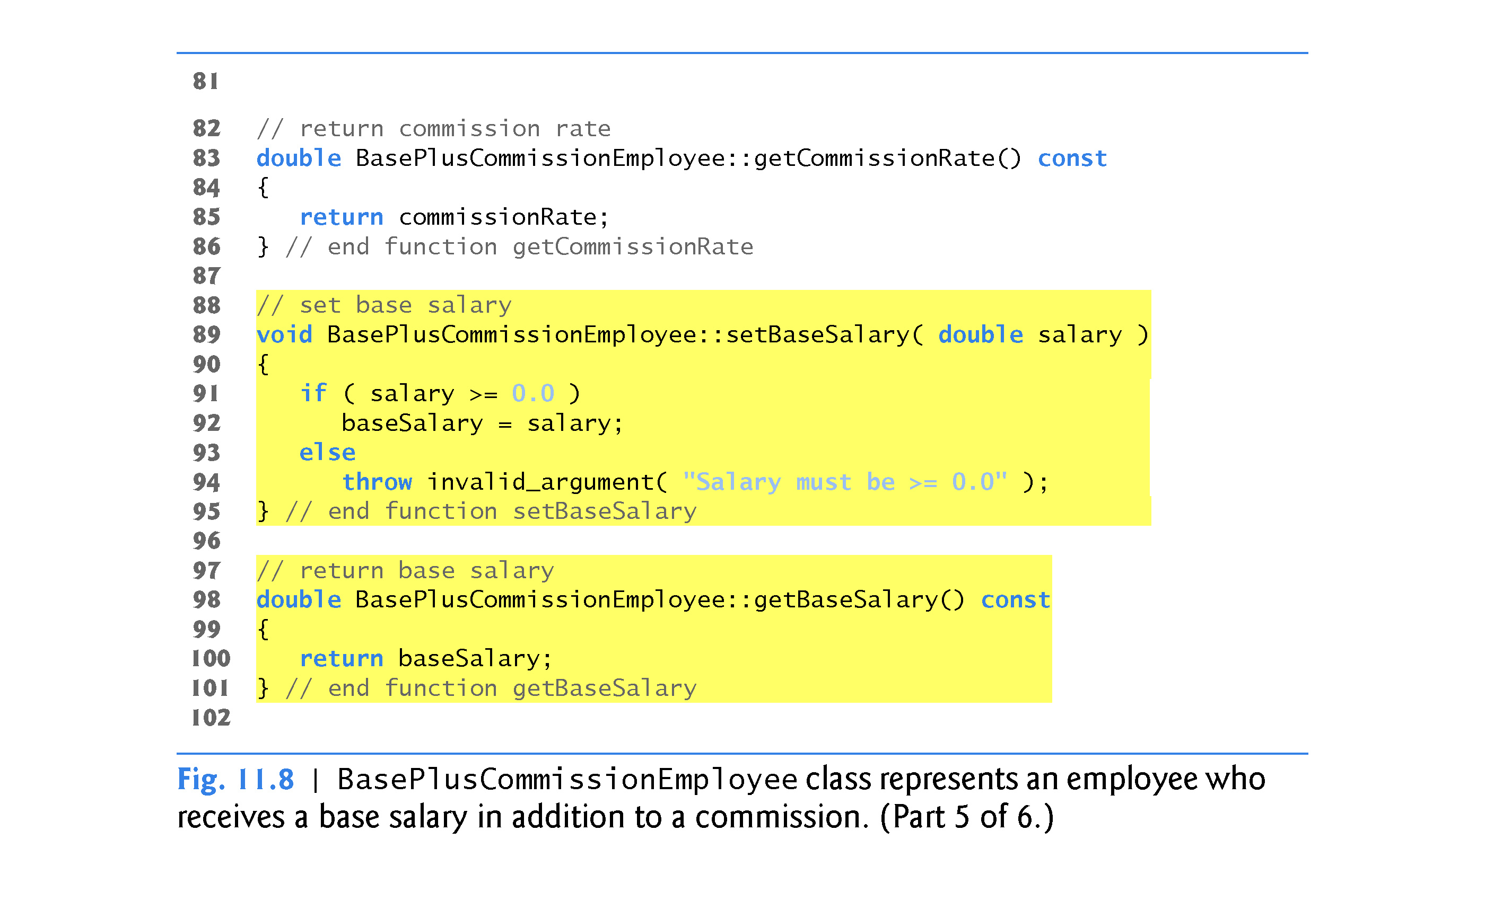

Slide 37
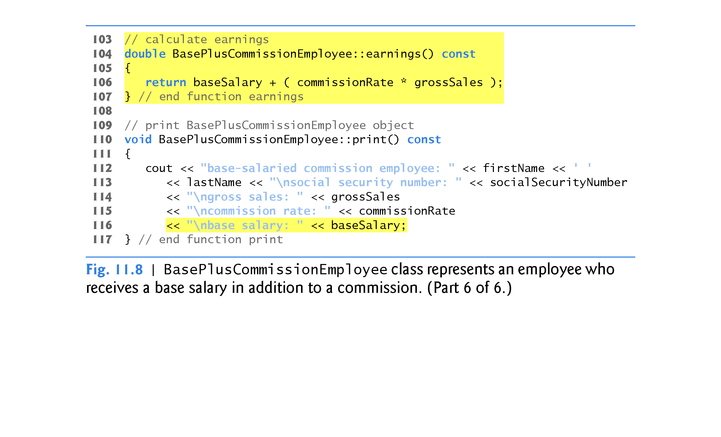

Slide 38
11.3.2 Creating a BasePlusCommissionEmployee Class Without Using Inheritance
Defining Class BasePlusCommissionEmployee
The BasePlusCommissionEmployee header (Fig. 11.7) specifies class BasePlusCommissionEmployee’s public services, which include the BasePlusCommissionEmployee constructor and member functions earnings and print.
Lines 15–31 declare public get and set functions for the class’s private data members firstName, lastName, socialSecurityNumber, grossSales, commissionRate and baseSalary.

Slide 39
11.3.2 Creating a BasePlusCommissionEmployee Class Without Using Inheritance
Note the similarity between this class and class Commission-Employee (Figs. 11.4–11.5)—in this example, we won’t yet exploit that similarity.
Class BasePlusCommissionEmployee’s earnings member function computes the earnings of a base-salaried commission employee.
Testing Class BasePlusCommissionEmployee
Figure 11.9 tests class BasePlusCommissionEmployee.

Slide 40
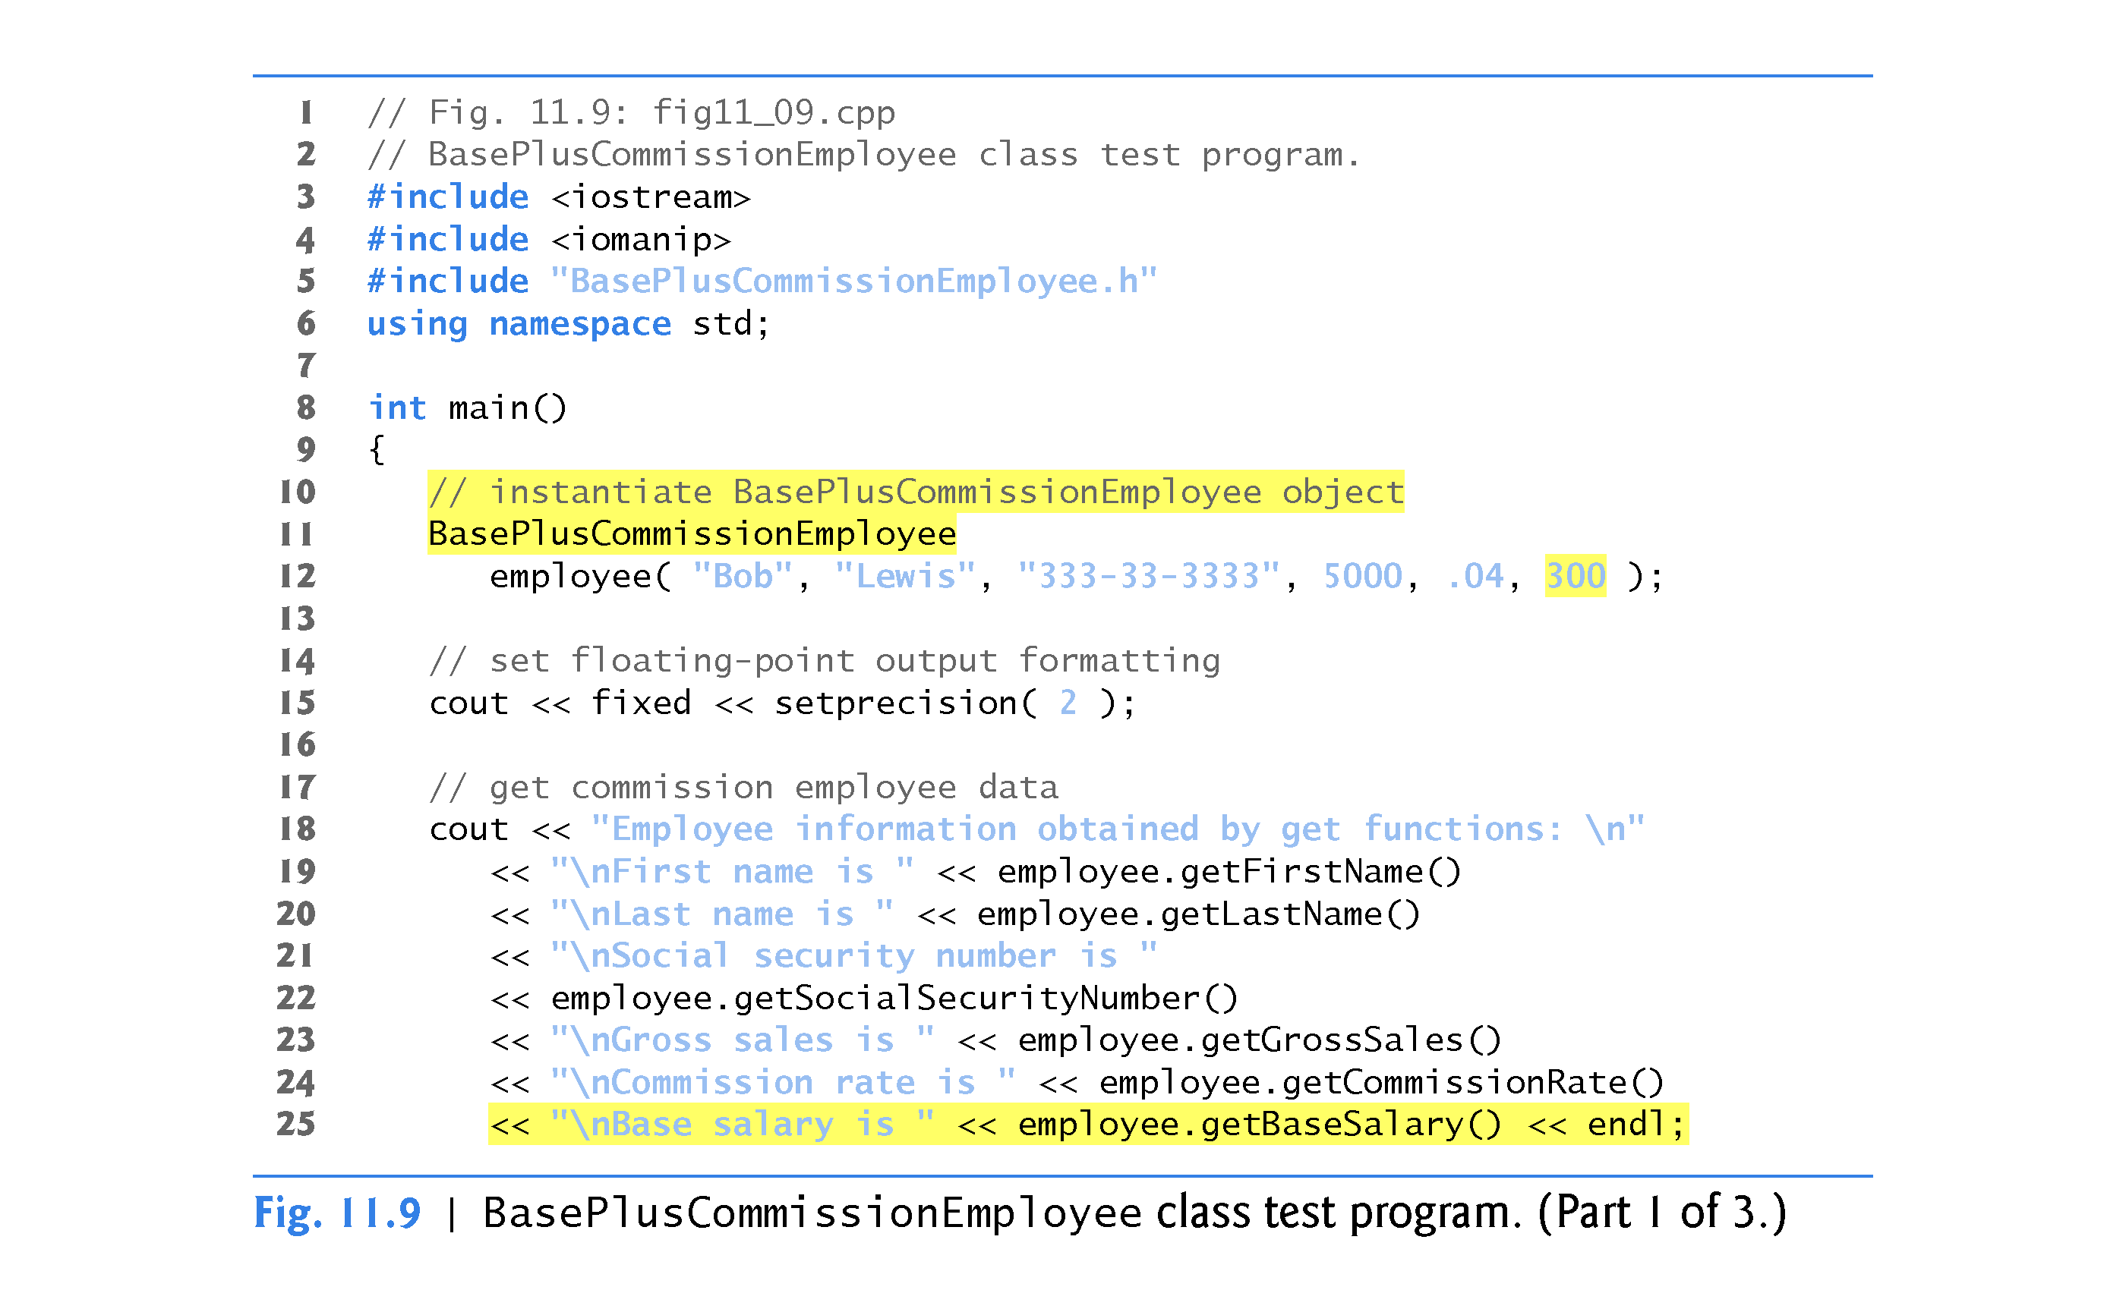

Slide 41
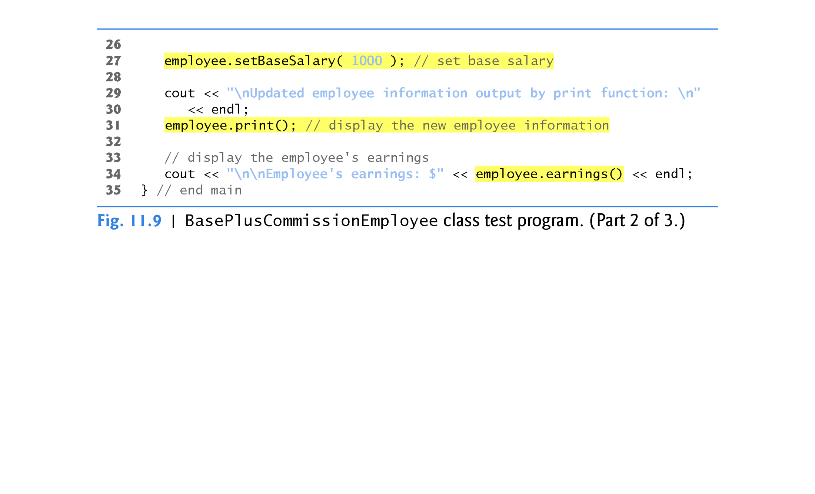

Slide 42
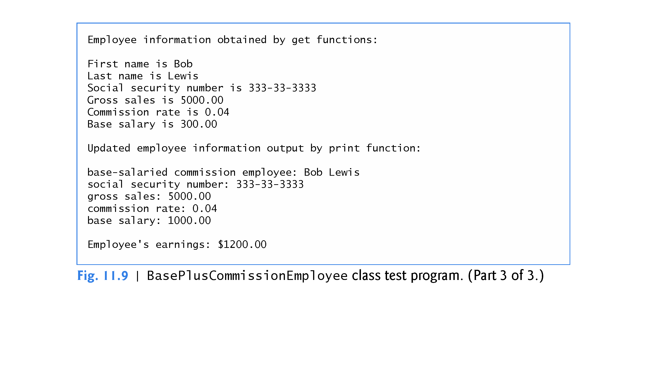

Slide 43
11.3.2 Creating a BasePlusCommissionEmployee Class Without Using Inheritance
Exploring the Similarities Between Class BasePlusCommissionEmployee and Class CommissionEmployee
Most of the code for class BasePlusCommissionEmployee (Figs. 11.7–11.8) is similar, if not identical, to the code for class CommissionEmployee (Figs. 11.4–11.5).
In class BasePlusCommissionEmployee, private data members firstName and lastName and member functions setFirstName, getFirstName, setLastName and getLastName are identical to those of class CommissionEmployee.
Both classes contain private data members socialSecurityNumber, commissionRate and grossSales, as well as get and set functions to manipulate these members.

Slide 44
11.3.2 Creating a BasePlusCommissionEmployee Class Without Using Inheritance
The BasePlusCommissionEmployee constructor is almost identical to that of class CommissionEmployee, except that BasePlusCommissionEmployee’s constructor also sets the baseSalary.
The other additions to class BasePlusCommissionEmployee are private data member baseSalary and member functions setBaseSalary and getBaseSalary.
Class BasePlusCommissionEmployee’s print member function is nearly identical to that of class CommissionEmployee, except that BasePlusCommissionEmployee’s print also outputs the value of data member baseSalary.

Slide 45
11.3.2 Creating a BasePlusCommissionEmployee Class Without Using Inheritance
We literally copied code from class CommissionEmployee and pasted it into class BasePlusCommissionEmployee, then modified class BasePlusCommissionEmployee to include a base salary and member functions that manipulate the base salary.
This copy-and-paste approach is error prone and time consuming.
Worse yet, it can spread many physical copies of the same code throughout a system, creating a code-maintenance nightmare.

Slide 46
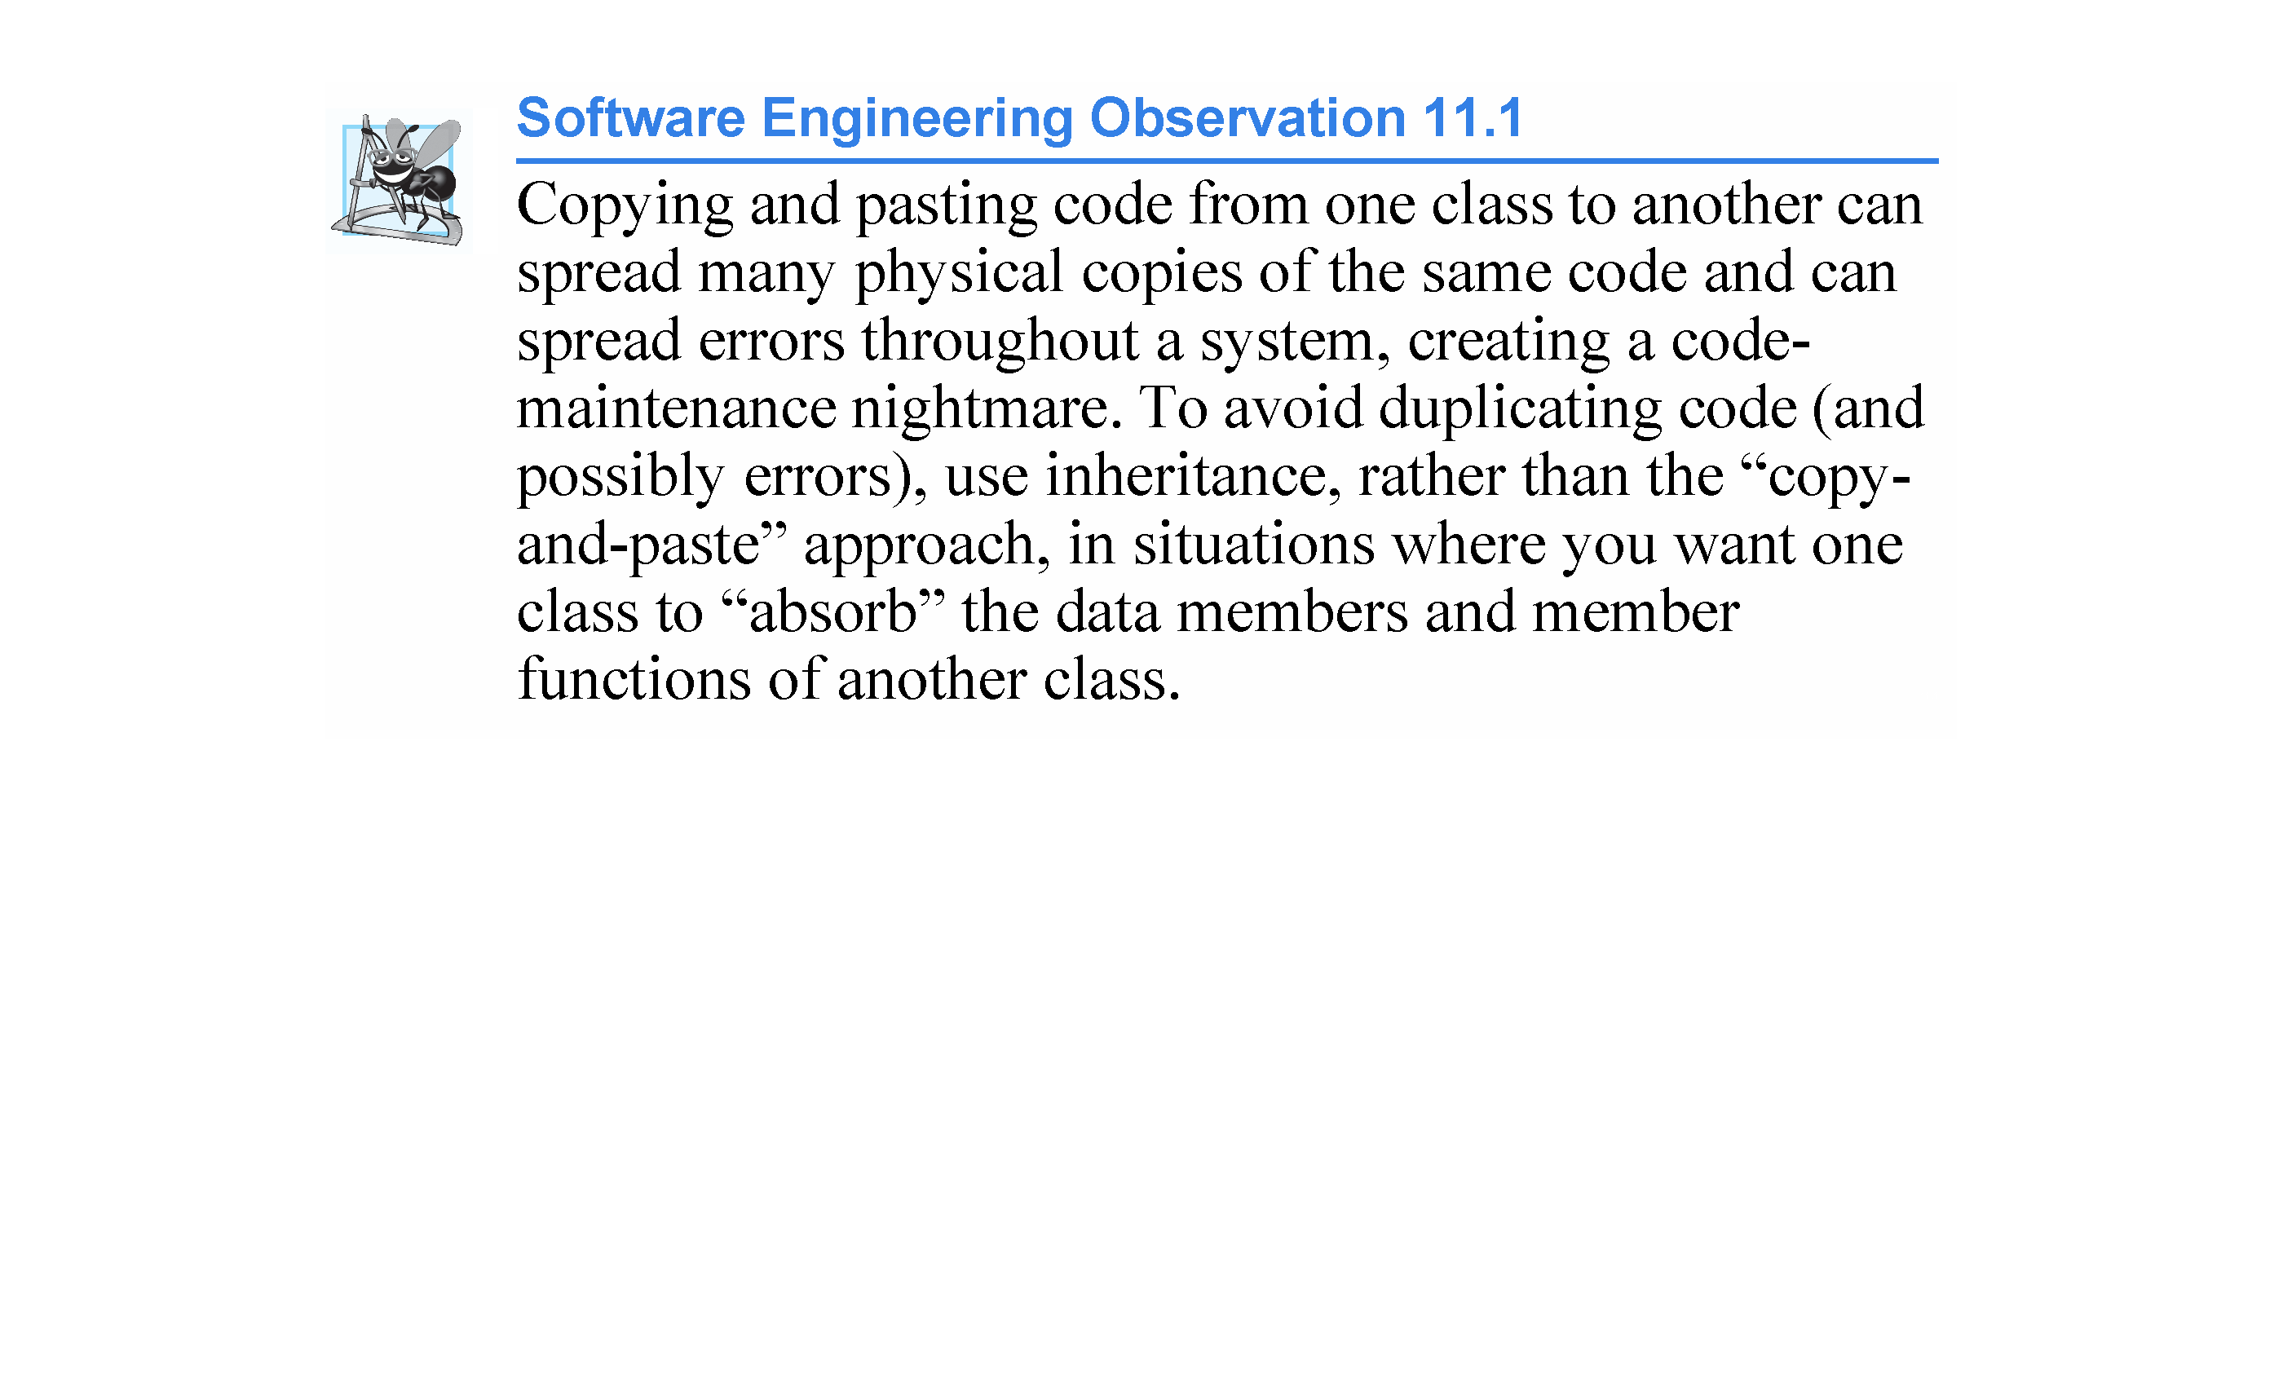

Slide 47
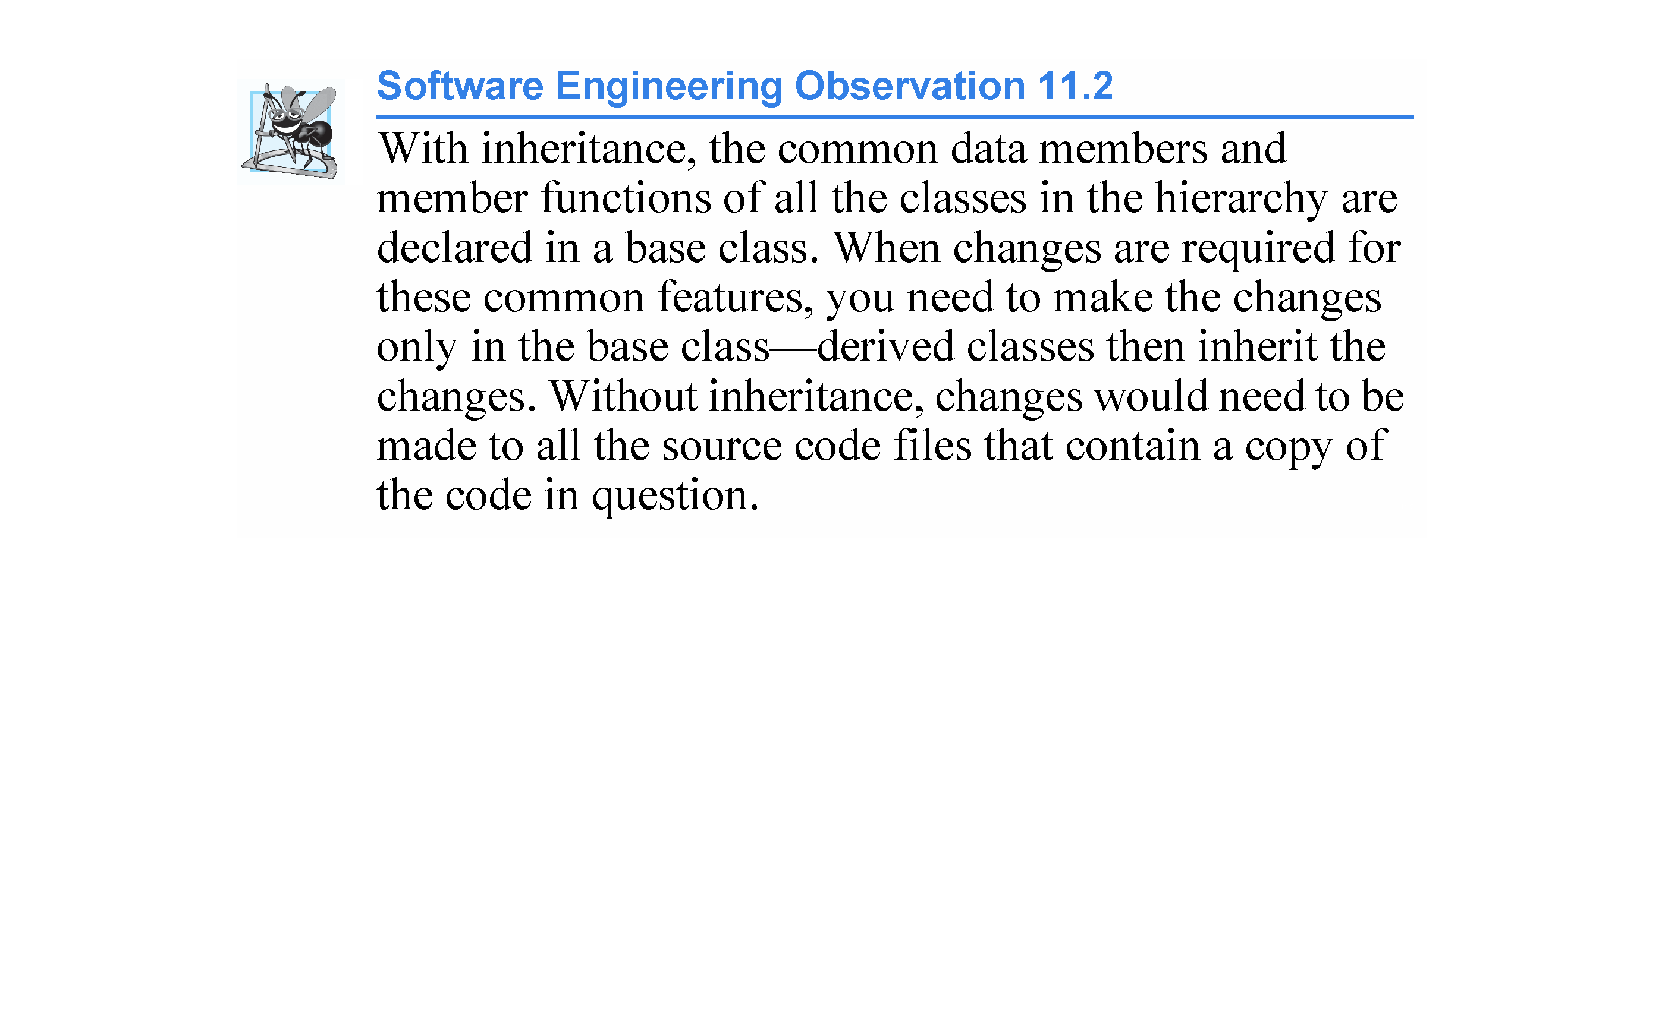

Slide 48
11.3.3 Creating a CommissionEmployee – BasePlusCommissionEmployee Inheritance Hierarchy
Now we create and test a new BasePlusCommissionEmployee class (Figs. 11.10–11.11) that derives from class CommissionEmployee (Figs. 11.4–11.5).
In this example, a BasePlusCommissionEmployee object “is-a” CommissionEmployee (because inheritance passes on the capabilities of class CommissionEmployee), but class BasePlusCommissionEmployee also has data member baseSalary (Fig. 11.10, line 22).
The colon (:) in line 10 of the class declaration inheritance.
Keyword public indicates the type of inheritance.
As a derived class (formed with public inheritance), BasePlusCommissionEmployee inherits all the members of class CommissionEmployee, except for the constructor - each class provides its own constructors that are specific to the class.

Slide 49
11.3.3 Creating a CommissionEmployee – BasePlusCommissionEmployee Inheritance Hierarchy
Destructors, like constructors, are NOT inherited
Thus, the public services of BasePlusCommissionEmployee include its constructor and the public member functions inherited from class CommissionEmployee
although we cannot see these inherited member functions in BasePlusCommissionEmployee’s source code, they’re nevertheless a part of derived class BasePlusCommissionEmployee.
The derived class’s public services also include member functions setBaseSalary, getBaseSalary, earnings and print.

Slide 50
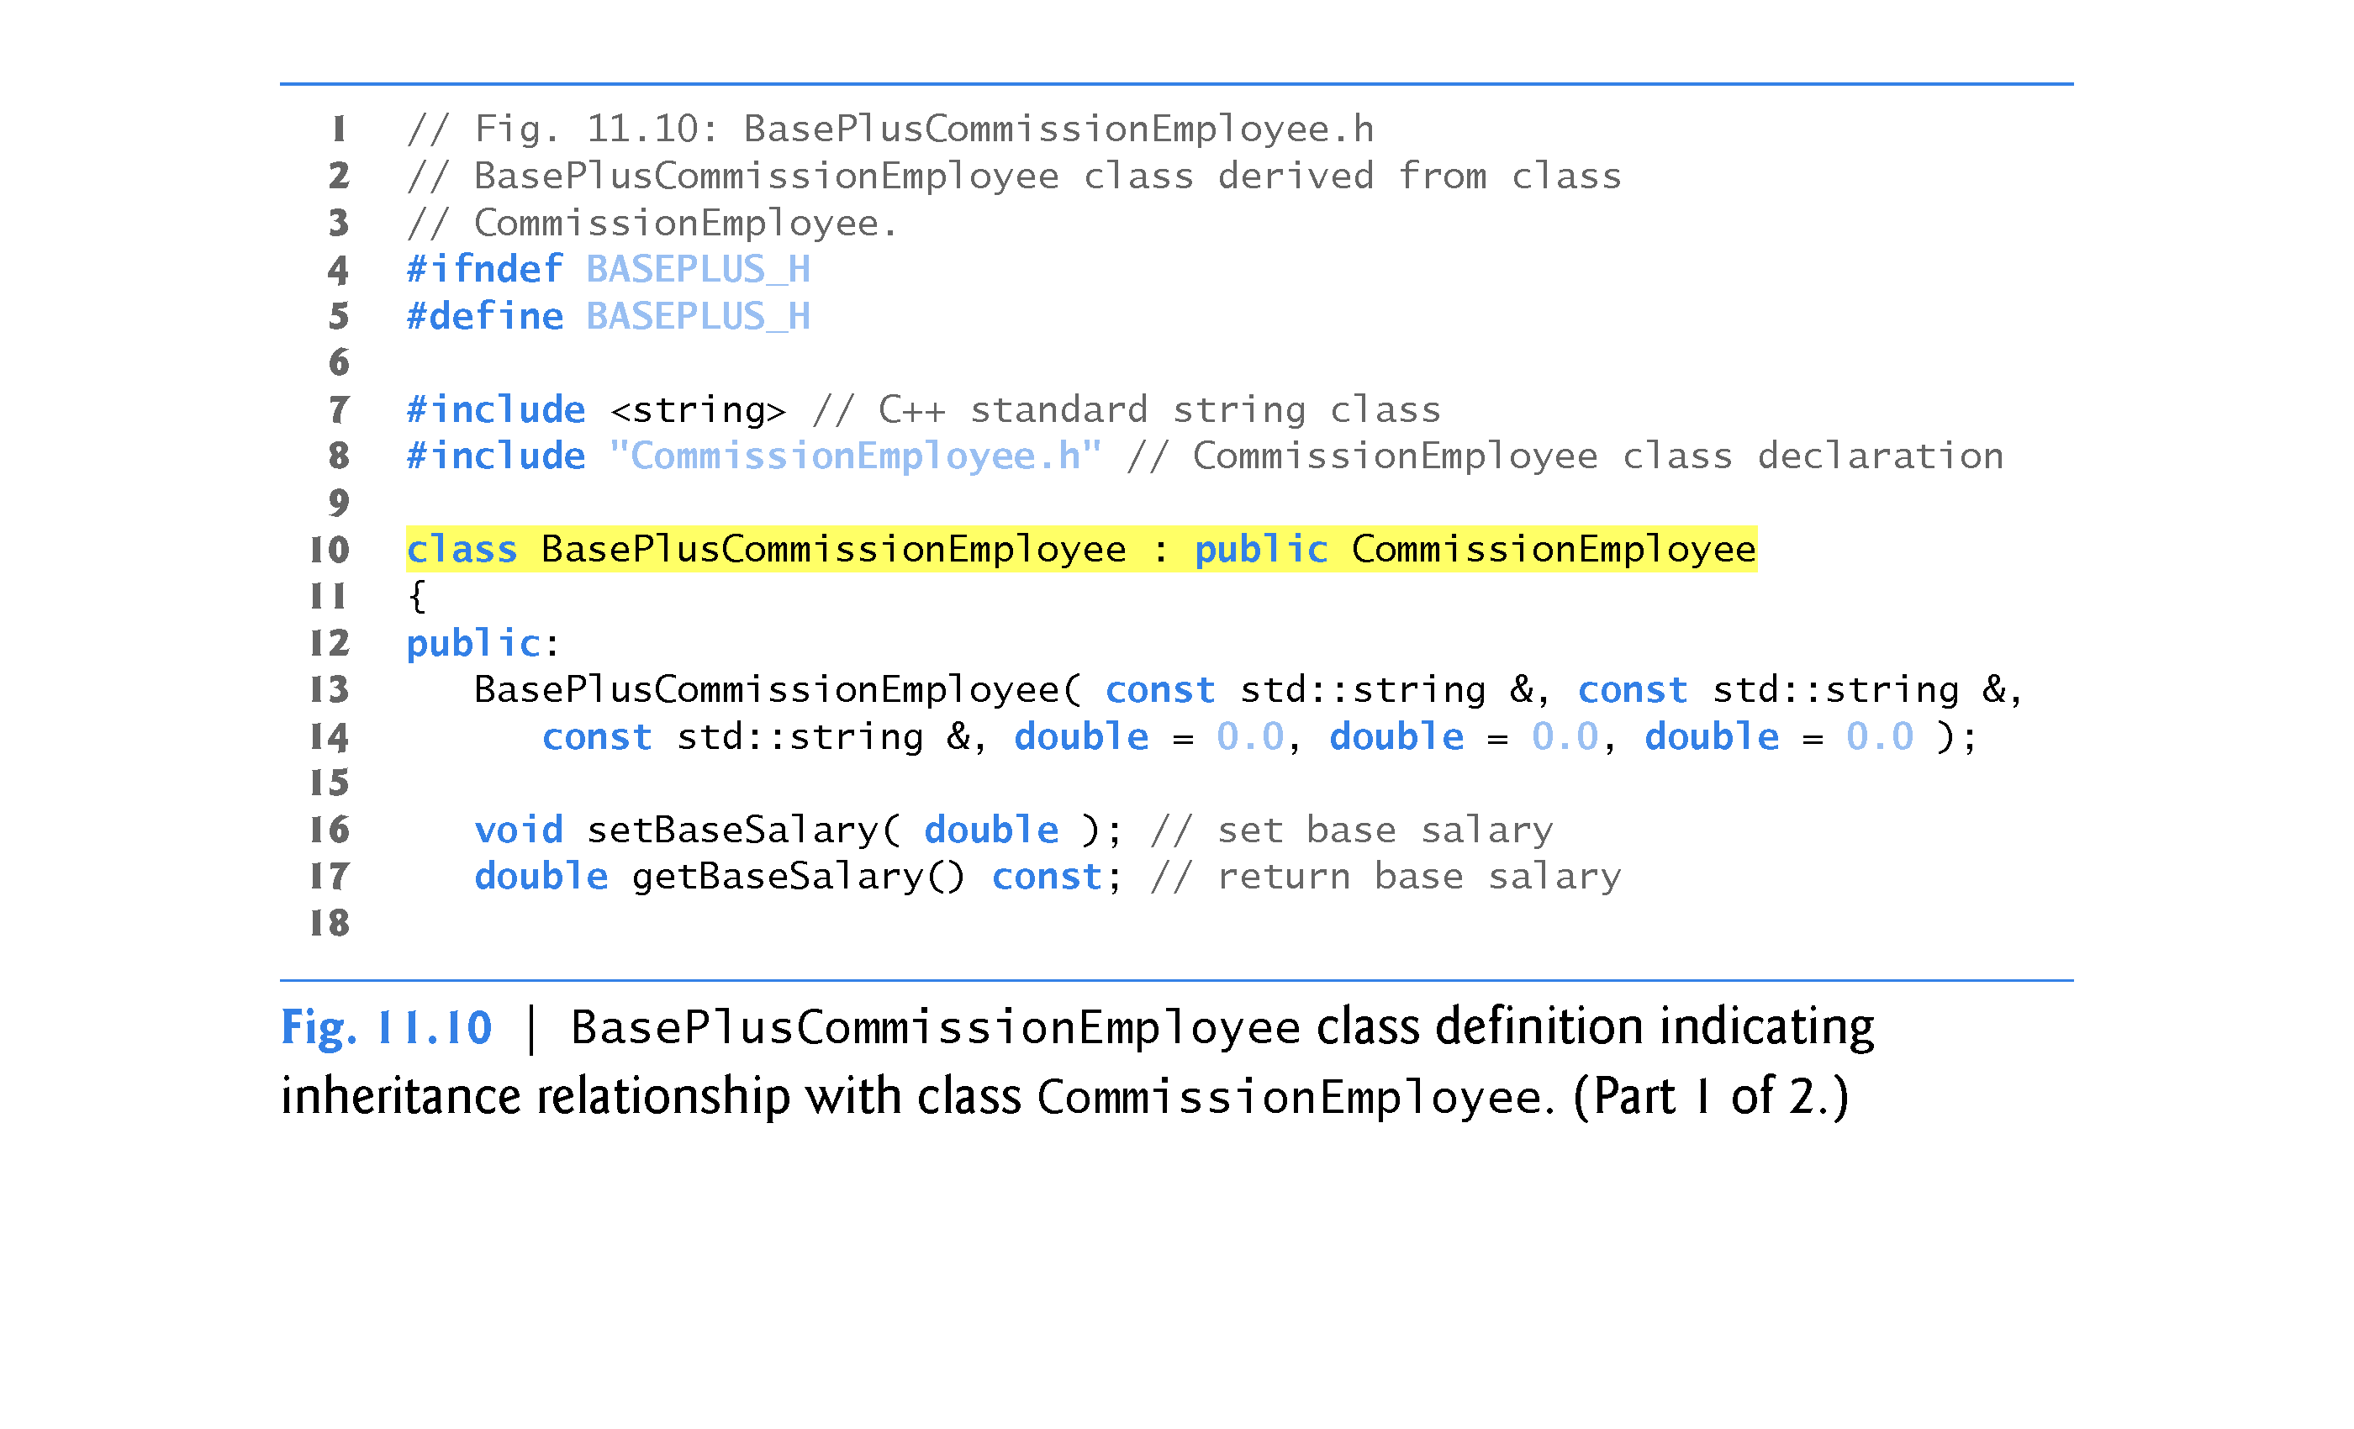

Slide 51
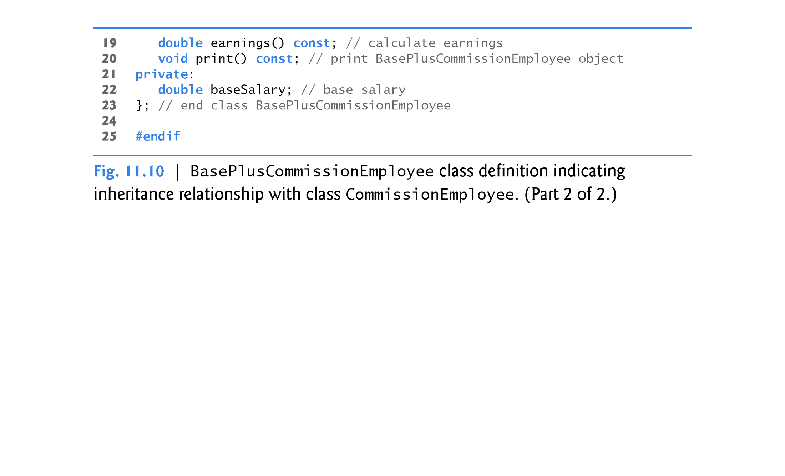

Slide 52
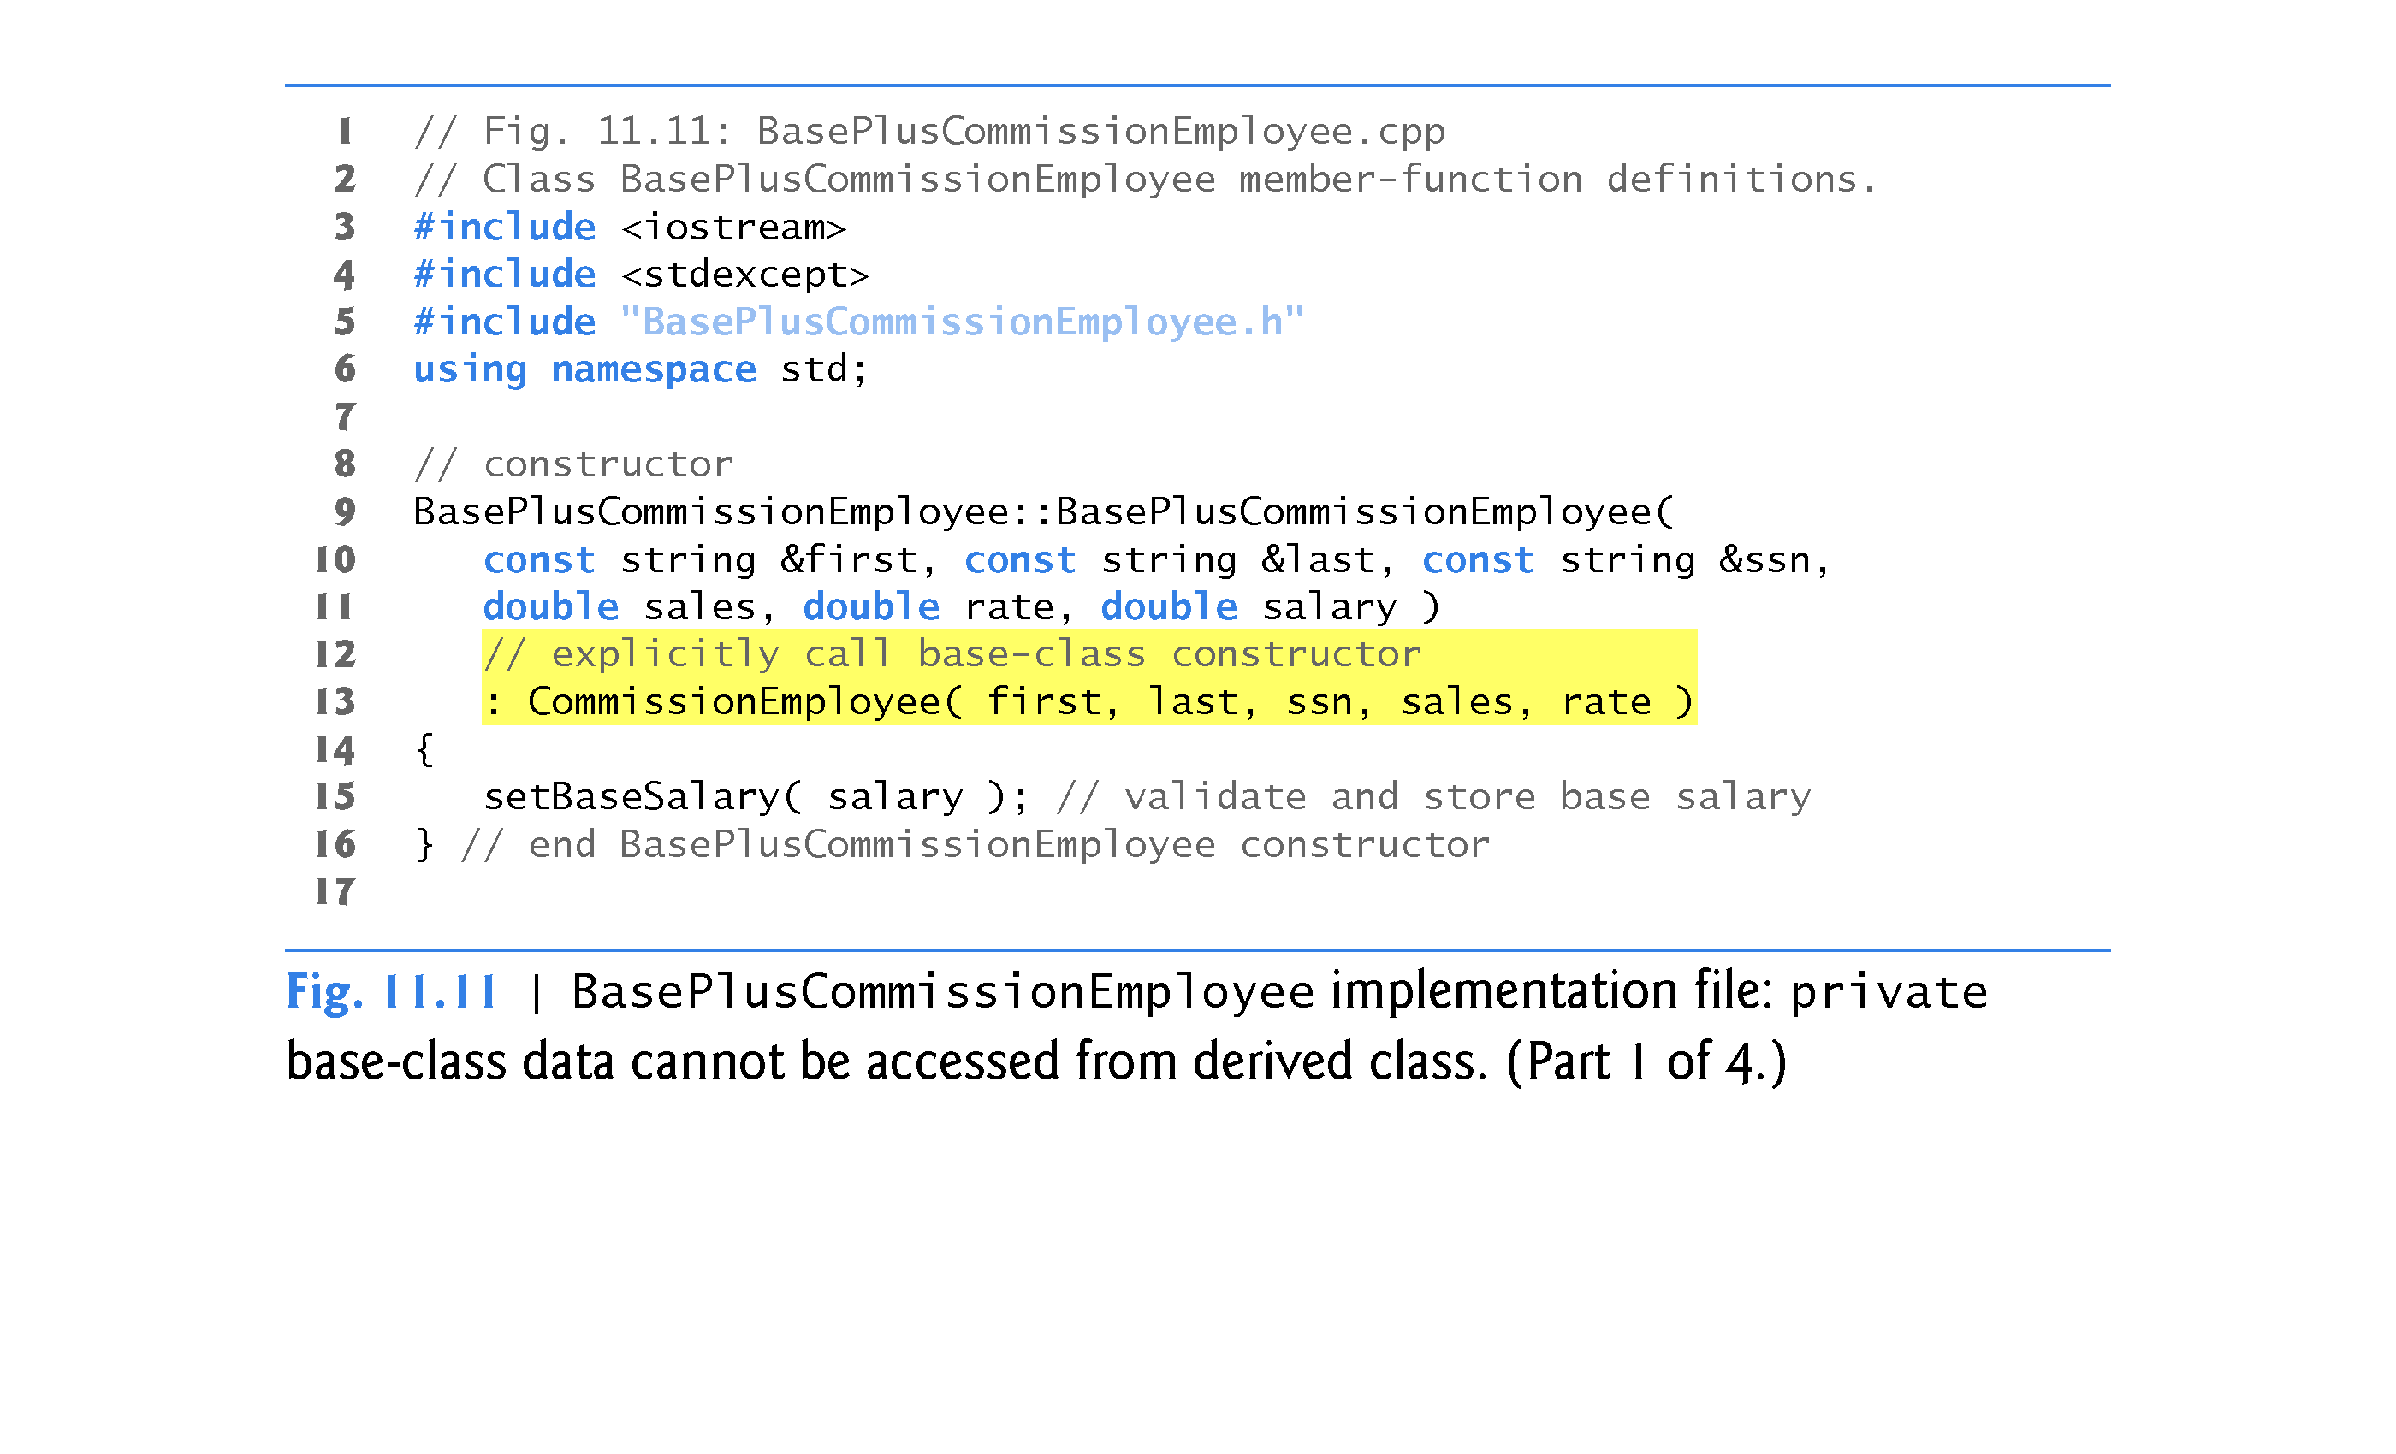

Slide 53
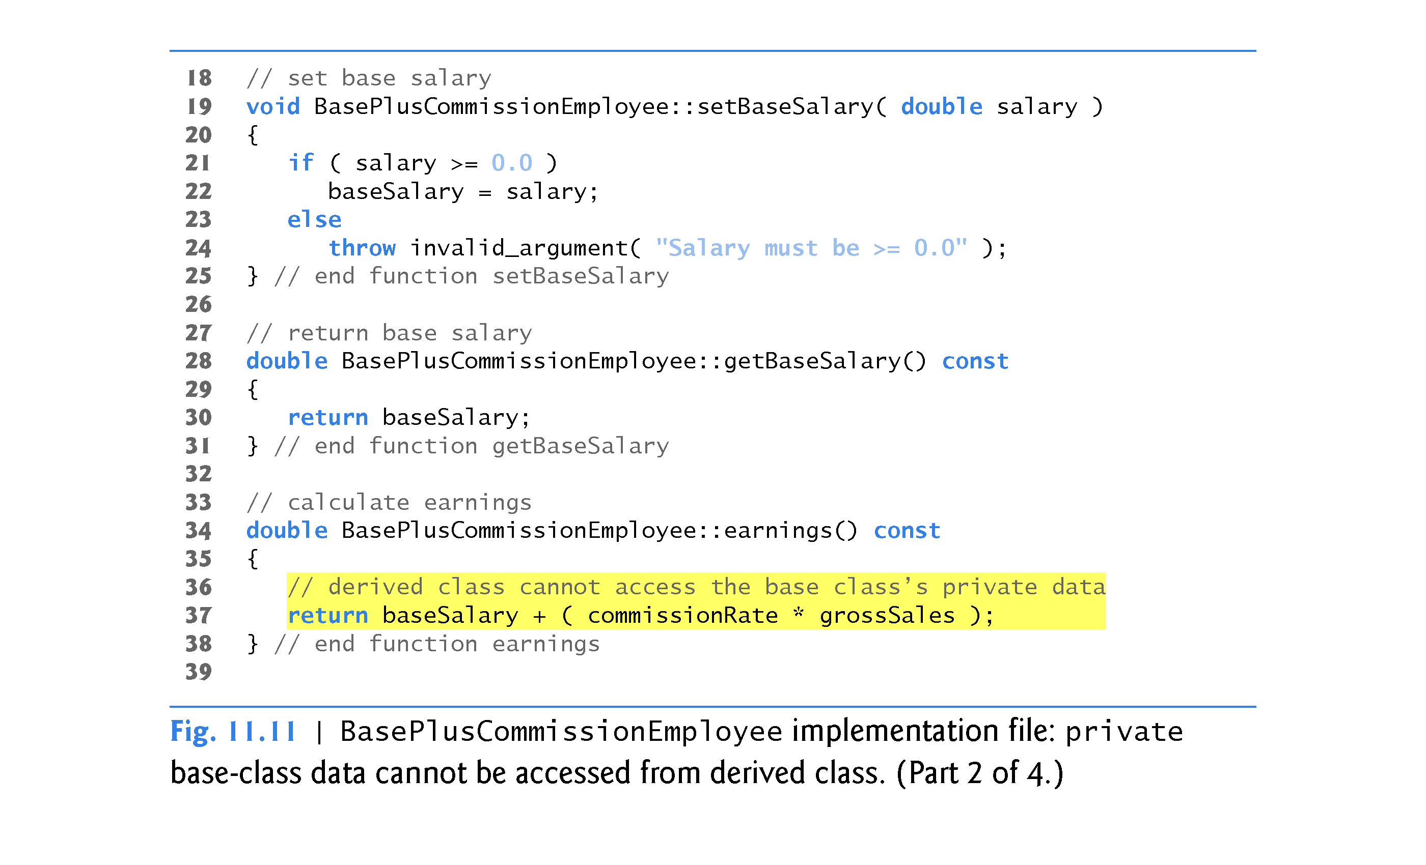

Slide 54
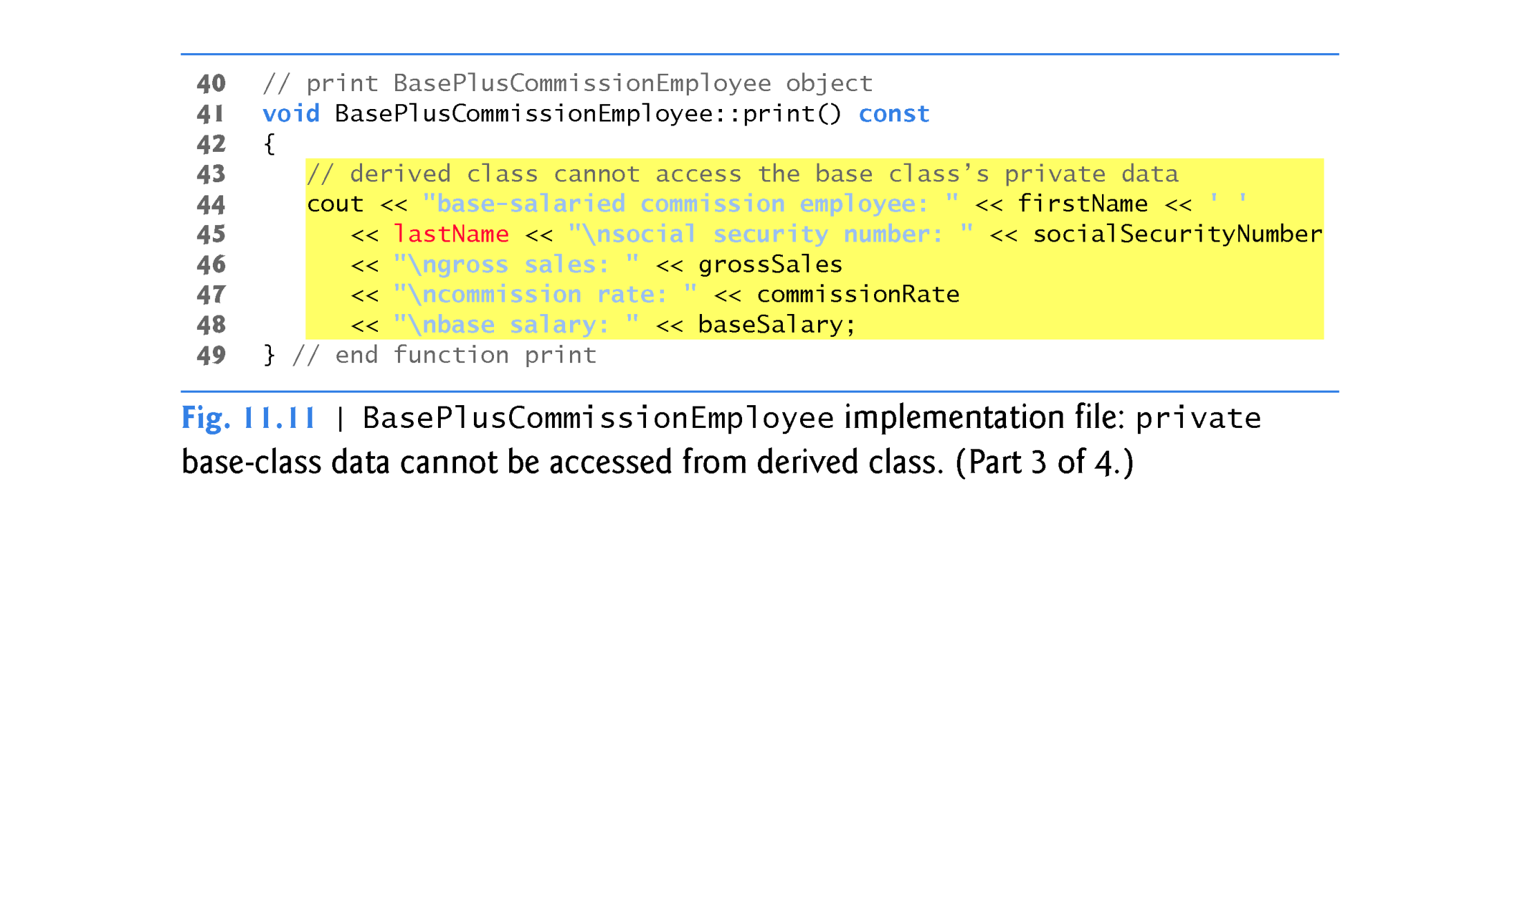

Slide 55
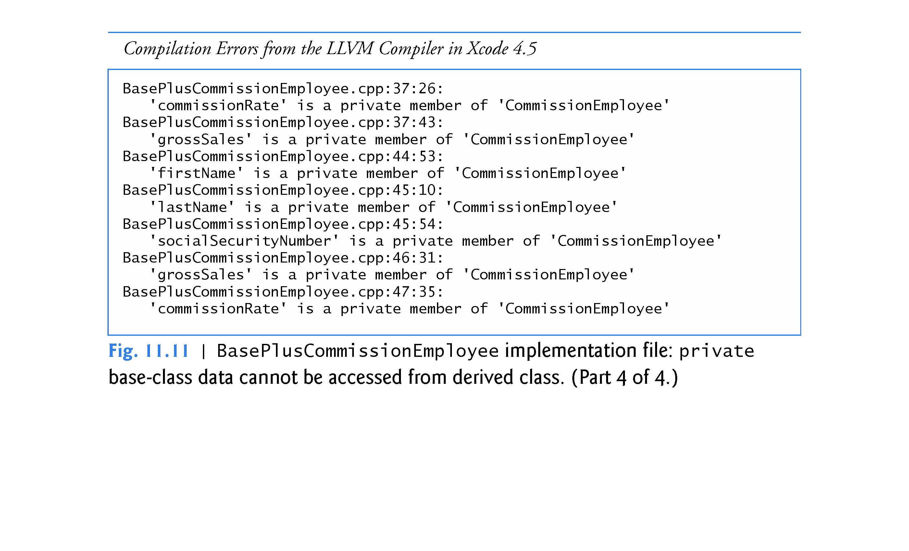

Slide 56
11.3.3 Creating a CommissionEmployee BasePlusCommissionEmployee Inheritance Hierarchy
Figure 11.11 shows BasePlusCommissionEmployee’s member-function implementations.
The constructor introduces base-class initializer syntax, which uses a member initializer to pass arguments to the base-class constructor.
C++ requires that a derived-class constructor call its base-class constructor to initialize the base-class data members that are inherited into the derived class.
If BasePlusCommissionEmployee’s constructor did not invoke class CommissionEmployee’s constructor explicitly, C++ would attempt to invoke class CommissionEmployee’s default constructor - but the class does not have such a constructor, so the compiler would issue an error.

Slide 57
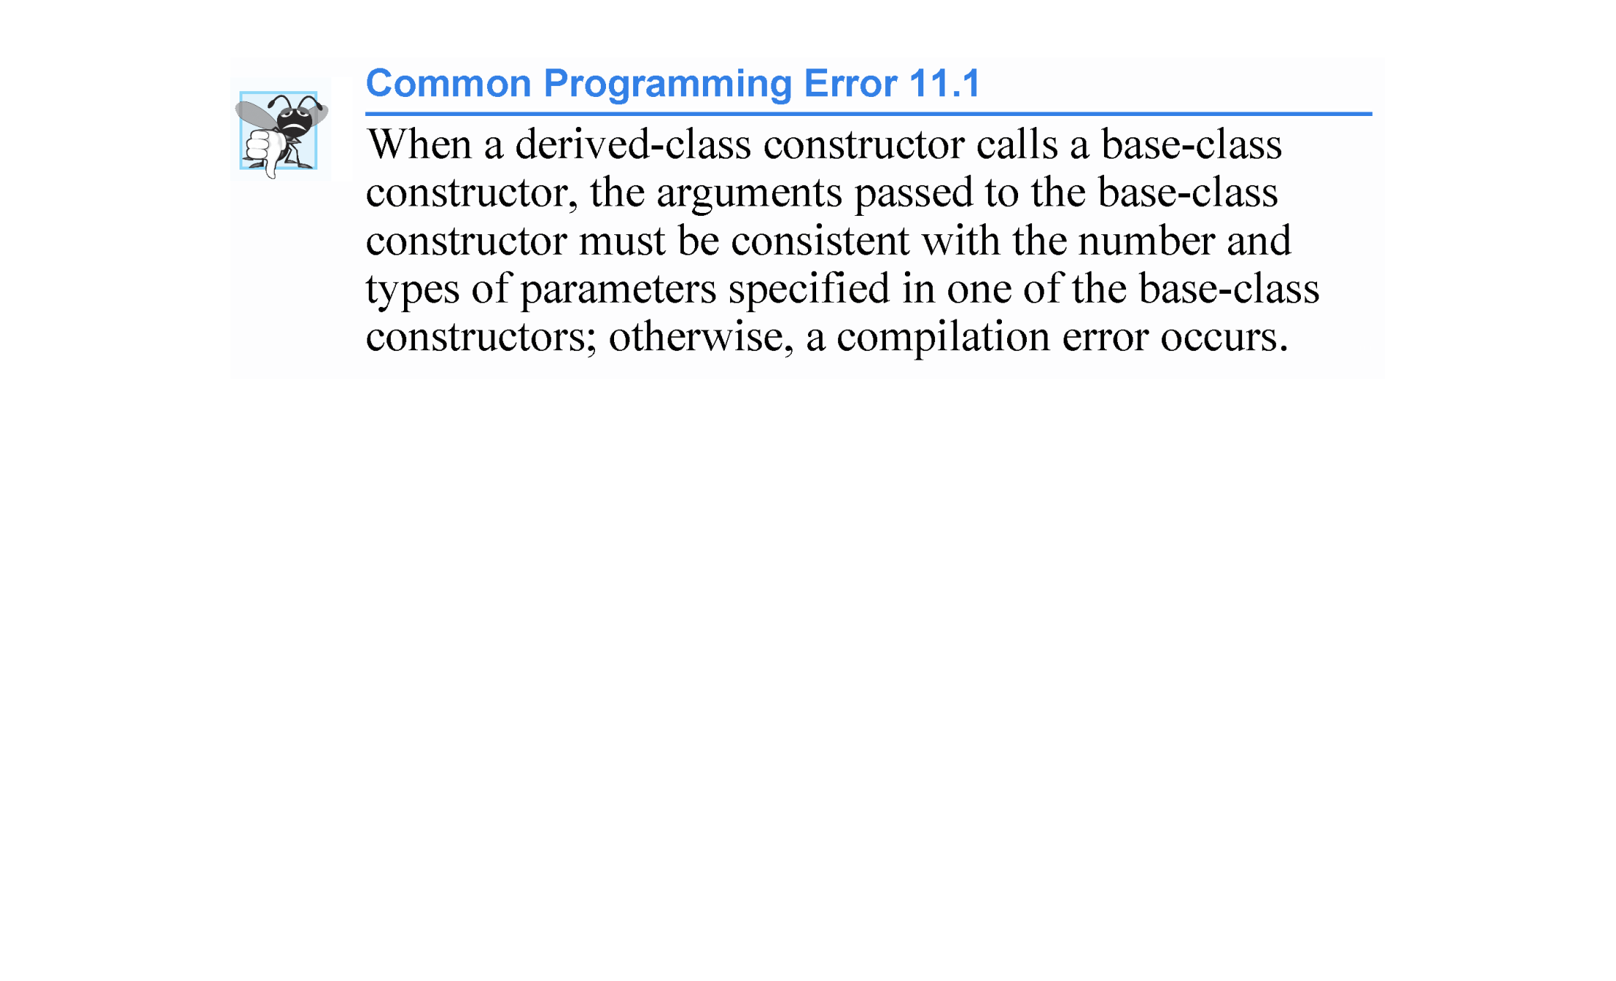

Slide 58
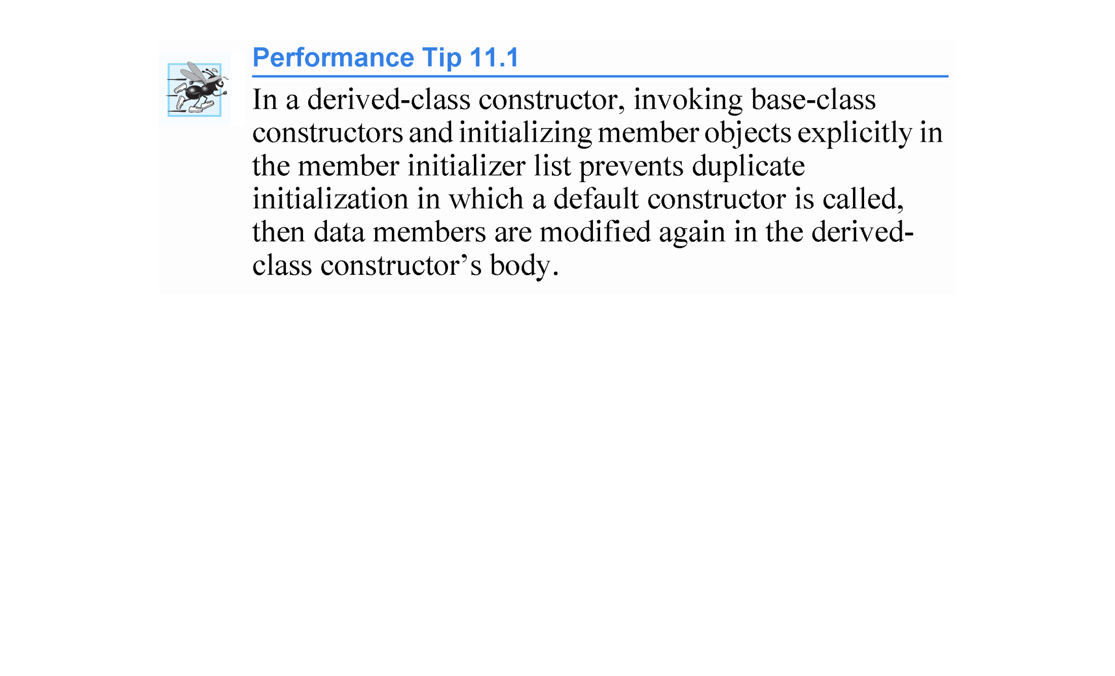

Slide 59
11.3.3 Creating a CommissionEmployee BasePlusCommissionEmployee Inheritance Hierarchy
Compilation Errors from Accessing Base-Class private Members
The compiler generates errors for line 37 of Fig. 11.11 because base class CommissionEmployee’s data members commissionRate and grossSales are private - derived class BasePlusCommissionEmployee’s member functions are not allowed to access base class CommissionEmployee’s private data.
We used red text in Fig. 11.11 to indicate erroneous code.
The compiler issues additional errors in lines 44–47 of BasePlus-Commission-Employee’s print member function for the same reason.
C++ rigidly enforces restrictions on accessing private data members, so that even a derived class (which is intimately related to its base class) cannot access the base class’s private data.

Slide 60
11.3.3 Creating a CommissionEmployee BasePlusCommissionEmployee Inheritance Hierarchy
Preventing the Errors in BasePlusCommissionEmployee
We purposely included the erroneous code in Fig. 11.11 to emphasize that a derived class’s member functions cannot access its base class’s private data.
The errors in BasePlusCommissionEmployee could have been prevented by using the get member functions inherited from class CommissionEmployee.

Slide 61
11.3.3 Creating a CommissionEmployee BasePlusCommissionEmployee Inheritance Hierarchy
For example, line 37 could have invoked getCommissionRate and getGrossSales to access CommissionEmployee’s private data members commissionRate and grossSales, respectively.
Similarly, lines 44–47 could have used appropriate get member functions to retrieve the values of the base class’s data members.

Slide 62
11.3.3 Creating a CommissionEmployee–BasePlusCommissionEmployee Inheritance Hierarchy
Including the Base-Class Header in the Derived-Class Header with #include
We include the base class’s header in the derived class’s header (line 8 of Fig. 11.10).
This is necessary for three reasons.
The derived class uses the base class’s name in line 10, so we must tell the compiler that the base class exists.
The compiler uses a class declaration to determine the size of an object of that class. A client program that creates an object of a class includes the class declaration to enable the compiler to reserve the proper amount of memory for the object.
The compiler must determine whether the derived class uses the base class’s inherited members properly.

Slide 63
11.3.3 Creating a CommissionEmployee–BasePlusCommissionEmployee Inheritance Hierarchy
Linking Process in an Inheritance Hierarchy
In Section 3.7, we discussed the linking process for creating an executable GradeBook application.
The linking process is similar for a program that uses classes in an inheritance hierarchy.
The process requires the object code for all classes used in the program and the object code for the direct and indirect base classes of any derived classes used by the program.
The code is also linked with the object code for any C++ Standard Library classes used in the classes or the client code.

Slide 64
11.3.4 CommissionEmployee–BasePlusCommissionEmployee Inheritance Hierarchy Using protected Data
In this section, we introduce the access specifier protected.
To enable class BasePlusCommissionEmployee to directly access CommissionEmployee data members firstName, lastName, socialSecurityNumber, grossSales and commissionRate, we can declare those members as protected in the base class.
A base class’s protected members can be accessed within the body of that base class, by members and friends of that base class, and by members and friends of any classes derived from that base class.

Slide 65
11.3.4 CommissionEmployee–BasePlusCommissionEmployee Inheritance Hierarchy Using protected Data (cont.)
Defining Base Class CommissionEmployee with protected Data
Class CommissionEmployee (Fig. 11.12) now declares data members firstName, lastName, socialSecurityNumber, grossSales and commissionRate as protected (lines 31–36) rather than private.
The member-function implementations are identical to those in Fig. 11.5.

Slide 66
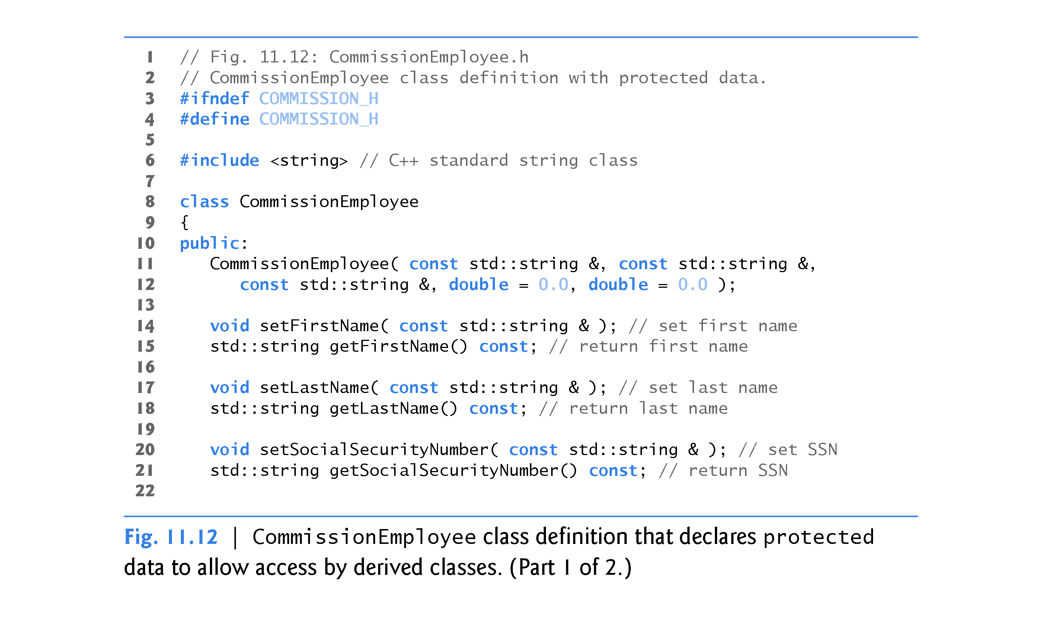

Slide 67
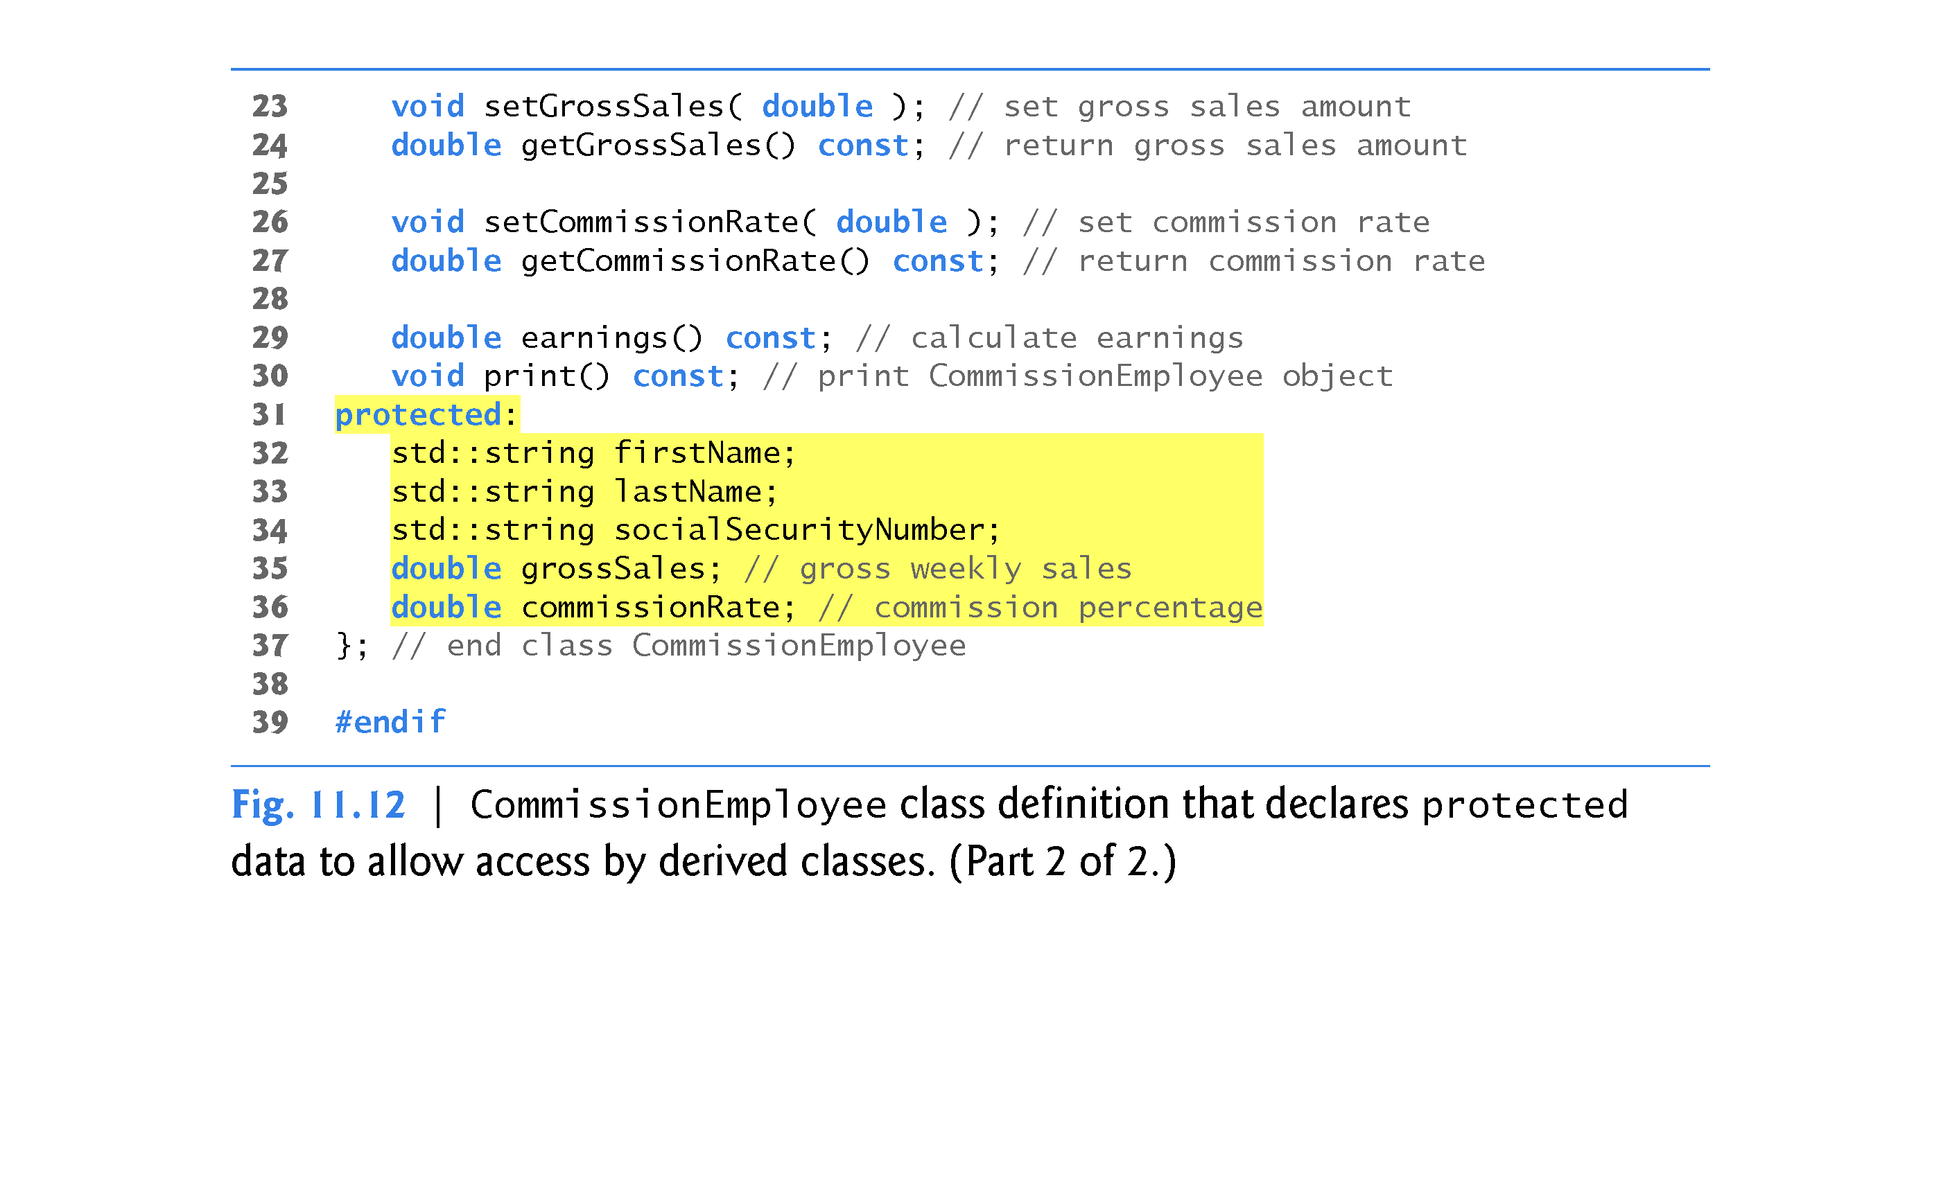

Slide 68
11.3.4 CommissionEmployeeBasePlusCommissionEmployee Inheritance Hierarchy Using protected Data (cont.)
BasePlusCommissionEmployee inherits from class CommissionEmployee in Fig. 11.12.
Objects of class BasePlusCommissionEmployee can access inherited data members that are declared protected in class CommissionEmployee (i.e., data members firstName, lastName, socialSecurityNumber, grossSales and commissionRate).
As a result, the compiler does not generate errors when compiling the BasePlusCommissionEmployee earnings and print member-function definitions in Fig. 11.11 (lines 34–38 and 41–49, respectively).
Objects of a derived class also can access protected members in any of that derived class’s indirect base classes.

Slide 69
11.3.4 CommissionEmployee–BasePlusCommissionEmployee Inheritance Hierarchy Using protected Data (cont.)
Testing the Modified BasePlusCommissionEmployee Class
To test the updated class hierarchy, we reused the test program from Fig. 11.9.
As shown in Fig. 11.13, the output is identical to that of Fig. 11.9.
The code for class BasePlusCommissionEmployee, which is 74 lines, is considerably shorter than the code for the noninherited version of the class, which is 161 lines, because the inherited version absorbs part of its functionality from CommissionEmployee, whereas the noninherited version does not absorb any functionality.
Also, there is now only one copy of the CommissionEmployee functionality declared and defined in class CommissionEmployee.
Makes the source code easier to maintain, modify and debug.

Slide 70
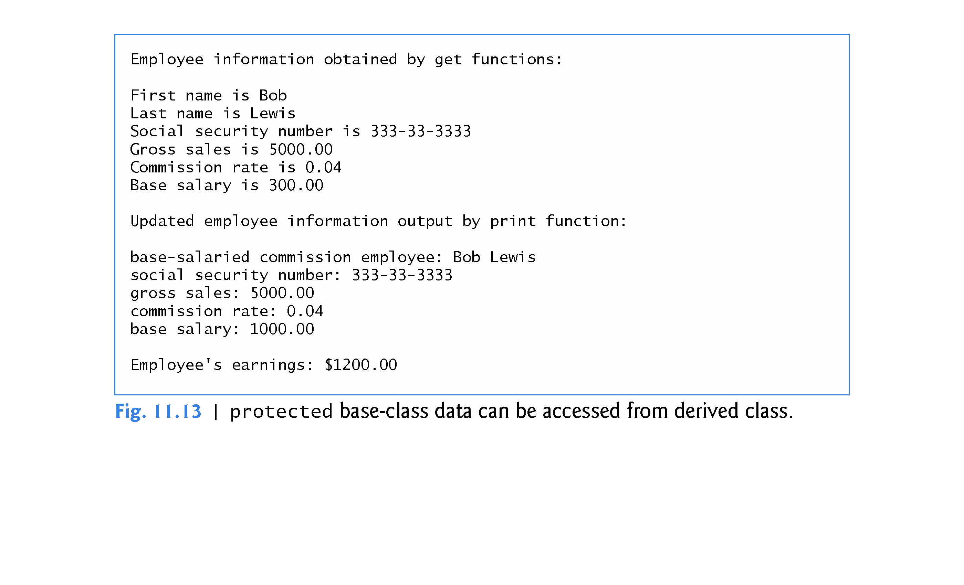

Slide 71
11.3.4 CommissionEmployee–BasePlusCommissionEmployee Inheritance Hierarchy Using protected Data (cont.)
Notes on Using protected Data
Inheriting protected data members slightly increases performance, because we can directly access the members without incurring the overhead of calls to set or get member functions.

Slide 72
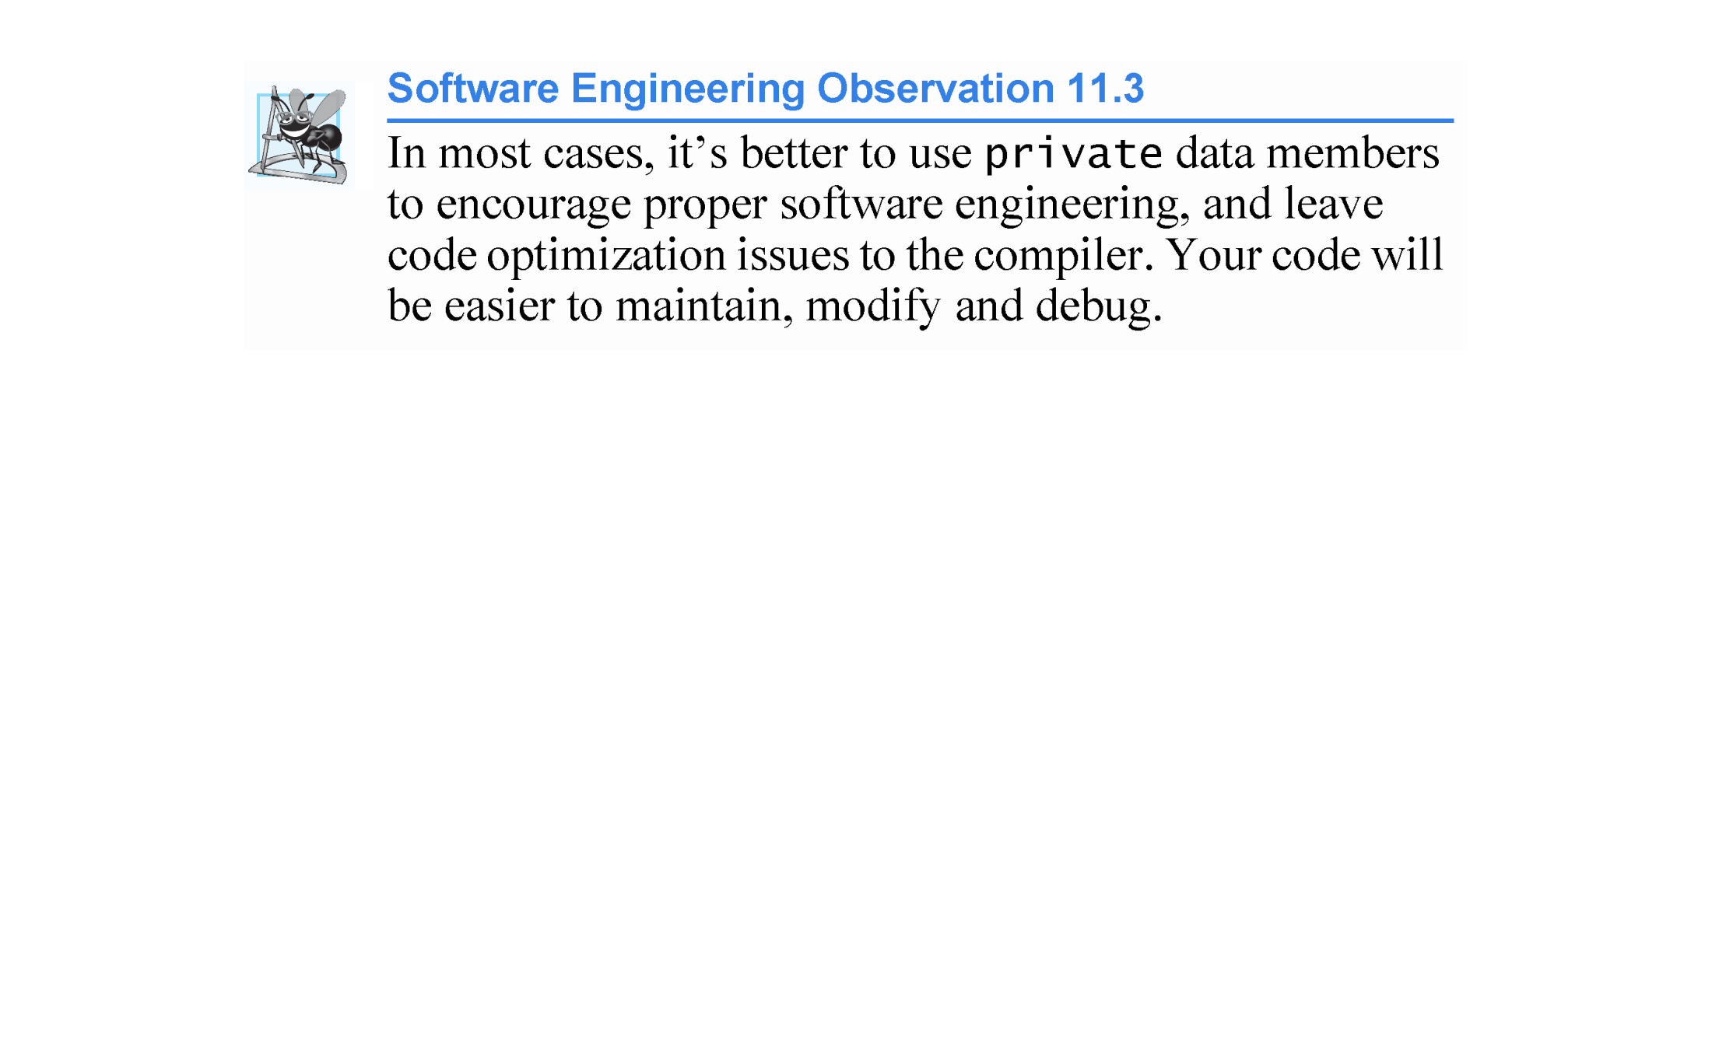

Slide 73
11.3.4 CommissionEmployee–BasePlusCommissionEmployee Inheritance Hierarchy Using protected Data (cont.)
Using protected data members creates two serious problems:
The derived-class object does not have to use a member function to set the value of the base class’s protected data member.
Derived-class member functions are more likely to be written so that they depend on the base-class implementation. Derived classes should depend only on the base-class services (i.e., non-private member functions) and not on the base-class implementation.
With protected data members in the base class, if the base-class implementation changes, we may need to modify all derived classes of that base class.
Such software is said to be fragile or brittle, because a small change in the base class can “break” derived-class implementation.

Slide 74
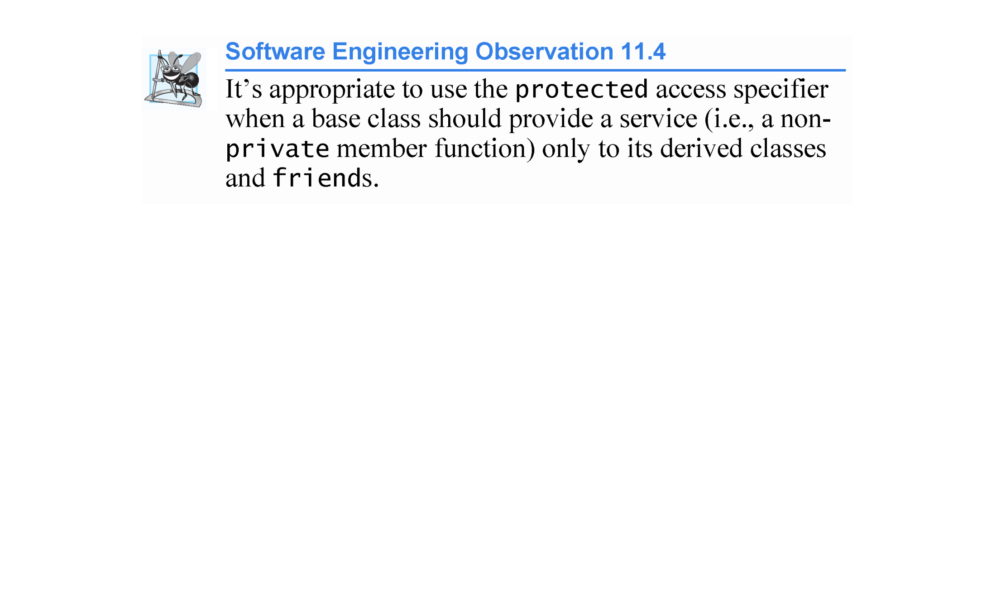

Slide 75
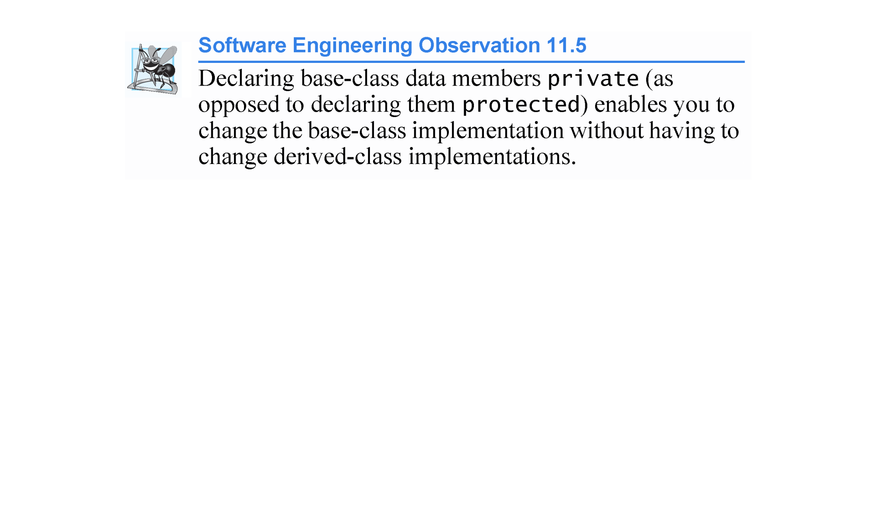

Slide 76
11.3.5 CommissionEmployee–BasePlusCommissionEmployee Inheritance Hierarchy Using private Data
We now reexamine our hierarchy once more, this time using the best software engineering practices.
Class CommissionEmployee now declares data members firstName, lastName, socialSecurityNumber, grossSales and commissionRate as private (as shown previously in lines 31–36 of Fig. 11.4).

Slide 77
11.3.5 CommissionEmployee–BasePlusCommissionEmployee Inheritance Hierarchy Using private Data (cont.)
Changes to Class CommissionEmployee’s Member Function Definitions
In the CommissionEmployee constructor implementation (Fig. 11.14, lines 9–16), we use member initializers (line 12) to set the values of members firstName, lastName and socialSecurityNumber.
We show how derived-class BasePlusCommissionEmployee (Fig. 11.15) can invoke non-private base-class member functions (setFirstName, getFirstName, setLastName, getLastName, setSocialSecurityNumber and getSocialSecurityNumber) to manipulate these data members.

Slide 78
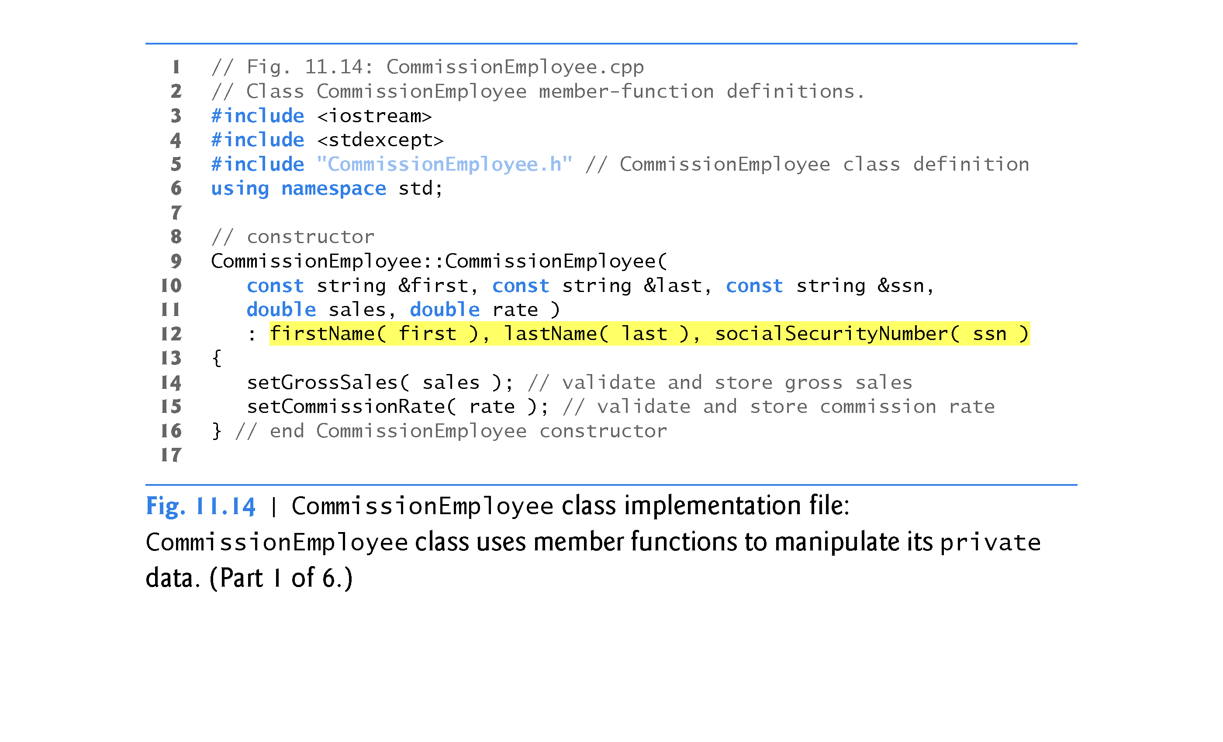

Slide 79
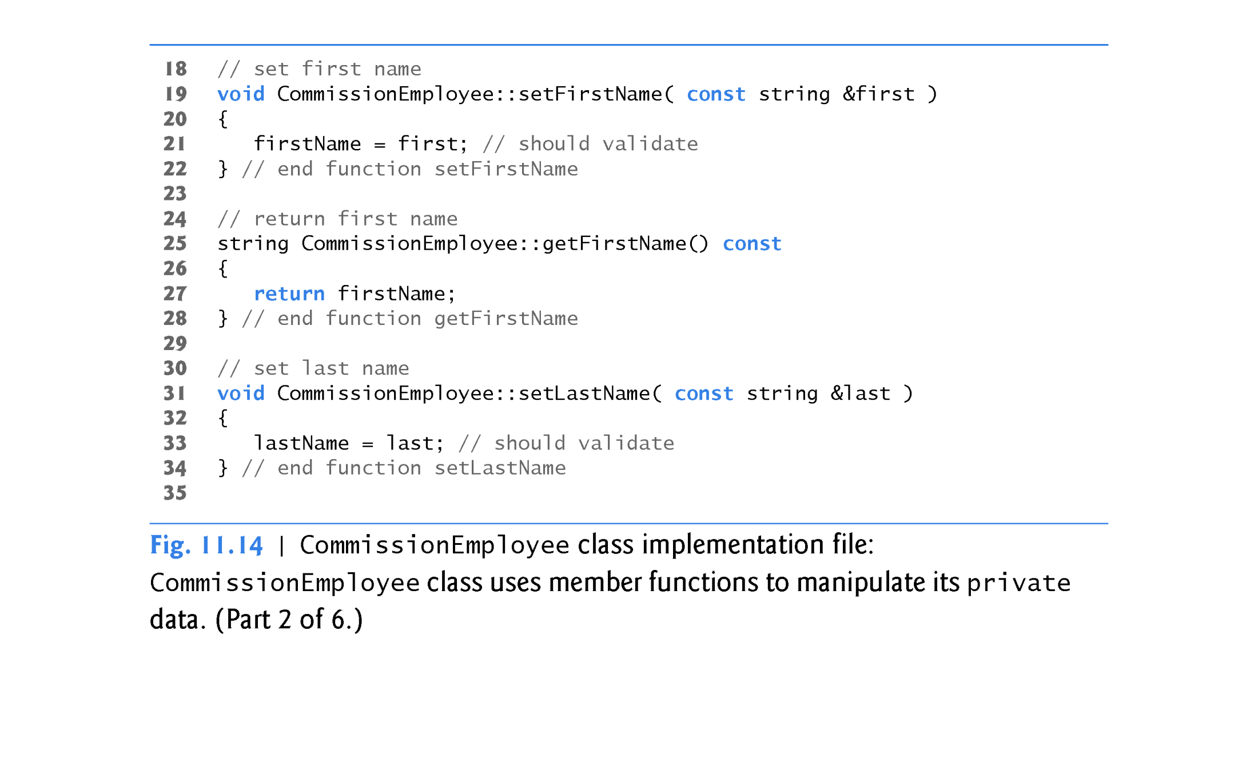

Slide 80
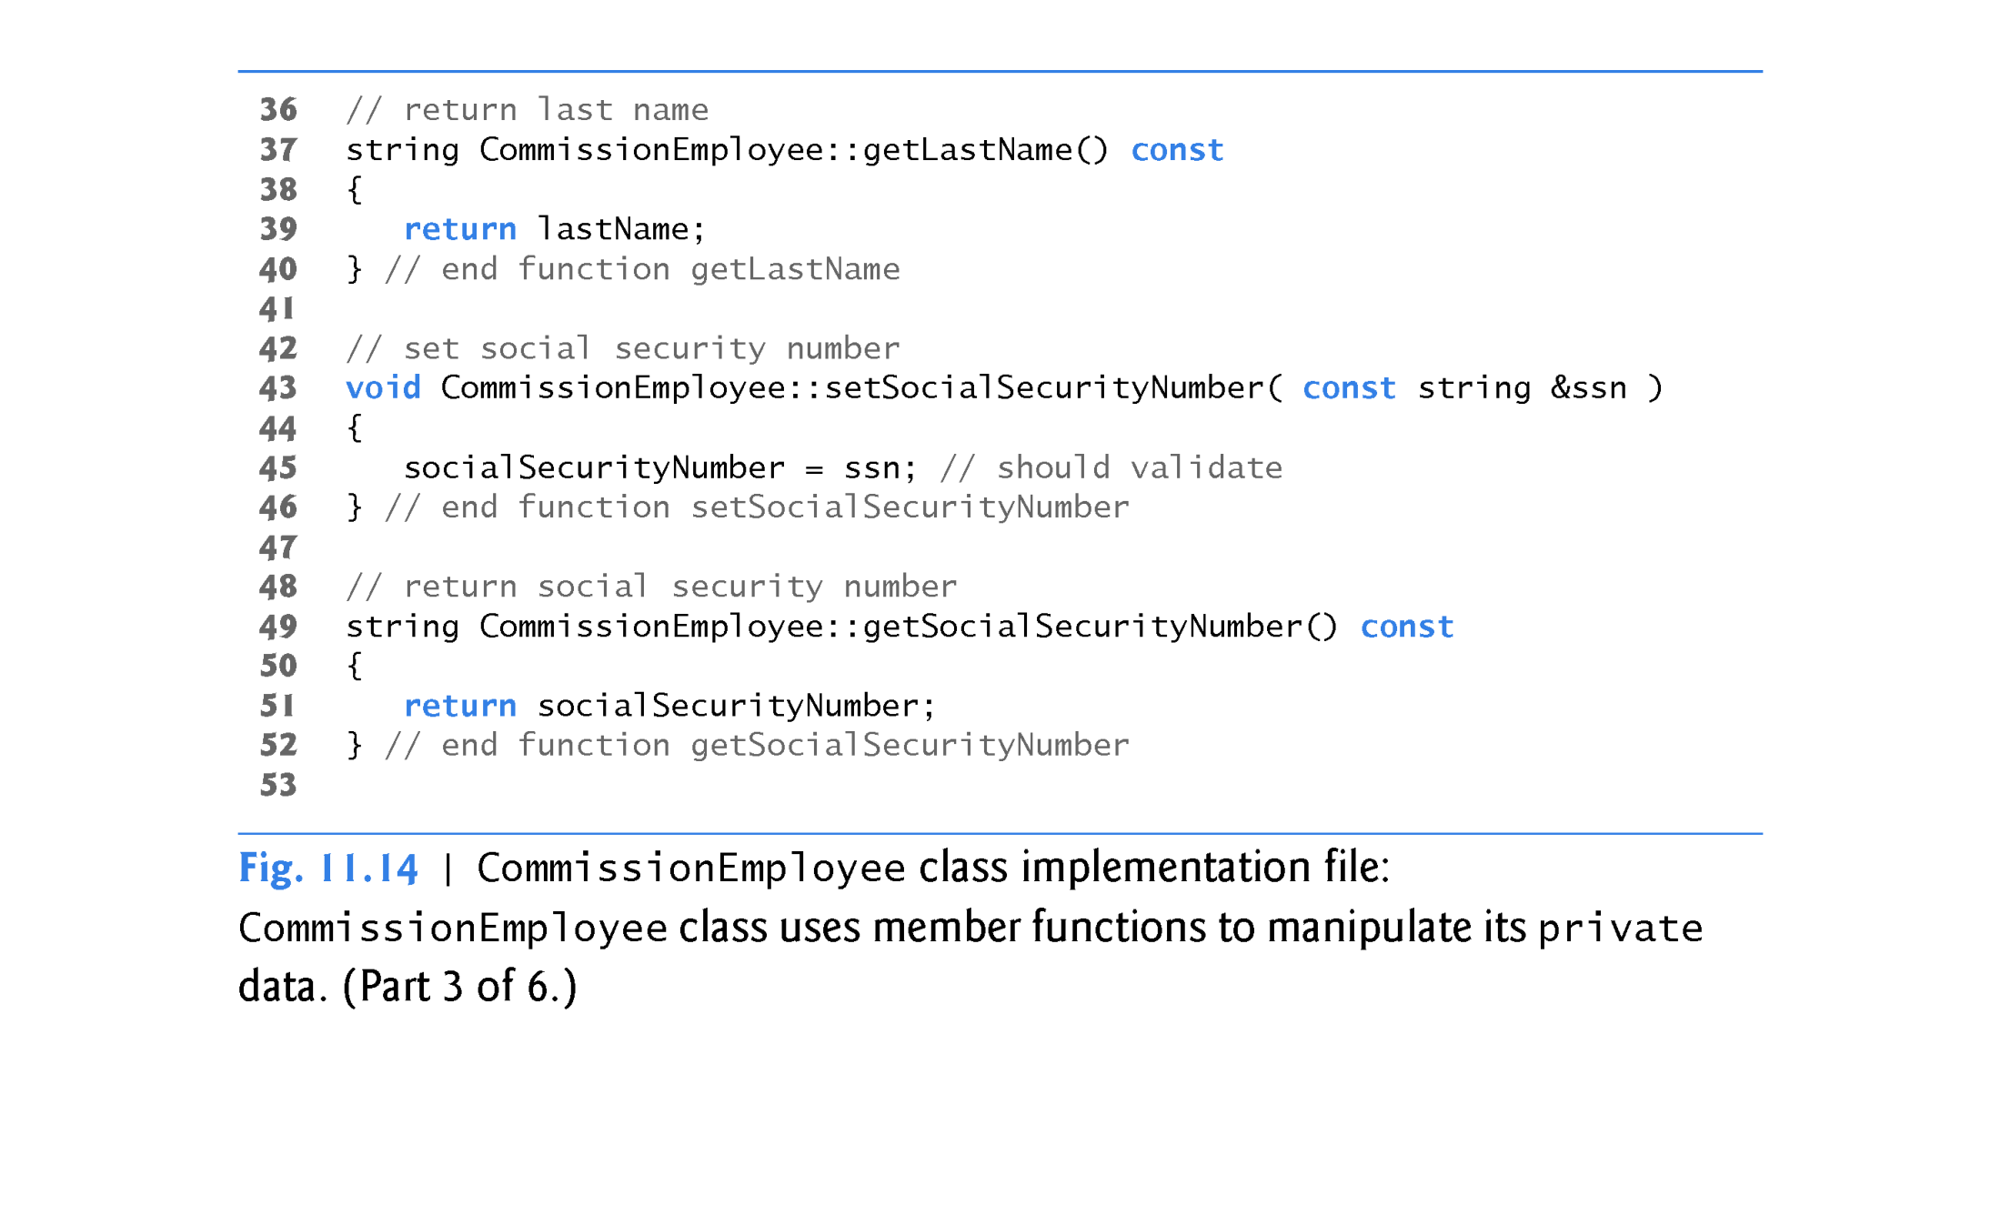

Slide 81
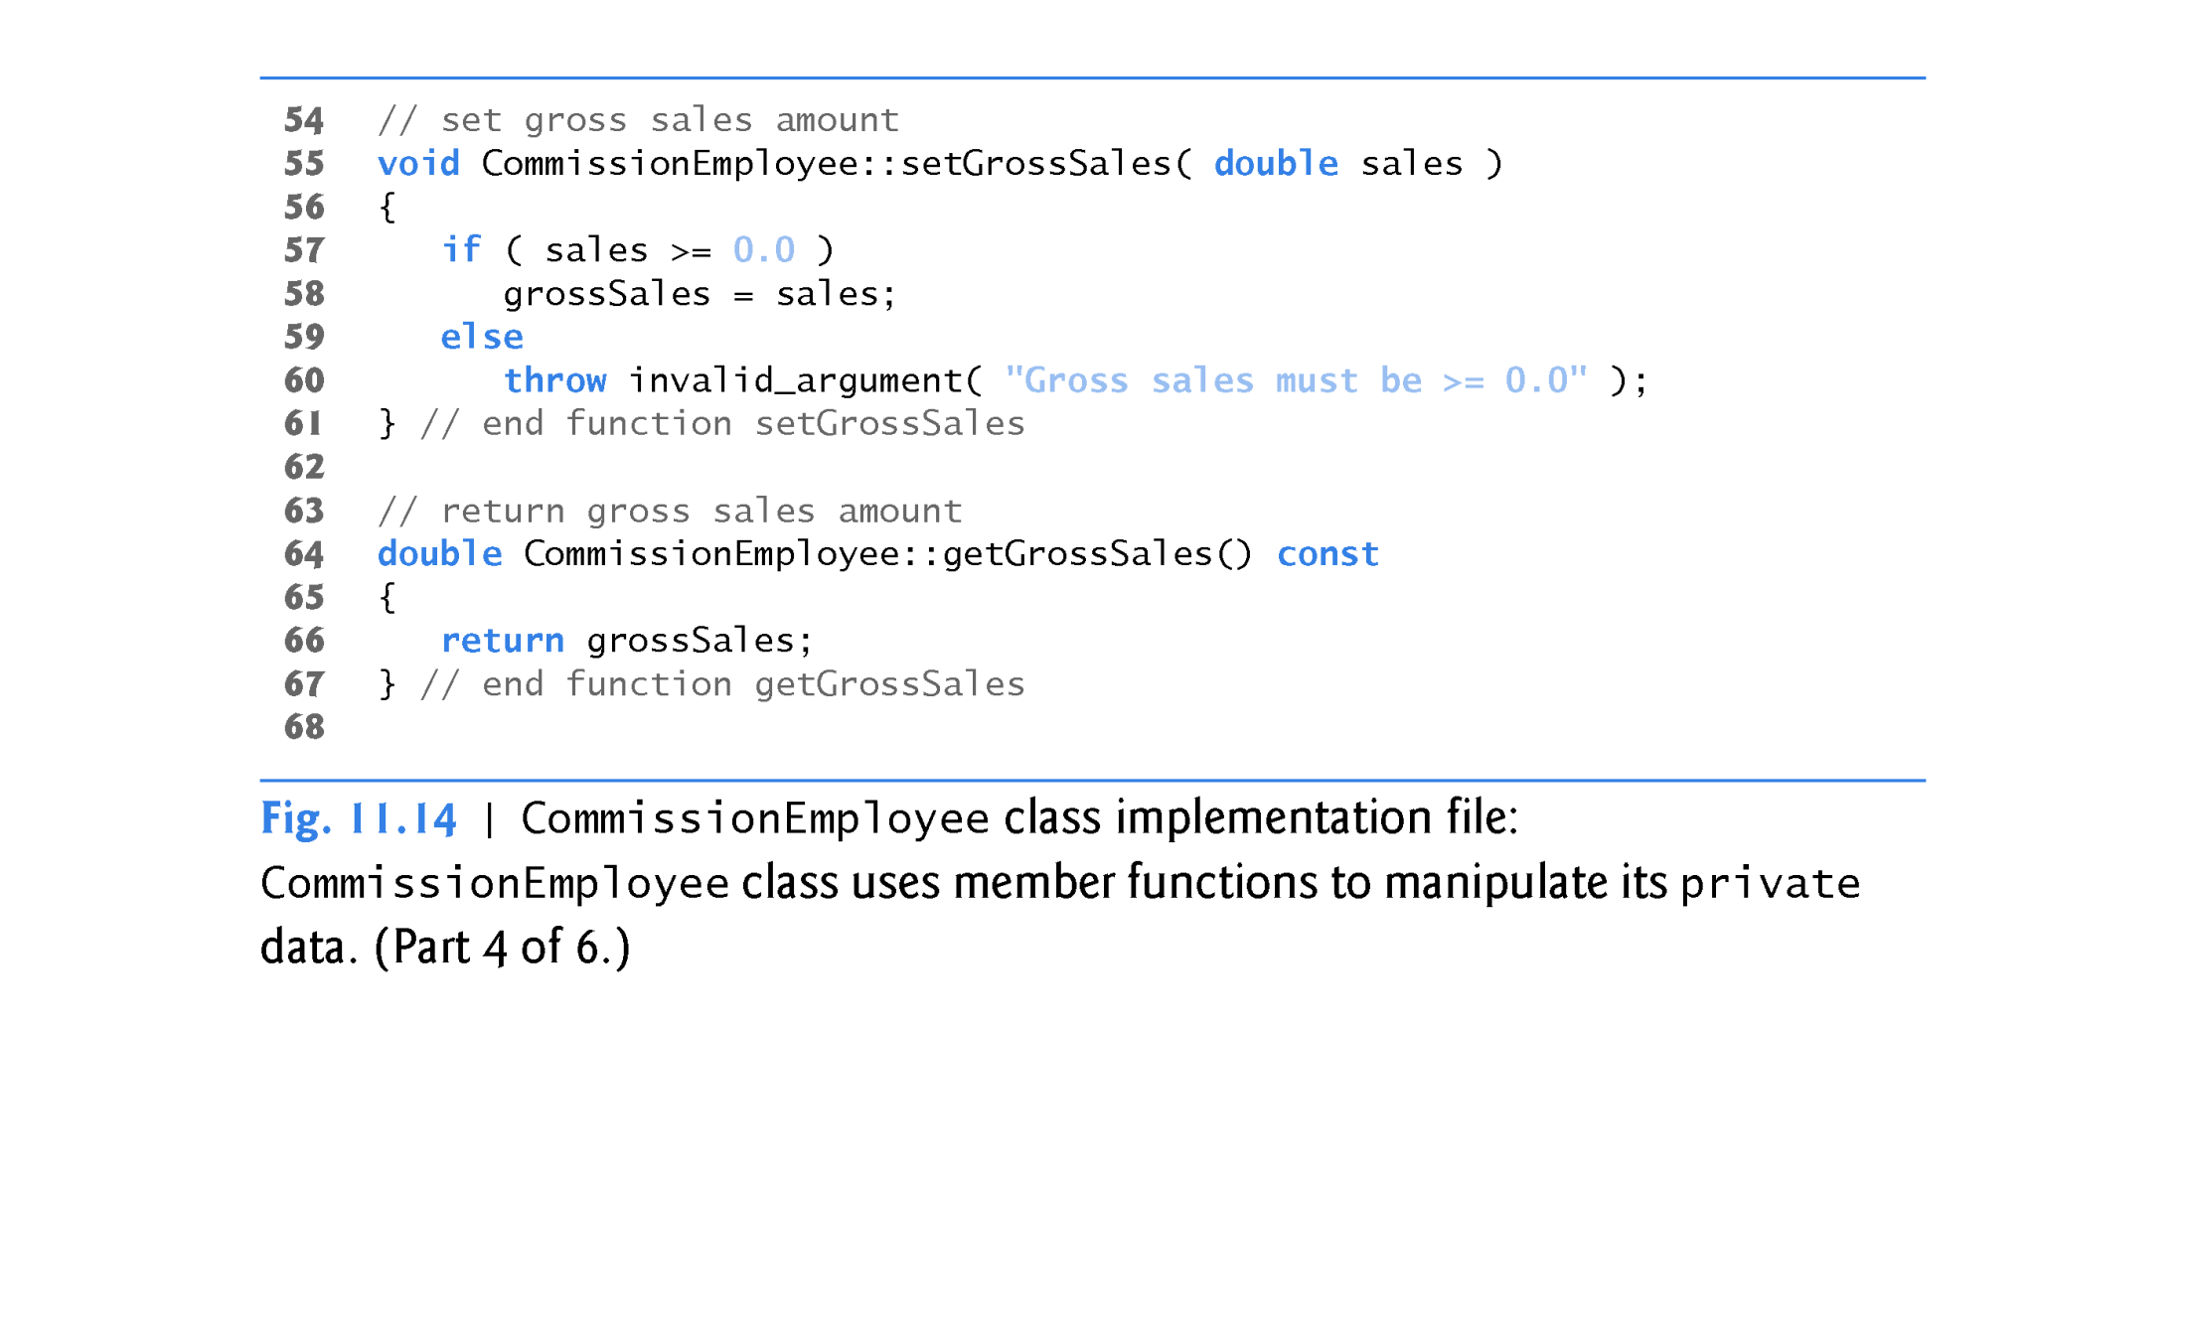

Slide 82
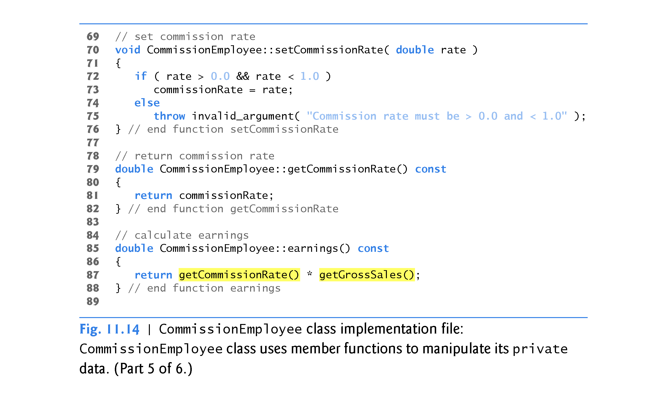

Slide 83
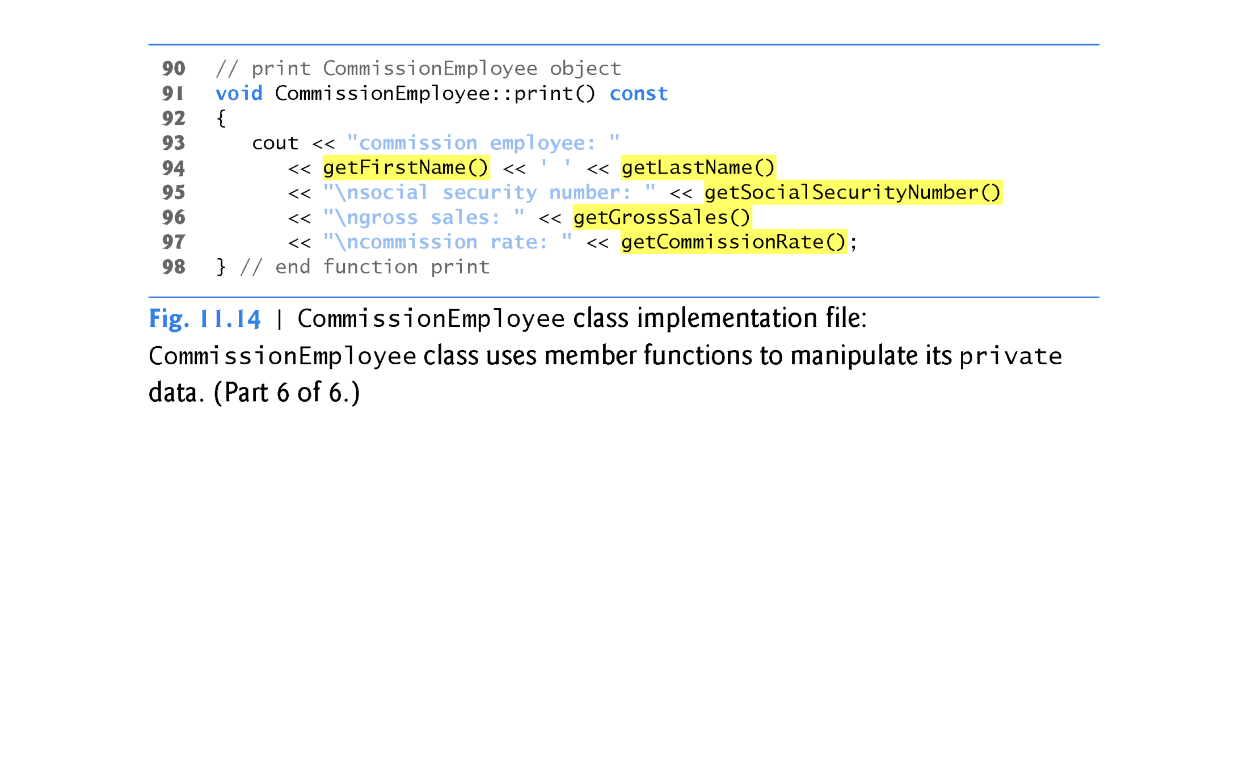

Slide 84
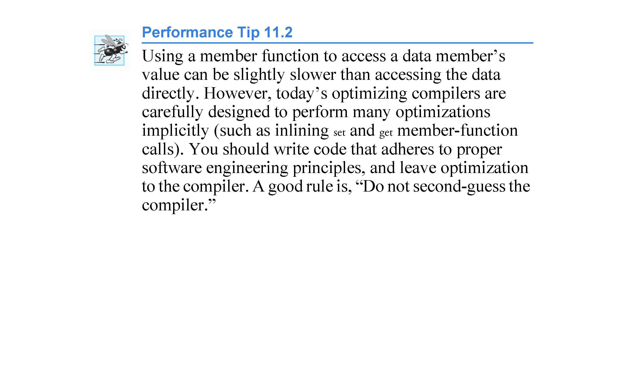

Slide 85
11.3.5 CommissionEmployee–BasePlusCommissionEmployee Inheritance Hierarchy Using private Data (cont.)
Changes to Class BasePlusCommissionEmployee’s Member Function Definitions
Class BasePlusCommissionEmployee has several changes to its member-function implementations (Fig. 11.15) that distinguish it from the previous version of the class (Figs. 11.10–11.11).
Member functions earnings (Fig. 11.15, lines 34–37) and print (lines 40–48) each invoke getBaseSalary to obtain the base salary value.

Slide 86
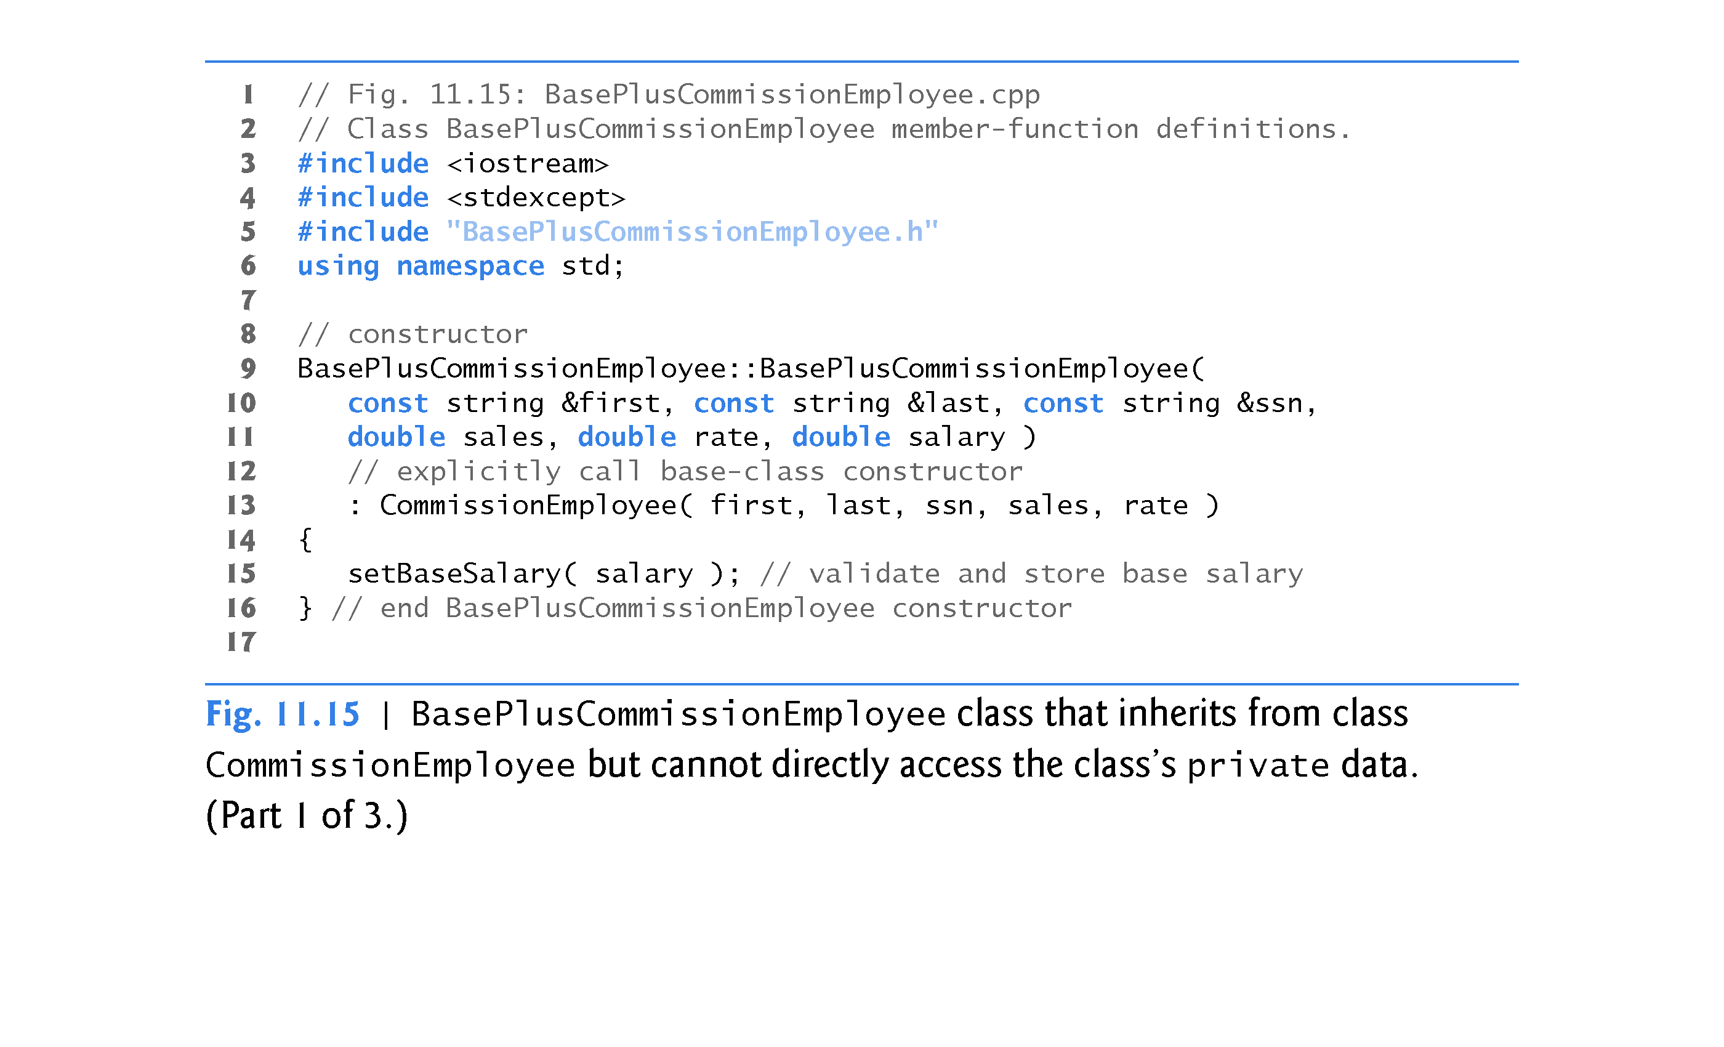

Slide 87


Slide 88


Slide 89
11.3.5 CommissionEmployee–BasePlusCommissionEmployee Inheritance Hierarchy Using private Data (cont.)
BasePlusCommissionEmployee Member Function earnings
Class BasePlusCommissionEmployee’s earnings function (Fig. 11.15, lines 34–37) redefines class CommissionEmployee’s earnings member function (Fig. 11.14, lines 85–88) to calculate the earnings of a base-salaried commission employee. It also calls CommissionEmployee’s earnings function.
Note the syntax used to invoke a redefined base-class member function from a derived class—place the base-class name and the binary scope resolution operator (::) before the base-class member-function name. This is equivalent to using super in Java [ super.earnings() ]
Good software engineering practice: If an object’s member function performs the actions needed by another object, we should call that member function rather than duplicating its code body.

Slide 90


Slide 91
11.3.5 CommissionEmployee–BasePlusCommissionEmployee Inheritance Hierarchy Using private Data (cont.)
BasePlusCommissionEmployee Member Function print
BasePlusCommissionEmployee’s print function (Fig. 11.15, lines 40–48) redefines class CommissionEmployee’s print function (Fig. 11.14, lines 91–98) to output the appropriate base-salaried commission employee information.
By using inheritance and by calling member functions that hide the data and ensure consistency, we’ve efficiently and effectively constructed a well-engineered class.

Slide 92
11.4 Constructors and Destructors in Derived Classes
Instantiating a derived-class object begins a chain of constructor calls in which the derived-class constructor, before performing its own tasks, invokes its direct base class’s constructor either explicitly (via a base-class member initializer) or implicitly (calling the base class’s default constructor).
If the base class is derived from another class, the base-class constructor is required to invoke the constructor of the next class up in the hierarchy, and so on.
The last constructor called in this chain is the constructor of the class at the base of the hierarchy, whose body actually finishes executing first.
The most derived-class constructor’s body finishes executing last.
Each base-class constructor initializes the base-class data members that the derived-class object inherits.

Slide 93


Slide 94
11.4 Constructors and Destructors in Derived Classes (cont.)
When a derived-class object is destroyed, the program calls that object’s destructor.
This begins a chain (or cascade) of destructor calls in which the derived-class destructor and the destructors of the direct and indirect base classes and the classes’ members execute in reverse of the order in which the constructors executed.
When a derived-class object’s destructor is called, the destructor performs its task, then invokes the destructor of the next base class up the hierarchy.
This process repeats until the destructor of the final base class at the top of the hierarchy is called.
Then the object is removed from memory.

Slide 95


Slide 96
11.4 Constructors and Destructors in Derived Classes (cont.)
Base-class constructors, destructors and overloaded assignment operators (Chapter 10) are not inherited by derived classes.
Derived-class constructors, destructors and overloaded assignment operators, however, can call base-class versions.

Slide 97
11.4 Constructors and Destructors in Derived Classes (cont.)
C++11: Inheriting Base Class Constructors
Sometimes a derived class’s constructors simply mimic the base class’s constructors.
A frequently requested convenience feature for C++11 was the ability to inherit a base class’s constructors.
You can now do this by explicitly including a using declaration of the form
using BaseClass::BaseClass; //using statement
anywhere in the derived-class definition.
In the preceding declaration, BaseClass is the base class’s name.

Slide 98
11.4 Constructors and Destructors in Derived Classes (cont.)
When you inherit constructors:
By default, each inherited constructor has the same access level (public, protected or private) as its corresponding base-class constructor.
The default, copy, and move constructors are not inherited.
If a constructor is deleted in the base class by placing = delete in its prototype, the corresponding constructor in the derived class is also deleted.
If the derived class does not explicitly define constructors, the compiler generates a default constructor in the derived class—even if it inherits other constructors from its base class.
If a constructor that you explicitly define in a derived class has the same parameter list as a base-class constructor, then the base-class constructor is not inherited.
A base-class constructor’s default arguments are not inherited. Instead, the compiler generates overloaded constructors in the derived class.

Slide 99
11.5 public, protected and private Inheritance
When deriving a class from a base class, the base class may be inherited through public, protected or private inheritance.
Use of protected and private inheritance is rare.
Figure 11.16 summarizes for each type of inheritance the accessibility of base-class members in a derived class.
The first column contains the base-class access specifiers.
A base class’s private members are never accessible directly from a derived class, but can be accessed through calls to the public and protected members of the base class.

Slide 100


Slide 101
11.6 Software Engineering with Inheritance
When we use inheritance to create a new class from an existing one, the new class inherits the data members and member functions of the existing class, as described in Fig. 11.16.
We can customize the new class to meet our needs by including additional members and by redefining base-class members.
The derived-class programmer does this in C++ without accessing the base class’s source code.
The derived class must be able to link to the base class’s object code.

Slide 102
11.6 Software Engineering with Inheritance (cont.)
When we use inheritance to create a new class from an existing one, the new class inherits the data members and member functions of the existing class.
We can customize the new class to meet our needs by redefining base-class members and by including additional members. In Chapter 12 – Polymorphism we will override inherited virtual member functions.
The derived-class programmer does this in C++ without accessing the base class’s source code (the derived class must be able to link to the base class’s object code).

Slide 103
11.7 Software Engineering with Inheritance (cont.)
Software developers can develop proprietary classes for sale or license.
Users then can derive new classes from these library classes rapidly and without accessing the proprietary source code.
The software developers need to supply the headers along with the object code
The availability of substantial and useful class libraries delivers the maximum benefits of software reuse through inheritance.

Slide 104


Slide 105


